Slide 1
RHIC Status
Haixin Huang
Time Meeting
03/01/2011

Slide 2
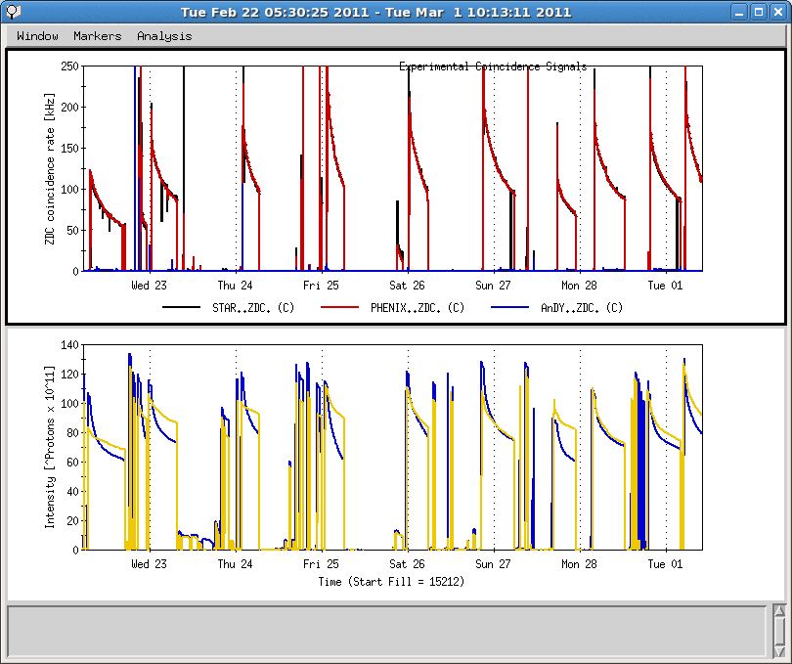
Last One Week
Trouble shooting de-bunching
Ice ball heater circuit breaker failure
16 hours APEX session
9MHz and Cryo problems
Successful 9MHz cavity commissioning
Phase jump problem with 9MHz
Network problem
Rain leak on PASS electronics

Slide 3
Progress since Last Week
  9MHz cavity commissioning was put into operation since Thursday night. Source for longitudinal emittance blow up at injection in blue has not been found. Adding more diagnostics.
  10Hz orbit feedback has been put into use at beginning of store, which reduced the luminosity oscillation and improved lifetime.
  Vertical tune swing has been moved earlier by 20s on the ramp to cover a strong resonance below 100GeV. Not much change in the polarization transmission efficiency seen. Left it in operation.
  Several round PHENIX rotator setting changes. Dial in the best guess Thursday night.

Slide 4
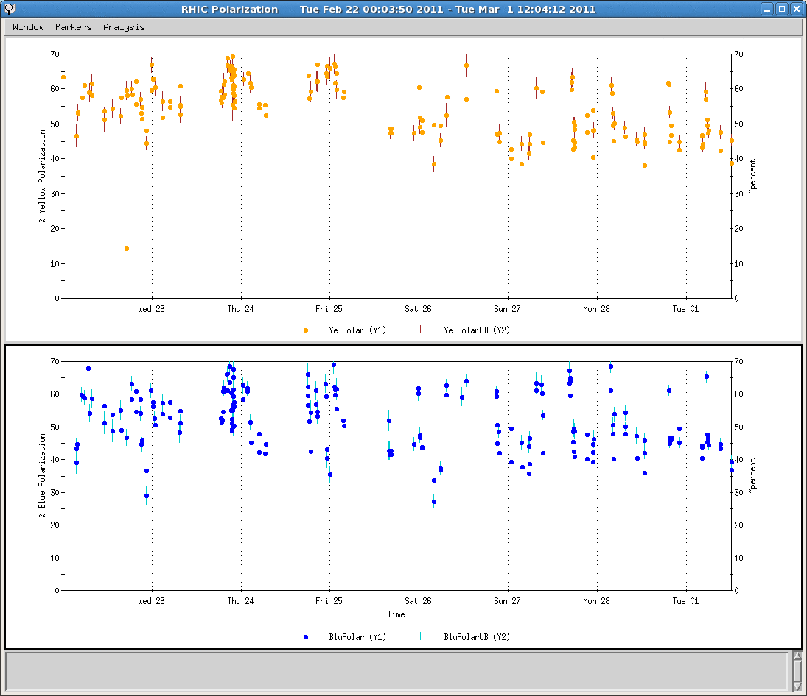
Polarization over Last Week

Slide 5
Toward Higher luminosity and Polarization
  Poor blue intensity lifetime at beginning of store. Will change working point for blue.
  Injection/AtR efficiency for yellow. Yellow injection kicker timing adjustment seems helpful, but did not stay.
  Injection drift compensation, need chromaticity measurement for this compensation. Without a good setting, we lose beam at injection due to poor lifetime.
  The ramp needs another chromaticity measurement to see where they are.
  Need snake current scan to set spin tune close to 0.5. This will be done over many stores. We will start after we settle on the new working point for blue

