Slide 1
CRYO REPORT
TIME MEETING
3-8-2011

Slide 2
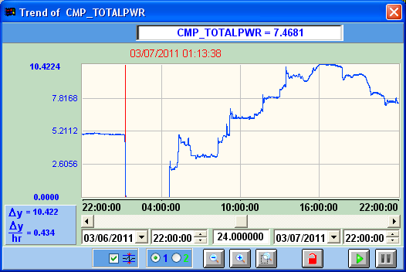

Slide 3
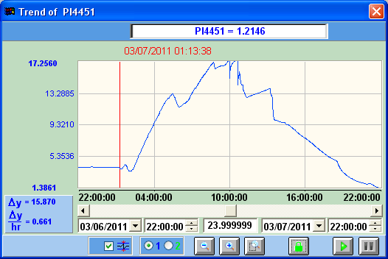

Slide 4
Cryo schedule: Best case
No warmup of sector / valvebox
Tue 3/08: Cooldown and fill Yellow
Wed 3/09: Fill and soak Yellow, Reliquefy gas
Thu 3/10: Cooldown and fill Blue Reliquefy gas
Fri 3/11: Cooldown and fill Blue, Reliquefy gas
Sat 3/12: Fill and soak Blue
Sun 3/13:

