Slide 1
RHIC Status
Haixin Huang
Time Meeting
03/08/2011

Slide 2
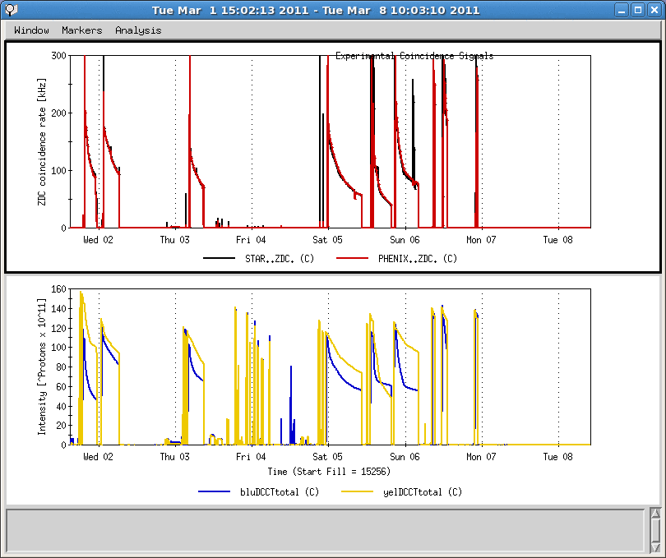
Last One Week
9MHz cavity tuner clutch problem
Maintenance, Delayed by LIPA
Cryo circuit break failure
Machine Development 6 hrs
Quench protection Switch Problem
B4-q89 ps failure

Slide 3
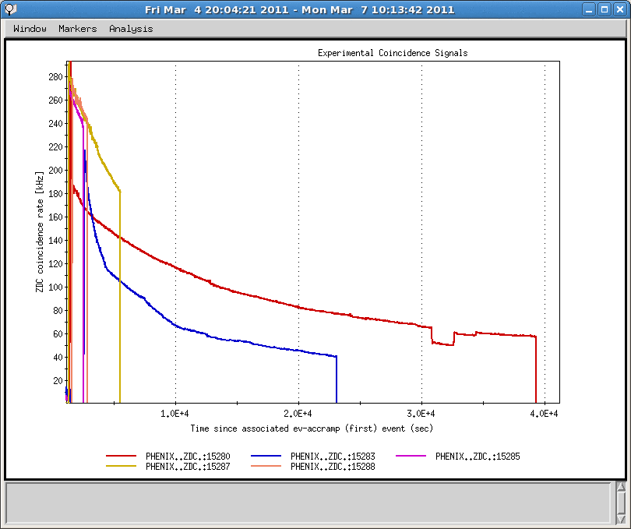
Recent ZDC Rates

Slide 4
Status
Waiting for cryo recovery right now. Cryo circuit breaker hit us the second time this run.
The blue de-bunching problem disappeared after maintenance day. There are glitches with 9MHz cavity running in past one week: phase jump; blue de-bunching; tuner clutch mechanical problem. Physics store was established last Friday after lowering the Landau cavity voltage.
Measured chromaticity with 9MHz cavity on the ramp for the first time in machine development. A minor adjustment for vertical chromaticity in the vertical tune swing part was done.
Blue working point has been pushed lower to improve beam lifetime at store.
The bunch intensity has been pushed higher over the weekend: 1.25*10^11 at flattop. ZDC peak rate around 280kHz.
Snake current scan already started (+-5A) but no visible effect in store polarization.
Average of jet polarization for all runs: 43.9+-1.2% in blue, 46.1+-1.2% in yellow. Keep in mind that the AtR spin transfer efficiency for blue and yellow are 95.9% and 99.1%, respectively.

Slide 5
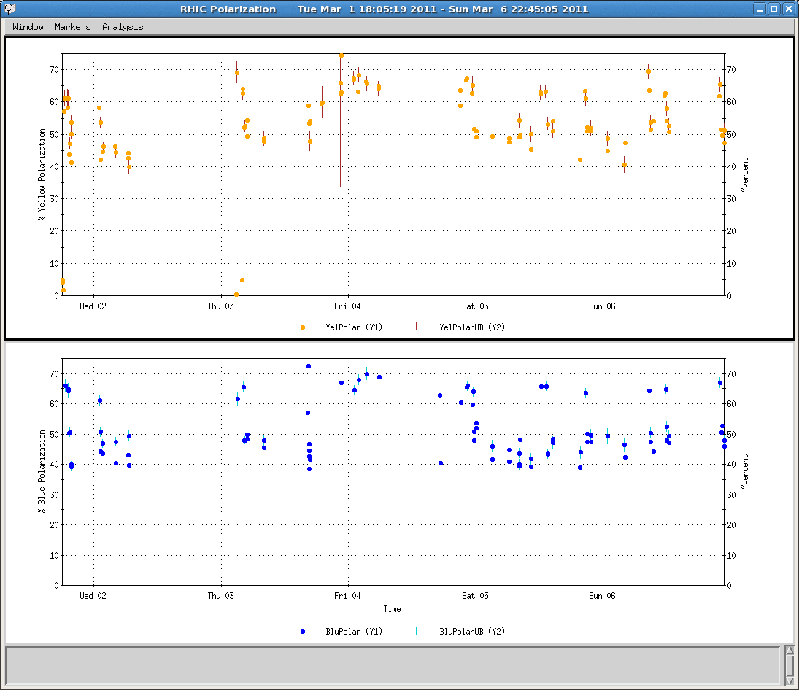
Polarization over Last Week
The only low pol. At beginning of store

Slide 6
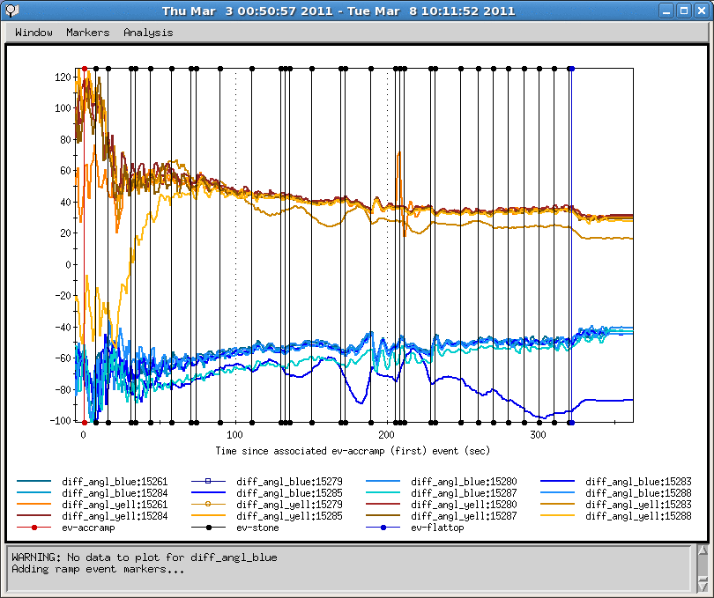
How Important Is Orbit Feedback?
Lower polarization in blue after ramp 15283 when orbit feedback was off
ramp 15283

Slide 7
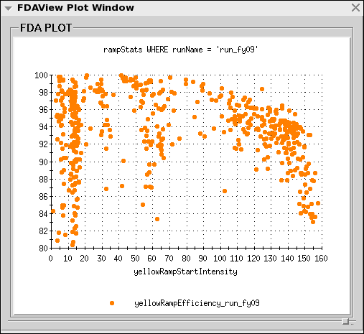
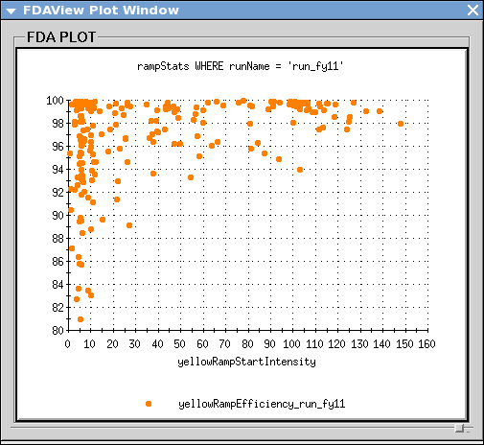
Yellow Ramp Efficiency of Run9 and Run11
Run9, 100GeV ramps included

Slide 8
Resume Operation
Poor blue intensity lifetime at beginning of store. Need to continue the search for a good working point for blue.
Injection/AtR efficiency is about the same for both blue and yellow now.
Both yellow snakes quenched during a fill on Sunday morning. This was after adjusting snake bump at 9 o’clock on Friday. Need to readjust snake bumps when beam comes back.
The Landau cavity voltage was dropped significantly to get beam survive the rebucketing. It may not be necessary. We will increase the voltage in steps over several stores.
Orbit corrections are ready to be implemented for a few IRs.
We probably need to resume a few shifts to get the previous setup back.

Slide 9
Reminder of What Have Been Achieved So Far
Higher polarization out of AGS (jump quads).
Higher polarization at RHIC store (tune and orbit on the ramp).
Orbit feedback works. We have excellent orbit control on the ramp.
9MHz cavity is operational. We may benefited from less e-cloud effect already. So far no indication of intensity issue.
10Hz orbit feedback works. Beneficial to luminosity.

