Slide 1
RHIC Status
Haixin Huang
Time Meeting
03/15/2011

Slide 2
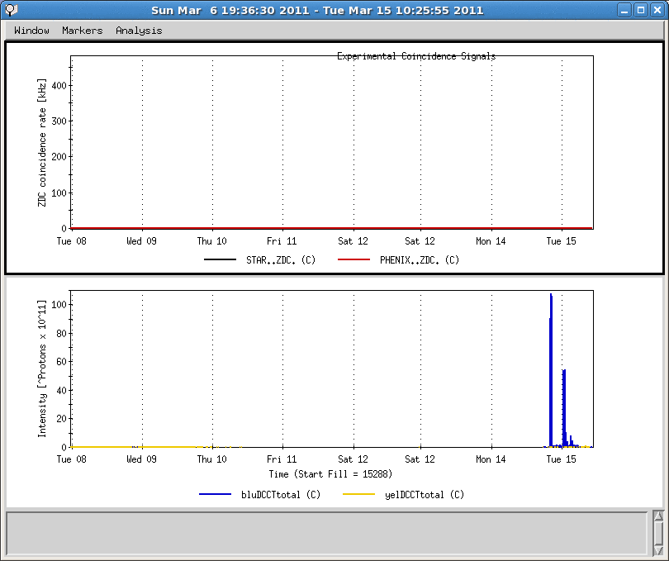
Last One Week
Beam established in both rings at injection
Blue ring was cold
PHENIX access
Finished all P/S work
Yellow ring was cold

Slide 3
Status and 3/15/2011
Many systems have been worked on last week (RF system, pulsed power supplies, BPMs…)
IP2 DX magnet training brought the current higher slightly, the crossing angle should reduce to 1.6mrad from 2.2 mrad. New ramps (pp11v9 and pp11rot3) are generated.
Cryo reported that we are ready to go this morning. First hysteresis ramp with both rings went well without problem.
Established beam in both rings last night.
Blue LLRF hardware problem: count two bunches for one request. It has been resolved.
BPM polarity check, beam based alignment were done extensively in blue.
We expect to resume physics store in two shifts.
After that, we will reduce chromaticities on the ramp in steps. The Landau cavity voltage will be ramp up during store (100->300V in one hour).
Resume snake current scan after the chromaticity change.

