Slide 1
RHIC Status
Haixin Huang
Time Meeting
03/22/2011

Slide 2
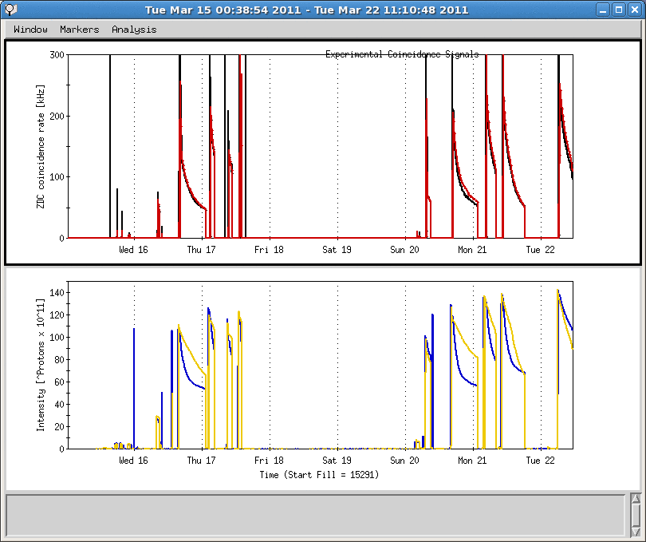
Last One Week
Linac timing problem, B06-tq4 tripped twice
Yellow snake quench, Cryo lead flow alarm
Linac mod7 and mod3 problem
Yellow snake quench, Cryo lead flow alarm
Power distribution problem, lost 48 hours
Yellow injection timing jitter resolved
Power dip

Slide 3
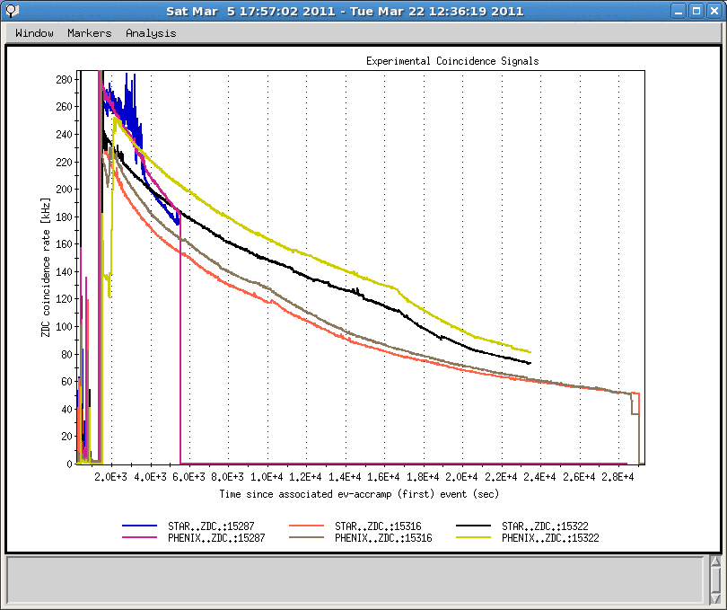
Luminosities of Last Two Fills

Slide 4
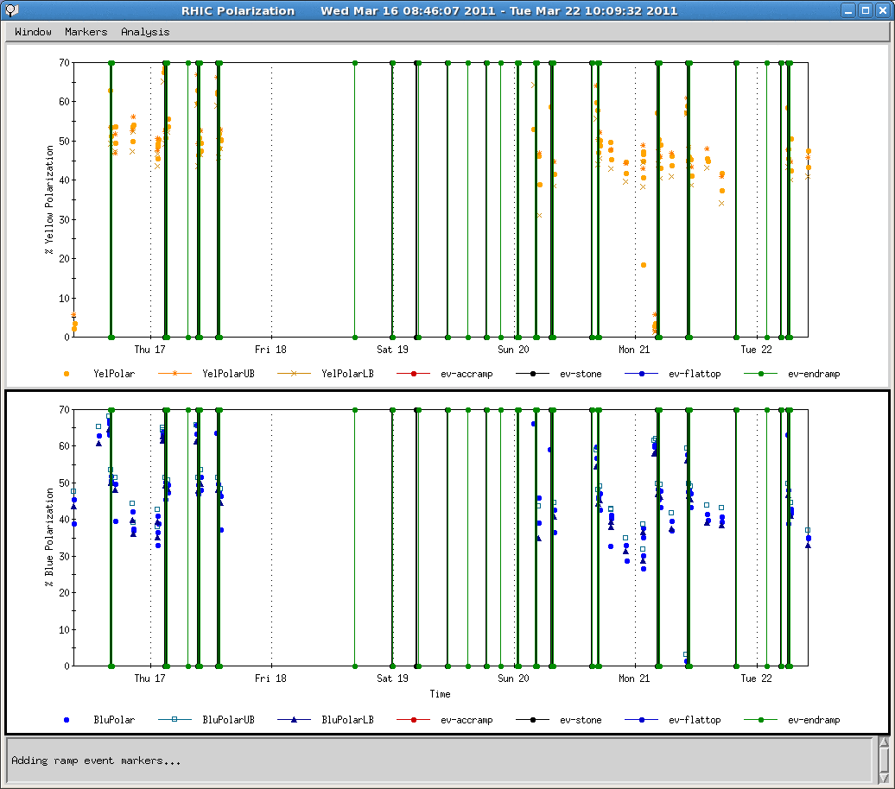
Polarization of Lat Week

Slide 5
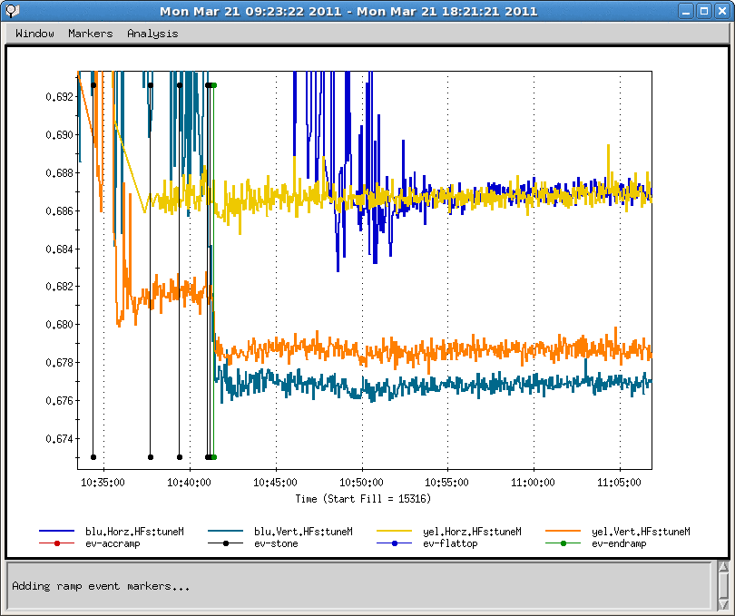
Tune from Schottky for Fill 15316

Slide 6
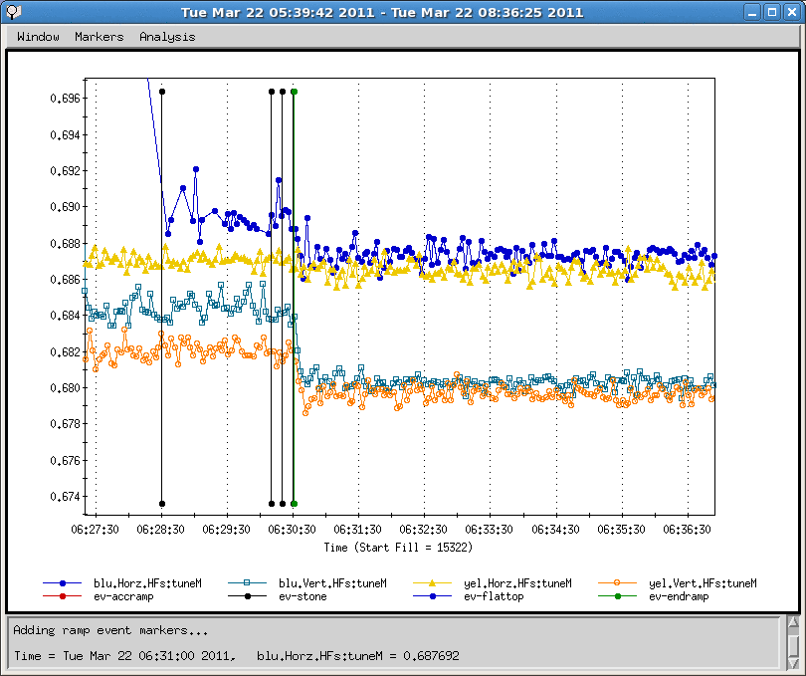
Tune from Schottky for Fill 15322

Slide 7
Status and Plan as of 3/22/2011
Power distribution problem resulted 48 hours down time. A power dip happened before this problem.
Cryo lead flow alarm before full cryo power restoration led to some down time.
Several failures in linac (mod7, mod3, and timing) caused additional significant down time.
Yellow injection kicker timing jitter caused yellow 3 o’clock snake quenched several times before it was fixed.
Vertical chromaticity was lowered for blue and yellow on the ramp.
The vertical tune was lowered for the recent store which greatly reduced the beam decay rate in blue.
The highest luminosity in this run has been restored.
First we will see if the good lifetime in blue is reproducible. If it does, we probably will try a little more in both beam.
Will continue to push bunch intensity.
Searching for reasons of poor blue polarization lifetime.
We start to monitor the emittance from AGS for every fill now.

