Slide 1
Take 5 for Safety
Research Operations Coordination & Oversight (ROCO) – Updating Key Plans for Hazard Identification
Collider-Accelerator Department
3-22-11

Slide 2
Research Operations Coordination and Oversight (ROCO)
ROCO is part of the Laboratory’s Blueprint Plan to provide the organizational framework across BNL to increase the focus on safe and effective research operations.
ROCO is a result of the investigation of the October 2008 well house explosion which taught the Lab that there were inconsistencies in coordination and oversight in research and operations.
Each Directorate has a Directorate Chief Operating Officer (DCOO) to coordinate ROCO implementation efforts. Our DCOO is Ed Lessard.
As part of the implementation of the ROCO model each Department and Division is being tasked with validating and documenting where hazards exist within each area of all of their buildings. This will be done with a Hazard Validation Tool.

Slide 3
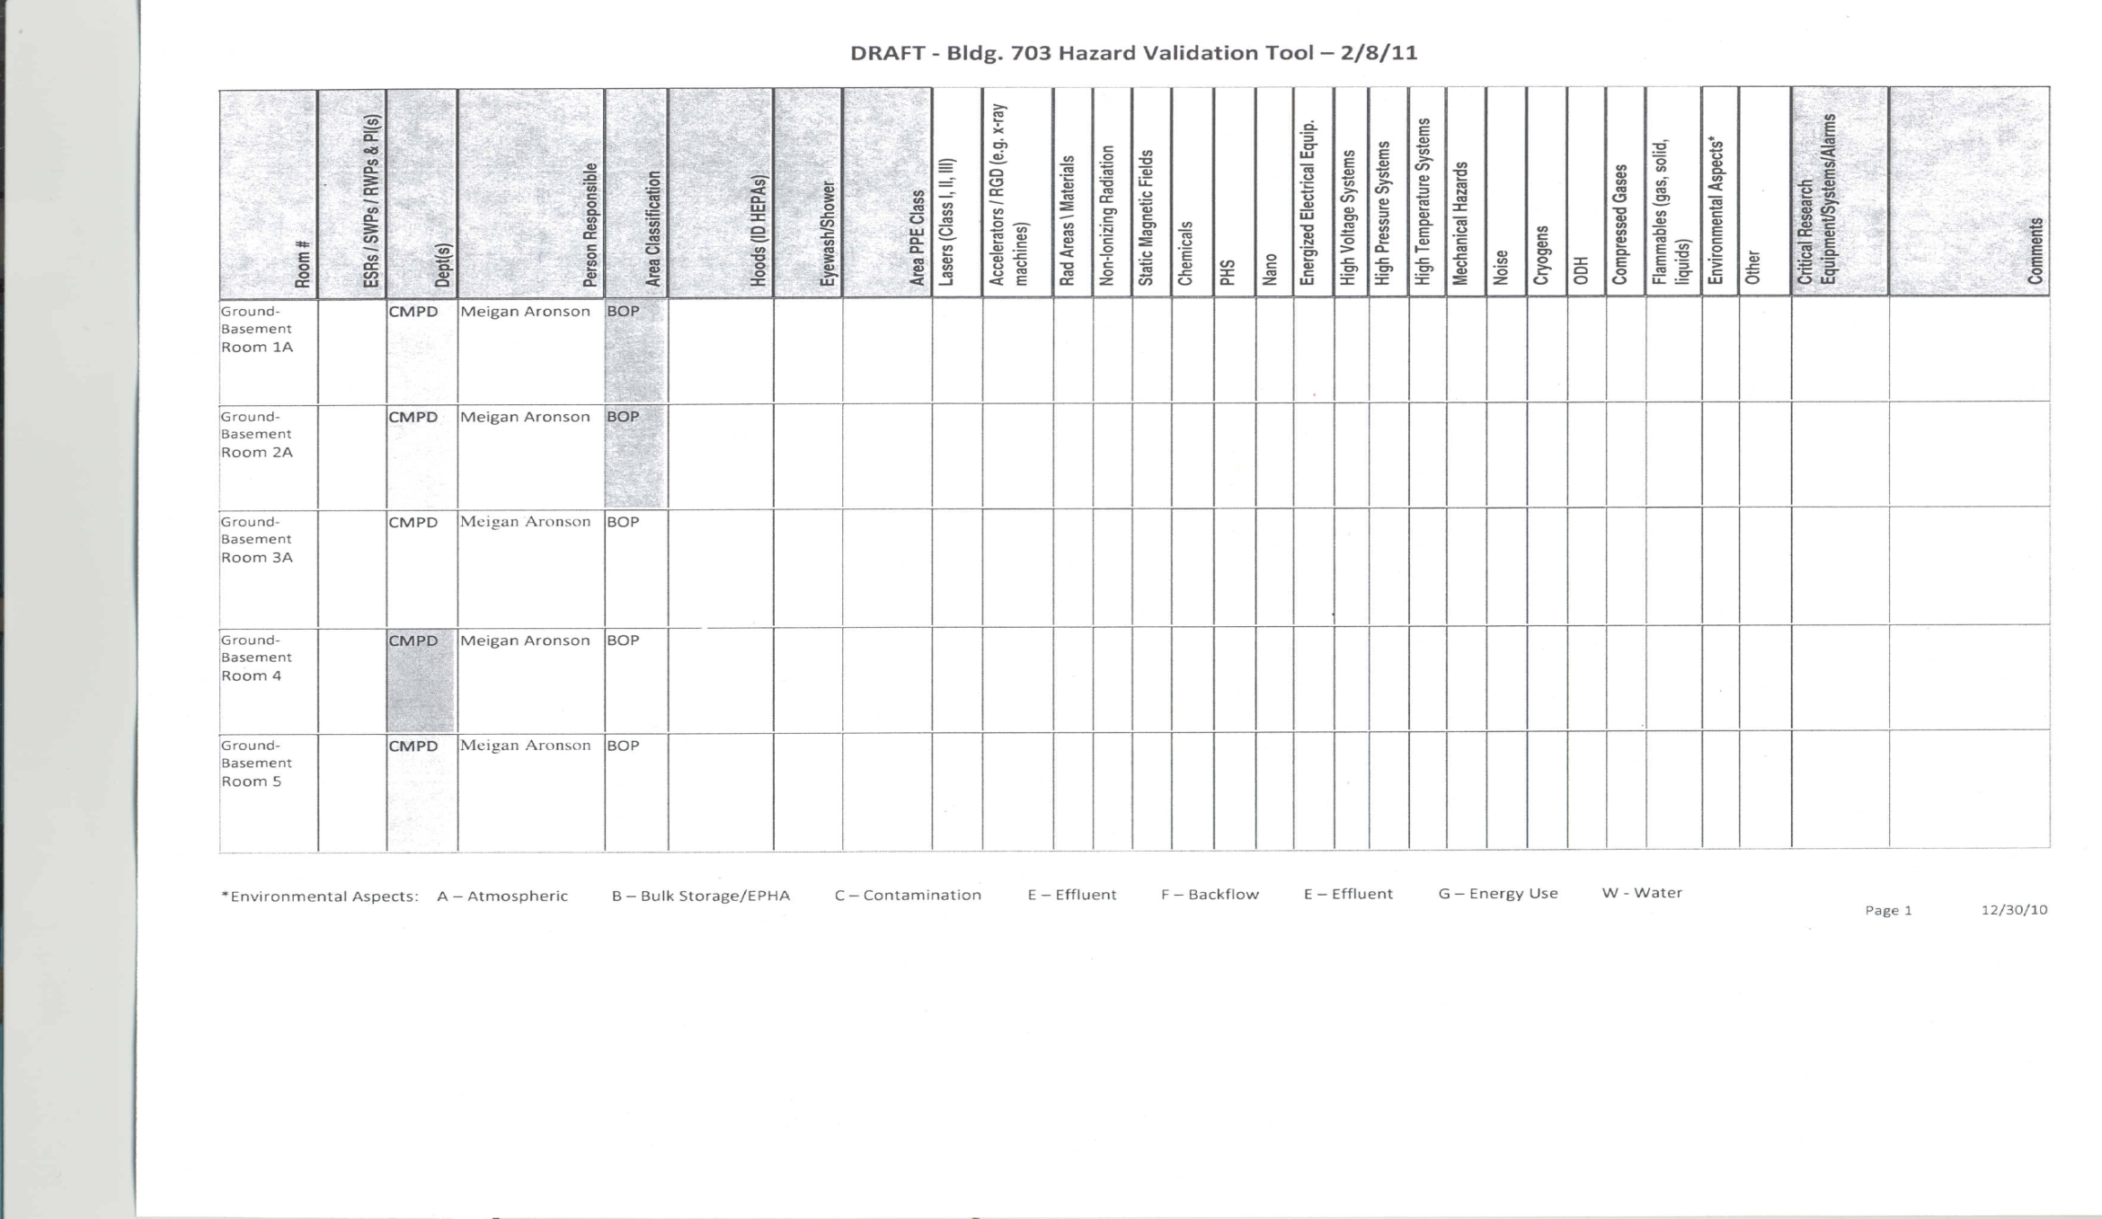
Hazard Validation Tool

Slide 4
Hazard Validation Requirements
To perform hazard evaluations an up to date Key Plan map of every floor of every C-AD building is required.
Area uses have changed and Key Plans have not been updated.
911 High Bay is a good example of change in use and there are many others.
912A has a Water Systems Tech Shop that is used as an area to perform pump maintenance – on the Key Plan map that room is listed as a Hazardous Waste Collection Area.

Slide 5
Key Plan Map Updates
To be done by C-AD Research Space Managers with the support of C-AD ESSHQ group.
Research Space Managers will be supplied with copies of current Key Plan Maps for their buildings which they will mark up with necessary corrections.
Necessary corrections will verify room numbers, change in room use, change in area configuration.
To be accomplished within 3 weeks.

