Slide 1
RHIC Status
Haixin Huang
Time Meeting
04/05/2011

Slide 2
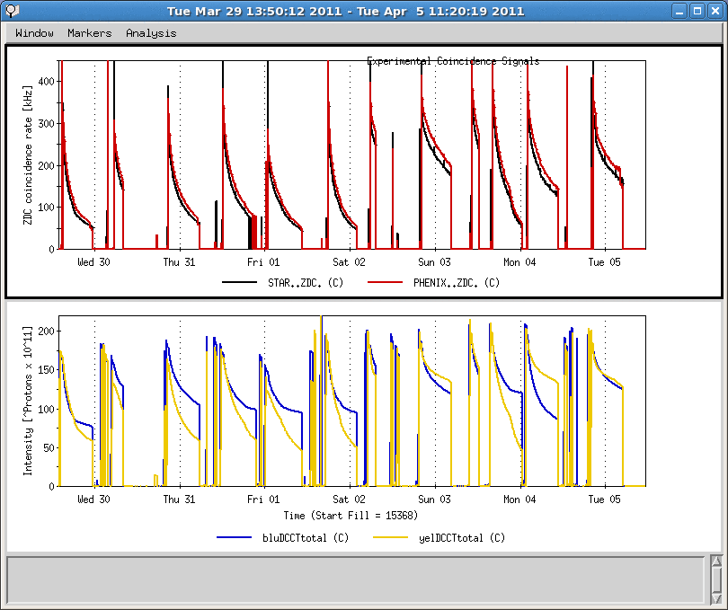
Last One Week
Blue abort kicker smoke detector fault
Yellow abort kicker prefire, Ground fault in P/S
Linac p/s problem
Maintenance Day

Slide 3
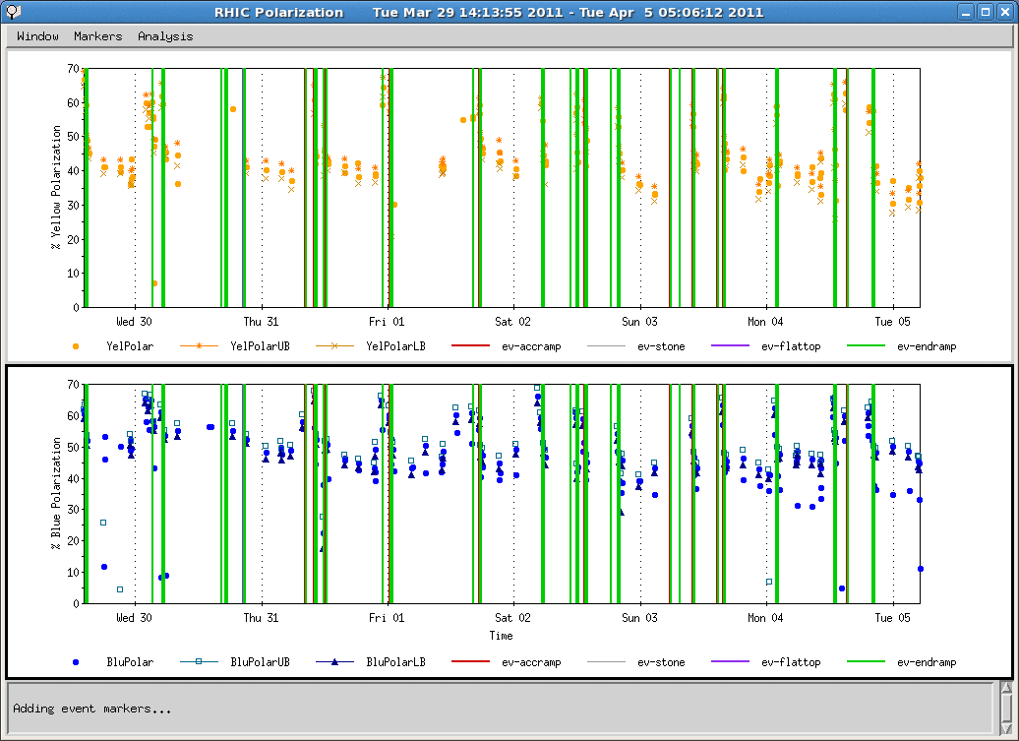
Polarization of Last Week

Slide 4
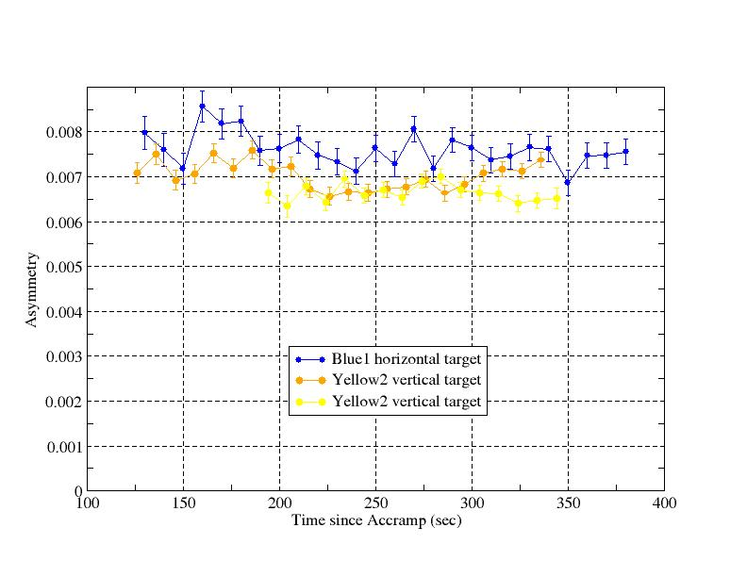
Ramp Measurements
110s: 100GeV; 270s: 250GeV; 320s: done beta squeeze
Seen flat asymmetry over the range. But if assuming analyzing power dependence on energy, polarization drop shown around 200sec.

Slide 5
Status and Plan as of 4/5/2011
Running relatively smooth last week, no major down time
Peak luminosity reached new record of 150* 10^30 cm^-2 s^-1.
Bunch intensity is typically 1.8*10^11 and as high as 1.9*10^11. We have seen no indication of limit from 9MHz cavity.
Collimator on the ramp has been put into use since last Friday.
We will keep Booster scraping in while maintain intensity at 1.7-1.8*10^11 level. Using other means (source temperature, AGS setup, AtR tuning) to maintain the intensity.
Down ramp development tomorrow for 16 hours, with contingency of additional 8 hours on Friday.

