Slide 1
RHIC Status
Haixin Huang
Time Meeting
04/12/2011

Slide 2
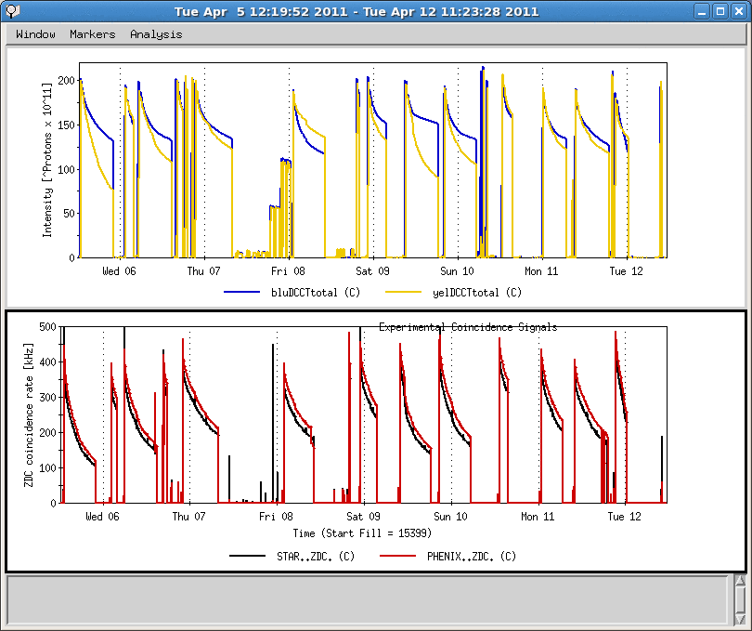
Last One Week
Yellow abort kicker prefire
9MHz bouncer cavity problem
Yellow QLI, Qunech Protection system failure
STAR rotator setup
PHENIX access (2 hors)
AGS H10 septum problem
Down ramp development (2 shifts)

Slide 3
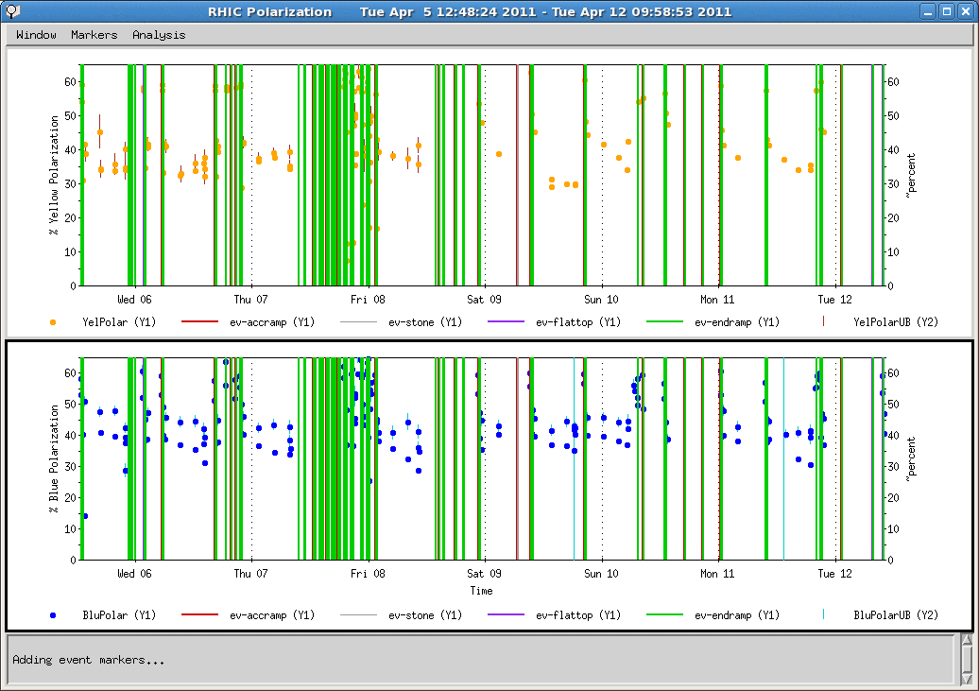
Polarization of Last Week
Only one yellow polarimeter since Friday

Slide 4
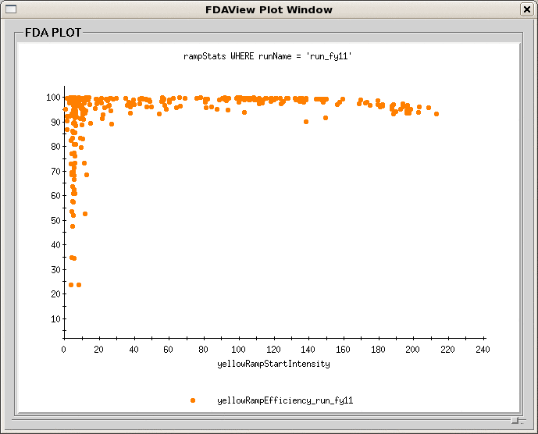
Ramp Efficiency in Yellow
Better efficiency benefited from 9MHz cavity and excellent tune/orbit control

Slide 5
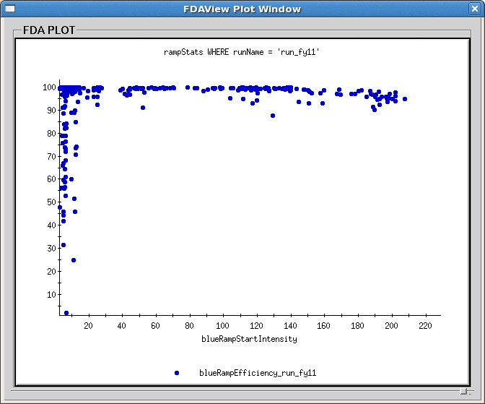
Ramp Efficiency in Blue

Slide 6
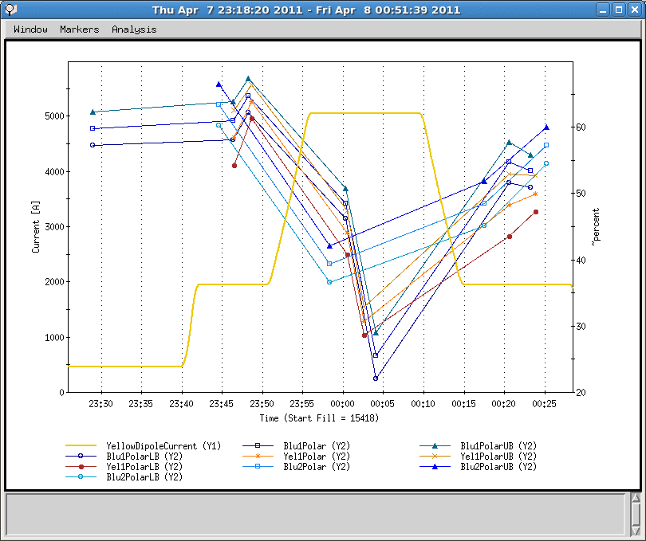
Ramp Measurements
Preliminary average ratios of polarization of three ramps:
100GeV->100GeV:0.777+-0.025
100GeV->250GeV:0.727+-0.016

Slide 7
Machine Development List (12hrs)
Ramps with vertical tune at 0.71 and 0.72. Bunch intensity of 1.3-1.4*10^11. Two ramps. The purpose is to see if higher polarization can be reached this year after all the effort to reduce orbit errors. We measured close to zero polarization at 0.72 last run. 3-4 hours.
Ramp with vertical tune at 0.671 to see if we indeed reach transmission efficiency plateau at this end. May need two ramps. 3 hours.
12 bunch ramp and stay at store for half hour to check e-cloud effect on emittance growth. 1hr.
Emittance growth at store without collision (expect to see no emittance growth in store). 1hr at store +1 hr setup.
Test of the new configuration of the llrf loops for the 9 MHz mode. The goal of the new loops is to achieve lower longitudinal emittance and shorter bunches at store. 2 hours at injection and possible 6-bunch ramp.

Slide 8
Status and Plan as of 4/12/2011
Total of 13 stores in last one week, six of them ended unintentionally.
Vertical tune at store has been raised to improve beam life time. The blue and yellow life time can be similar now.
Horizontal tune on the ramp (tune swing part) has been lowered by 0.005; the blue horizontal chromaticity was also lowered by one unit, no effect seen on polarization.
Down ramp development was very successful with the four feedback (tune/orbit/coupling/chromaticity) on for proton beam when we needed them the most.
STAR rotator has been turned on since Friday. The residual transverse polarization components are small.
Machine development tomorrow (8 hrs) and possible on Friday(4 hrs).
Focus of remaining operation will be on intensity and polarization life time at store.
Physics stores for the rest of week.

