Slide 1
Take 5 for Safety
Work Planning for Experiments
P. Cirnigliaro
Collider-Accelerator Department
4-12-11

Slide 2
Work Planning for Experiments
Supplements The Departments Commitment to Safe Operations
Provides lines of communication between C-AD and the experiment
Each experiment has a Worker Planned Work Document

Slide 3
WORK PLAN for Drell-Yan Test
Low Hazard – Worker Planned Work for Users at RHIC
Experiment Number: Running Period: 2010-11
Job Location: 2 o’clock IR
Experiment Spokesperson Leslie Bland: __________________________Date ______
Liaison Physicist Anjelika Drees: _______________________________Date ______
Liaison Engineer Charles Folz: __________________________________Date______
Work Control Coordinator Peter Cirnigliaro: _____________________Date______
C-A ESRC Chair Y. Makdisi: ___________________________________Date______
C-A Approval: _______________________ Approval Date _______________
(ESHQ Division Head)
Attachments:
C-A OPM, 2.5.2, 3.19, 11.1
Page: 1 to Page: 9
Documents a Definitive line of Authority

Slide 4
Provides the User with Information
Training Requirements
Electrical Safety Requirements of the Laboratory and Department
Mechanical Limitations for the Users
PPE requirements for the work area
Emergency Response instructions and Phone numbers
Environmental aspects of working in the Laboratory
Special Requirements (such as ODH)
Special requirements and training for the individual experimental area

Slide 5
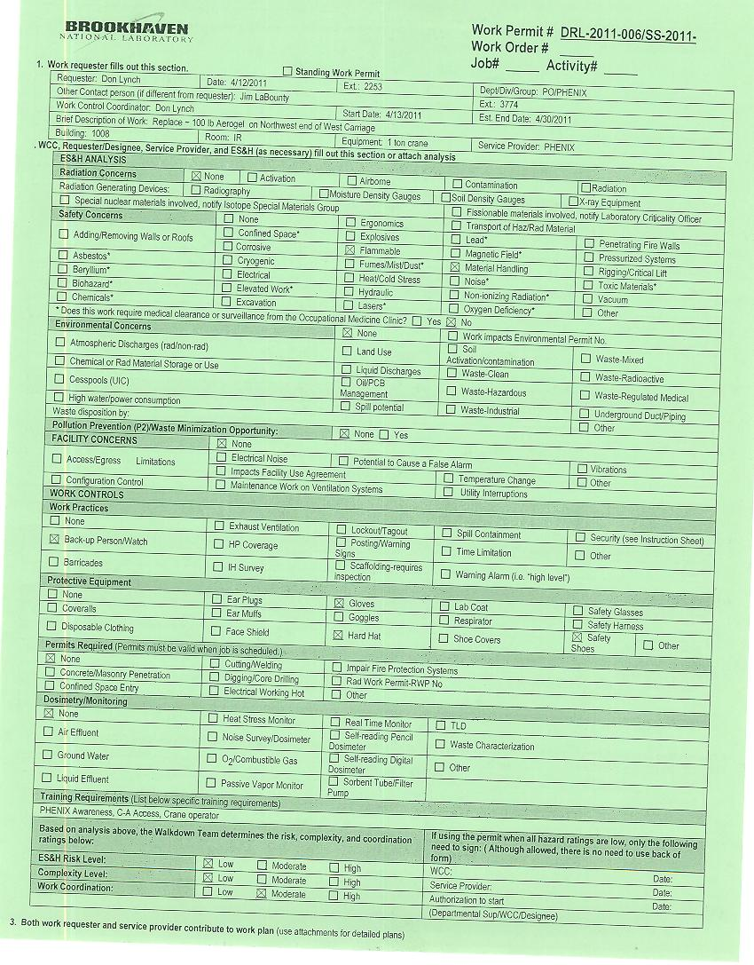
Provides the User with Information
When the task exceeds Worker Planned Work and EWP is required

