Slide 1
RHIC pp Status
Haixin Huang
Time Meeting
04/19/2011

Slide 2
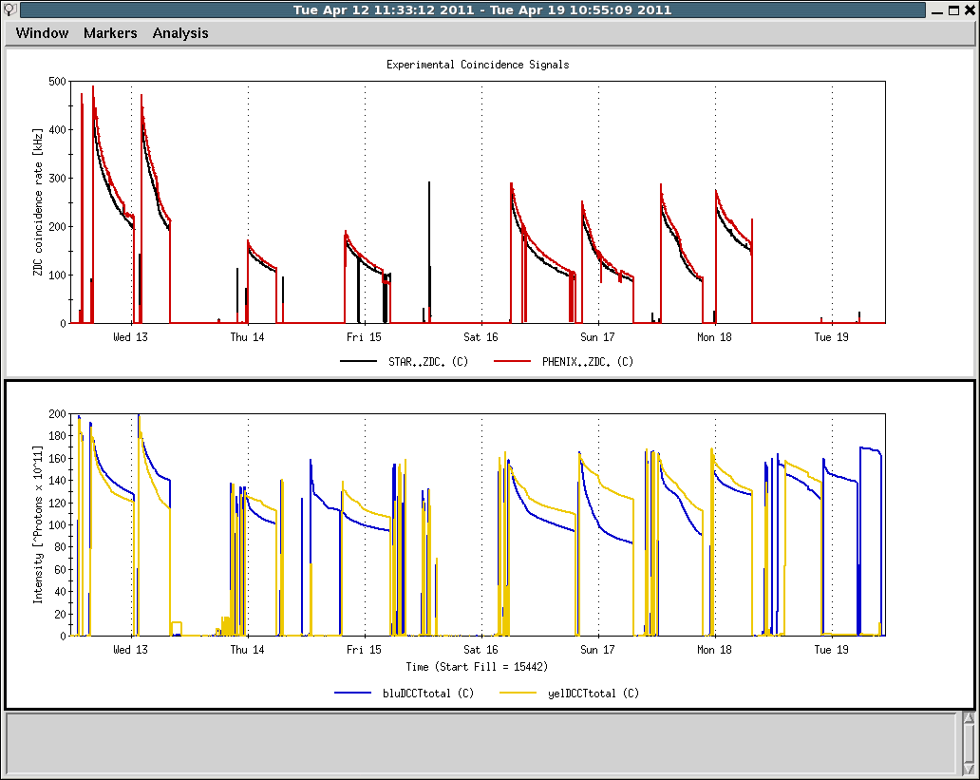
Last One Week
Machine development
Jet injection measurement, AtR P/S problem
Jet injection run
RHIC P/S problem and control issue
Maintenance, lost 9MHz cavity

Slide 3
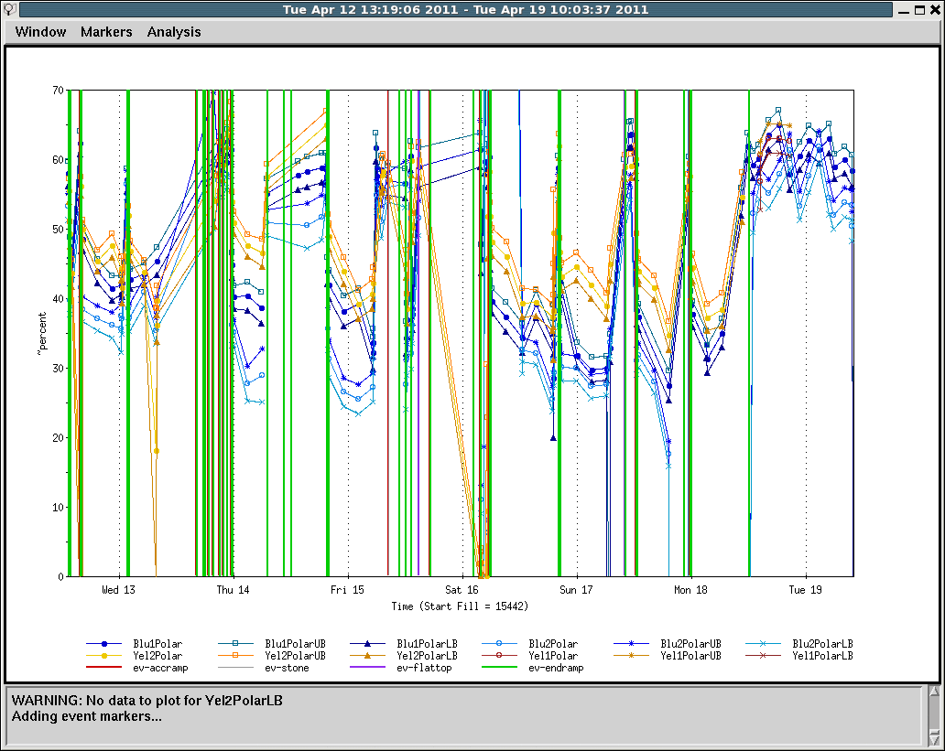
Polarization of Last Week
Polarization is lower in last a few stores in blue.

Slide 4
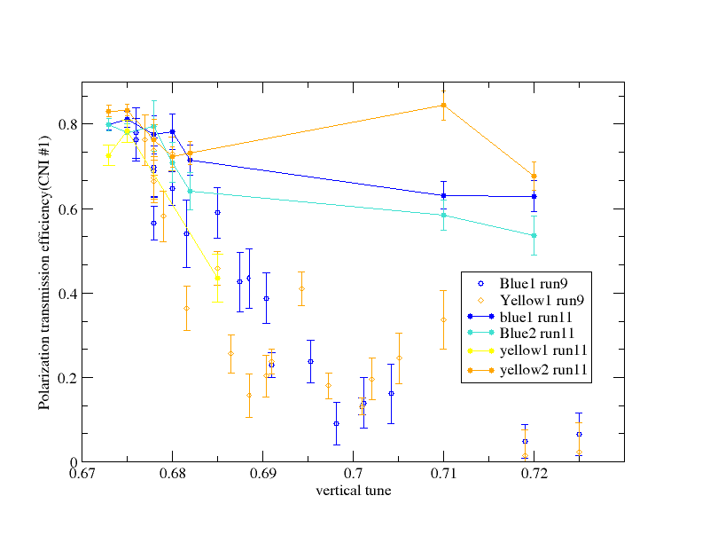
Polarization vs. Vertical Tune on the Ramp
Better efficiency at higher tune (0.71 and 0.72) shows that we have better rms orbit this run. The impact on the polarization at current working point is small, though.
3/4 resonance
7/10 resonance

Slide 5
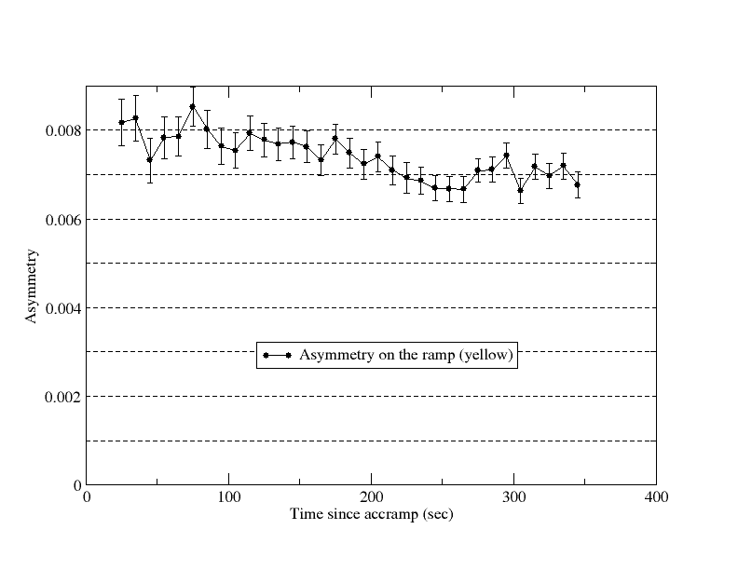
Asymmetry in Yellow on the Whole Ramp
100GeV
200GeV
250GeV

Slide 6
What Have Been Achieved This pp Run
Higher polarization out of AGS (jump quads).
Higher polarization at RHIC store (tune and orbit on the ramp).
Highest peak luminosity in RHIC so far (9MHz, orbit/tune).
Orbit feedback works. We have excellent orbit control on the ramp.
9MHz cavity is operational. We may benefited from less e-cloud effect already. So far no indication of intensity issue.
10Hz orbit feedback works. Beneficial to luminosity.
Up/Down ramp from 100GeV to 250GeV to compare polarization levels at the two energies.
Chromaticity feedback works for these ramps. Essential for the down ramp development.
Injection jet polarization measurement with a short notice.

