Slide 1
RHIC Heavy Ion Run-11
Gregory Marr
Run website: http://www.cadops.bnl.gov/AP/RHIC2011/
http://www.rhichome.bnl.gov/AP/RHIC2011/

Slide 2
Lattice Development
9 GeV now 9.8 GeV: “Au11v3”
2.5 m β* at STAR
3m β* at PHENIX
10m β* elsewhere
Nominal injection tunes (28.22, 29.23)
100 GeV: “Au11v1”
Copy of Run-10 lattice “Au104”
0.7 m β* at STAR, PHENIX
10m β* elsewhere
IBS-suppression lattice tunes (31.23, 32.22)

Slide 3
Upgrades impacting Heavy Ions
197 MHz Storage cavity relocation
Eliminating “common cavities” should improve beam loading issues associated with rebucketing.
Stochastic cooling
Vertical and longitudinal, no horizontal.

Slide 4
Present Status
19.6 GeV run well underway
Over 100 stores to date
Store length reduced to 30 minutes
Typical store-to-store turnaround ~5 minutes
Efforts concentrating on stability, repeatability

Slide 5
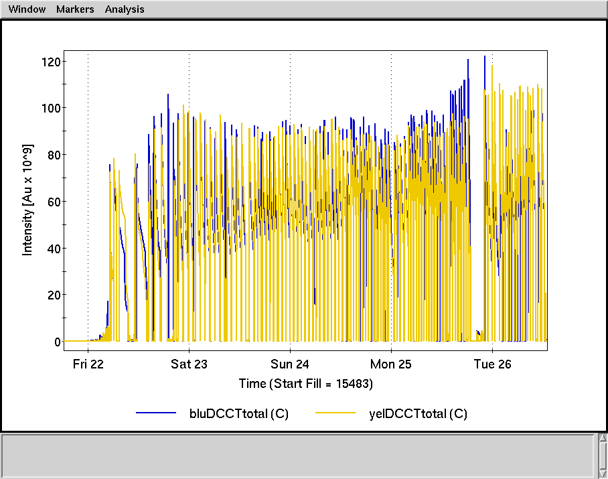

Slide 6
Schedule and Run Plan
Monday, 5/2: 19.6 GeV Au-Au run ends
APEX
Switch ramps
Power supply ramp tests
Monday-Tuesday 5/2-3: Initial beam setup
Injection, ramp tuning
Wednesday 5/4: store setup (around maintenance)
Friday, : Physics begins

