Slide 1
RHIC Heavy Ion Run-11
Gregory Marr
Run website: http://www.cadops.bnl.gov/AP/RHIC2011/
http://www.rhichome.bnl.gov/AP/RHIC2011/

Slide 2
Upgrades impacting Heavy Ions
197 MHz Storage cavity relocation
Eliminating “common cavities” should improve beam loading issues associated with rebucketing.
Stochastic cooling
Vertical and longitudinal, no horizontal.

Slide 3
Present Status
19.6 GeV run complete
Over 250 stores for physics
Despite some setbacks that left us a bit short, we were able to exceed some goals for this run
My thanks to Operations crews and support staff for a successful low energy run.
200 GeV run setup underway
First ramp with beam succeeded
Most ramp development complete, moving on to store setup.

Slide 4
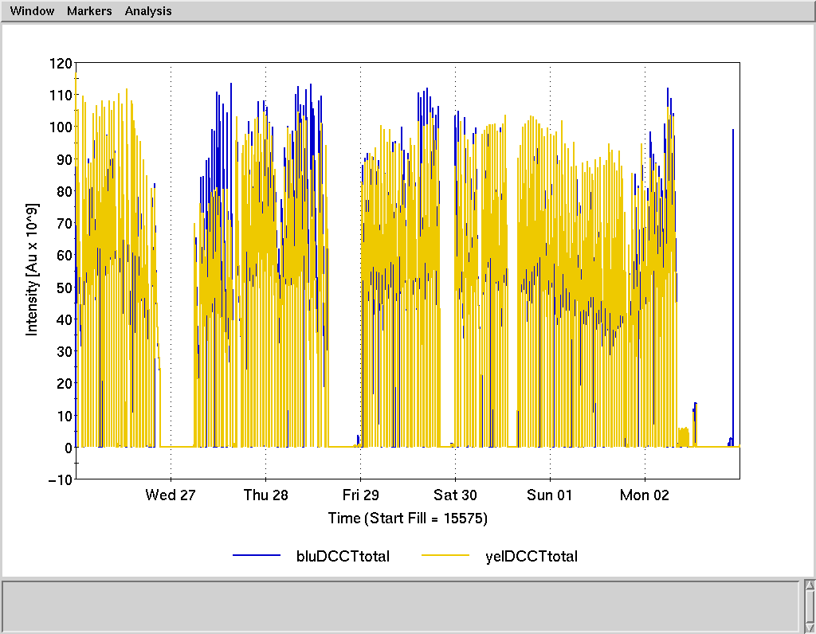

Slide 5
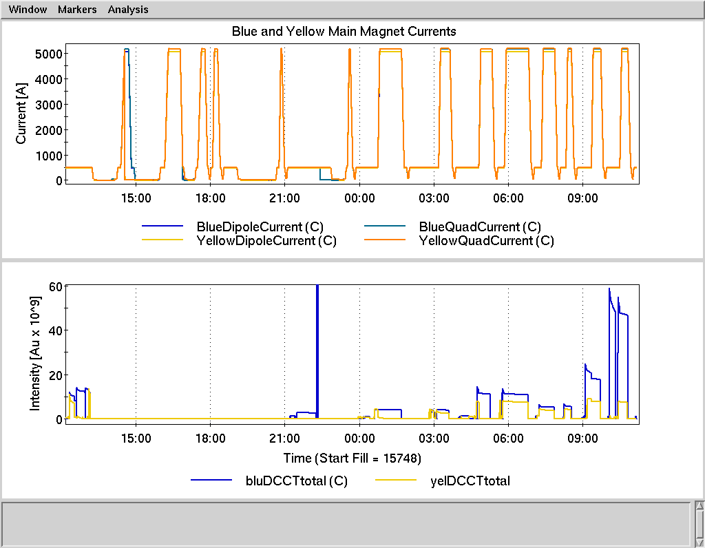

Slide 6
Schedule and Run Plan
Today: Continue ramp development, begin store setup
Wednesday, Thursday: store setup (around maintenance)
Collisions, collimation, rebucketing, stochastic cooling
Friday: Physics begins (?)

