Slide 1
RHIC Heavy Ion Run-11
Gregory Marr
Run website: http://www.cadops.bnl.gov/AP/RHIC2011/
http://www.rhichome.bnl.gov/AP/RHIC2011/

Slide 2
Present Status
200 GeV Physics underway
4 days setup from first ramp to Physics
Rebucketing operational
Stochastic cooling setup started
Tune, coupling, orbit feedbacks in use every ramp
Peak luminosities not yet up to best Run-10 levels

Slide 3
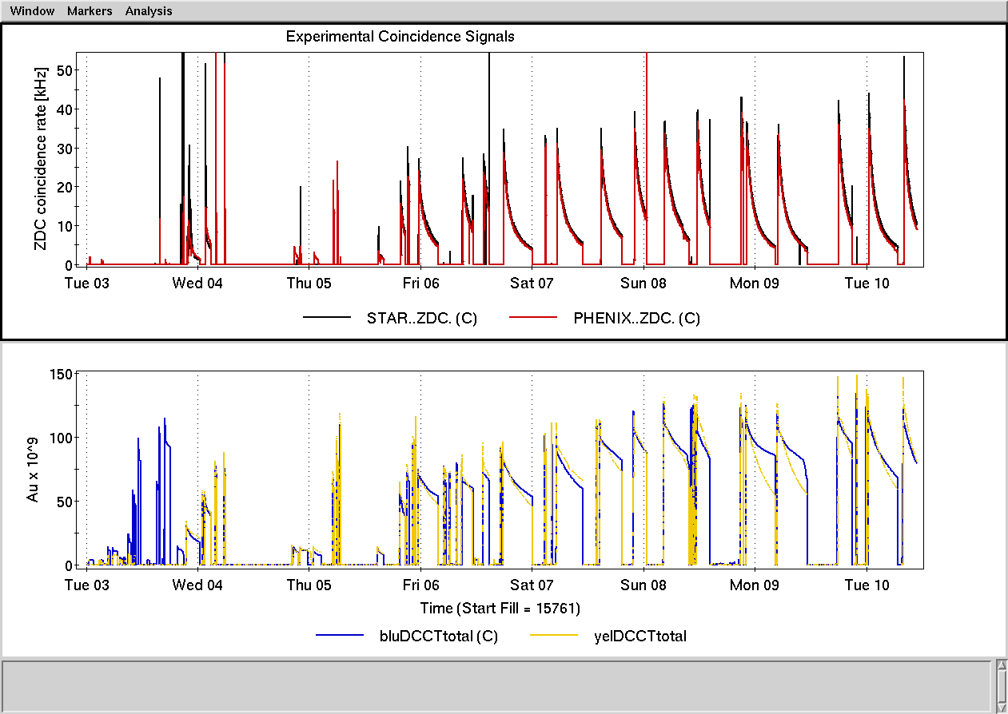

Slide 5
Schedule and Run Plan
Stochastic cooling setup continues
More RF voltage for rebucketing, awaits conditioning time for storage cavities
Tuning for high luminosity concentrating on available injected beam, ramp transmission (especially Yellow near transition).

