Slide 1
STAR Status – Run12 200GeV AuAu
Trigger Setup
High Tower triggers: NPE 18:
High Tower with a threshold at 4.2 GeV,
targeted for Upsilon physics Run with prescale 1 to sample all luminosity when it is running
Min Bias trigger with past and future protection against pileup (~450 beam x-ings)
targeted for low and intermediate-mass dileptons

Slide 2
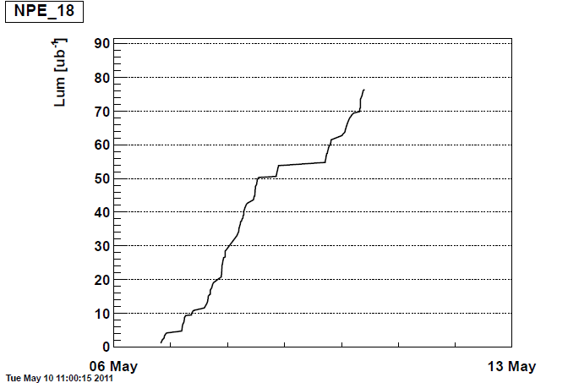
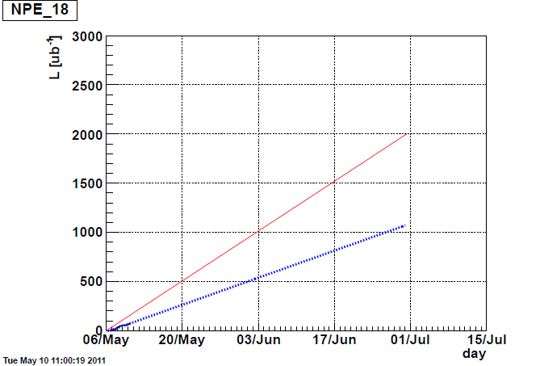
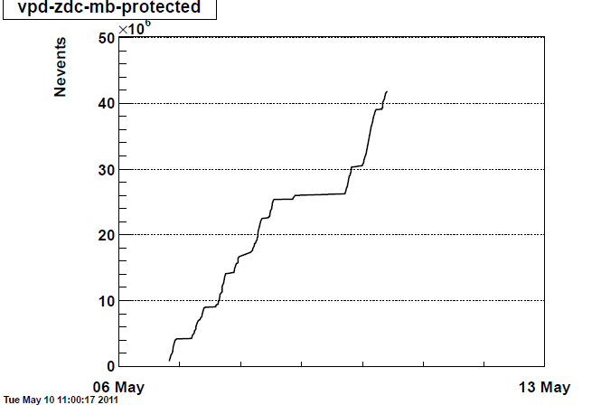
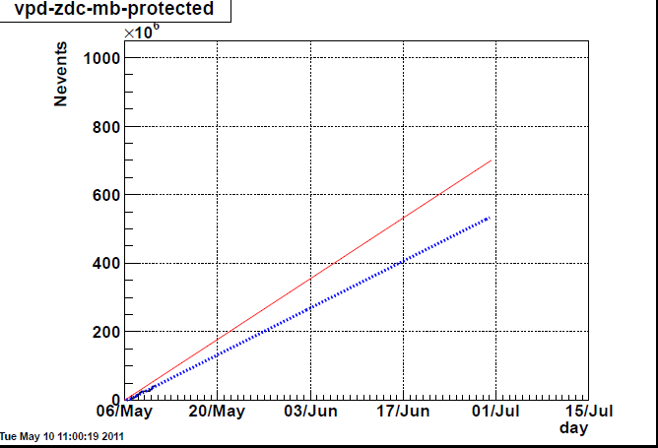
Rates and Projections vs Goals

