Slide 1
RHIC Heavy Ion Run-11
Gregory Marr
Run website: http://www.cadops.bnl.gov/AP/RHIC2011/
http://www.rhichome.bnl.gov/AP/RHIC2011/

Slide 2
Present Status
200 GeV Physics continues
  Blue & Yellow longitudinal stochastic cooling operational
  Yellow vertical cooling
  Blue vertical cooling setup in progress
  Rebucketing operational with 4 storage cavities per ring
  Tune, coupling, orbit feedbacks in use every ramp
  Peak luminosities typically near or above best Run-10 levels

Slide 3
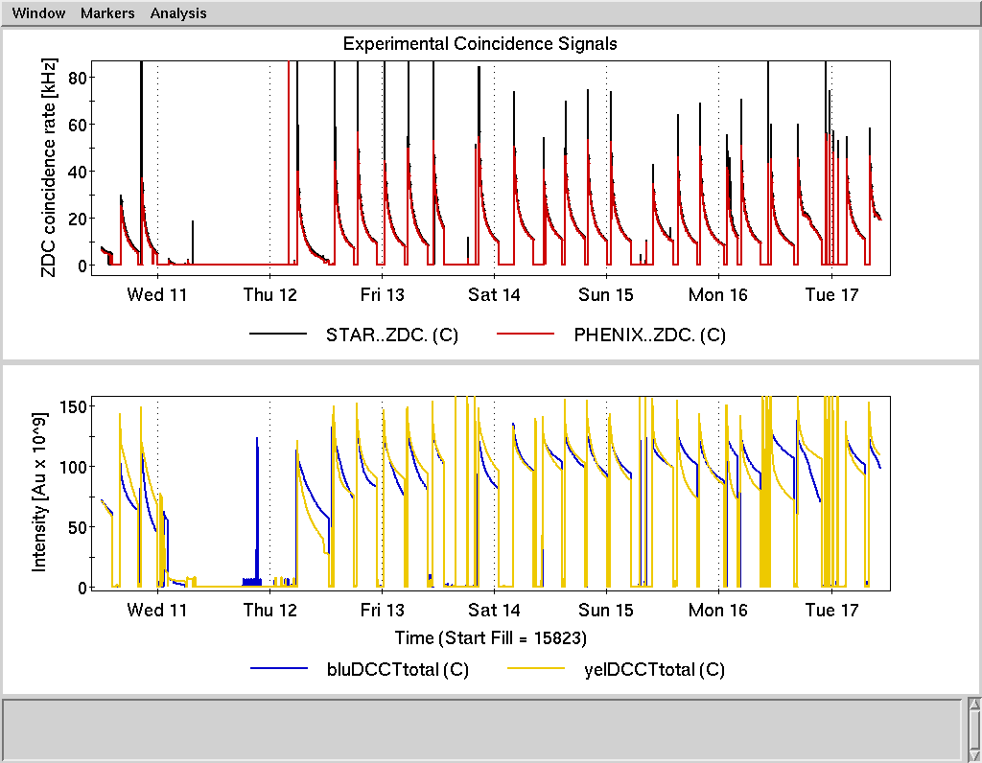

Slide 4
Preliminary, using Run-10 cross sections

Slide 5
Schedule and Run Plan
Stochastic cooling setup continues, anticipating 4 operational systems this week.
More RF voltage for rebucketing, expected following cavity conditioning during maintenance.
Tuning for high luminosity concentrating on Blue injection efficiency, Yellow store losses and lifetime.

