Slide 1
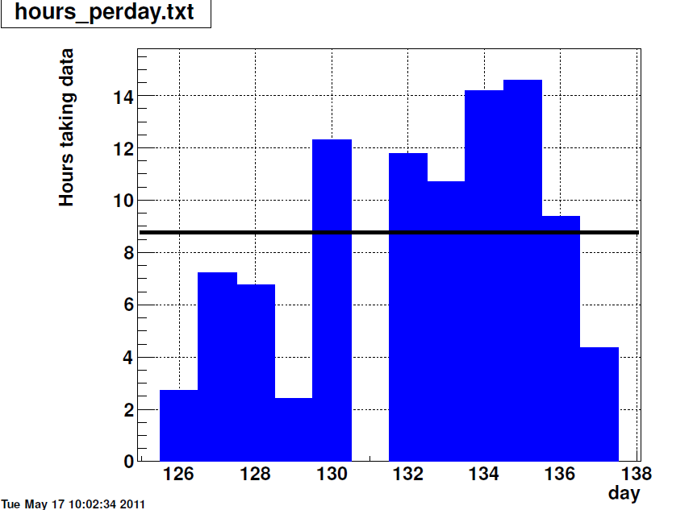
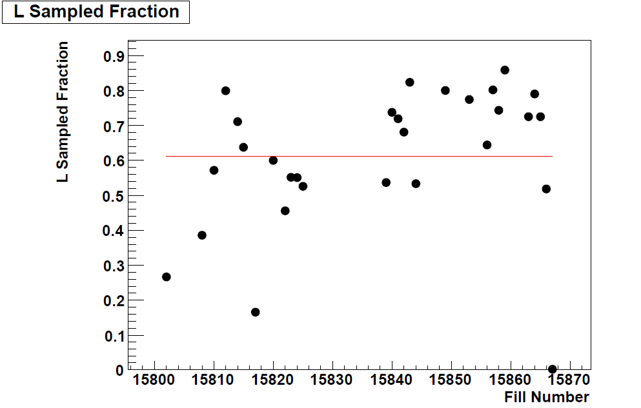
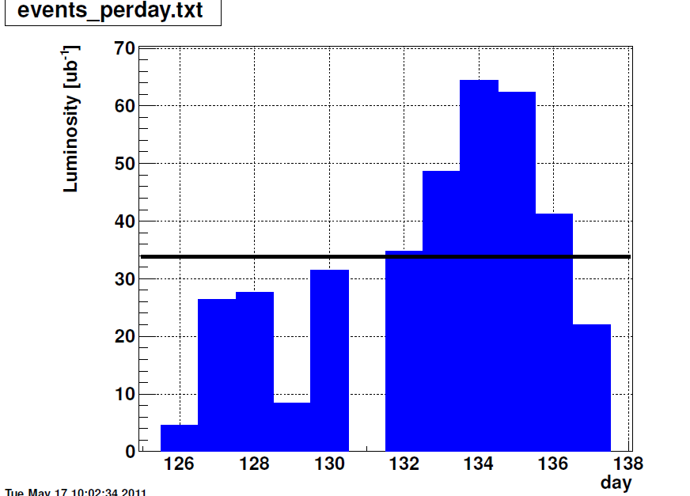
STAR Status – 05/17
Smooth data taking over the last week
Minor trouble Monday night: High beam backgrounds upset BEMC
A. Vossen

Slide 2
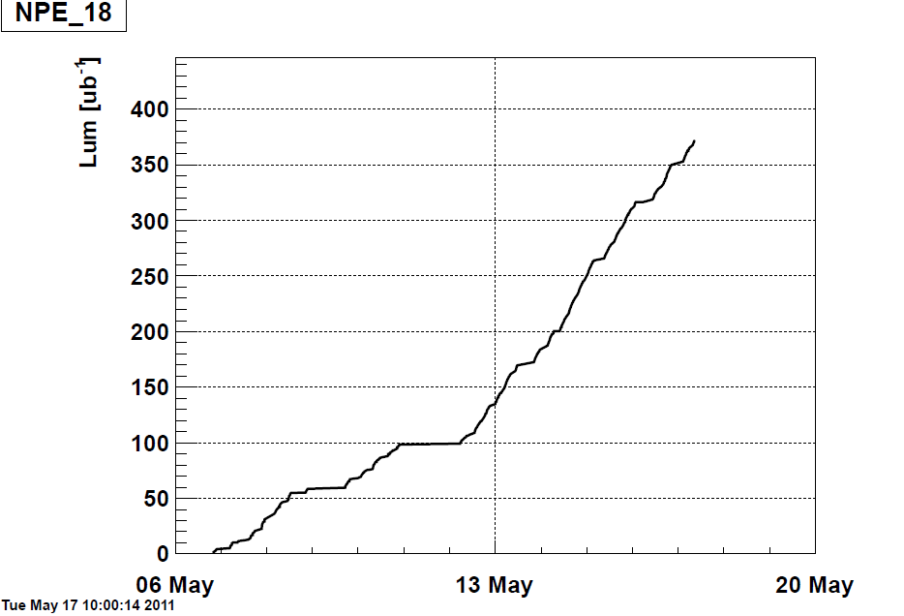
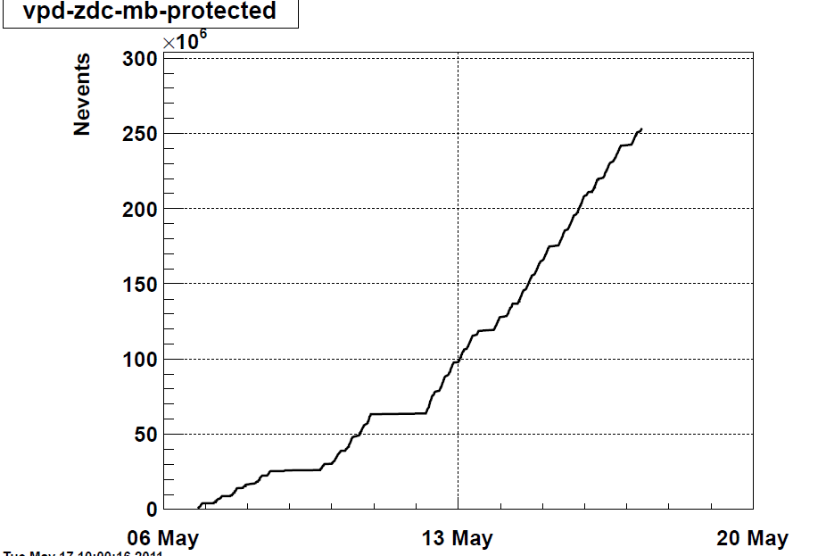
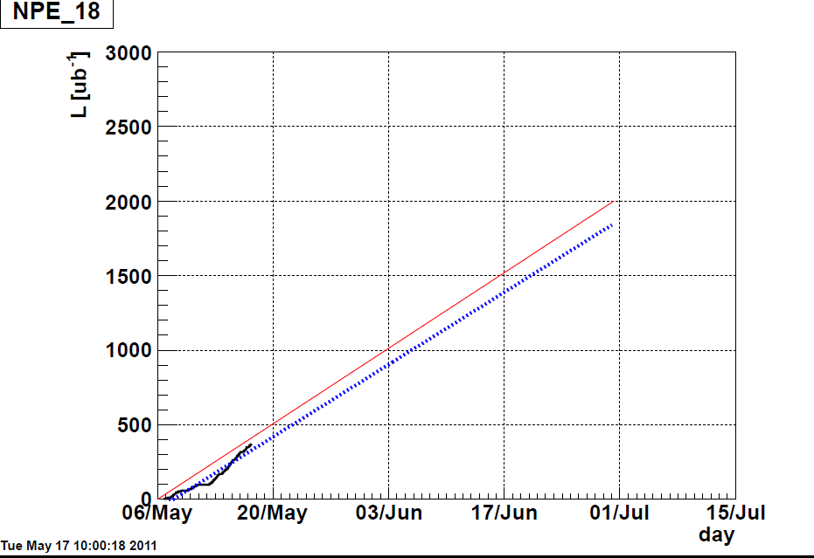
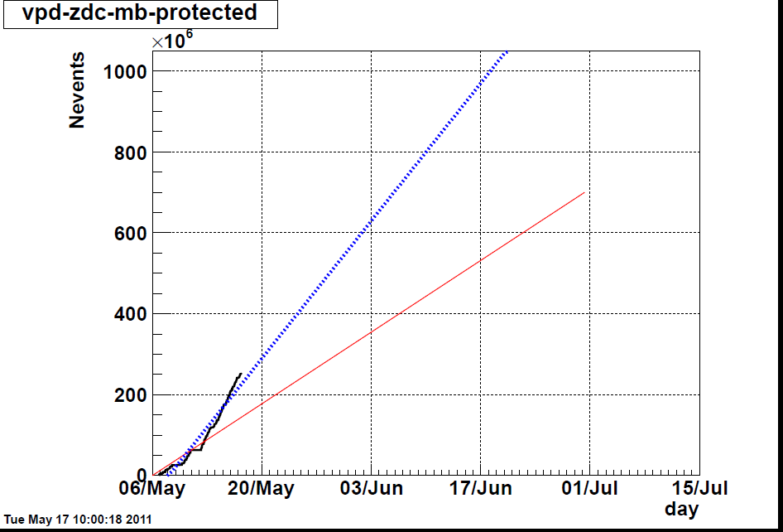
High Tower with a threshold at 4.2 GeV,
targeted for Upsilon physics Run with prescale 1 to sample all luminosity when it is running
Min Bias trigger with past and future protection against pileup (~450 beam x-ings)
targeted for low and intermediate-mass dileptons

