Slide 1
RHIC Heavy Ion Run-11
Gregory Marr
Run website: http://www.cadops.bnl.gov/AP/RHIC2011/
http://www.rhichome.bnl.gov/AP/RHIC2011/

Slide 2
Present Status
200 GeV Physics continues
  28 stores this week (including 14 in a row)
  Blue & Yellow stochastic cooling operational
    All 4 longitudinal and vertical systems running
  All storage cavities operational for rebucketing
  Testing methods to squeeze β* during store
  Peak luminosities typically near or above best Run-10 levels

Slide 3
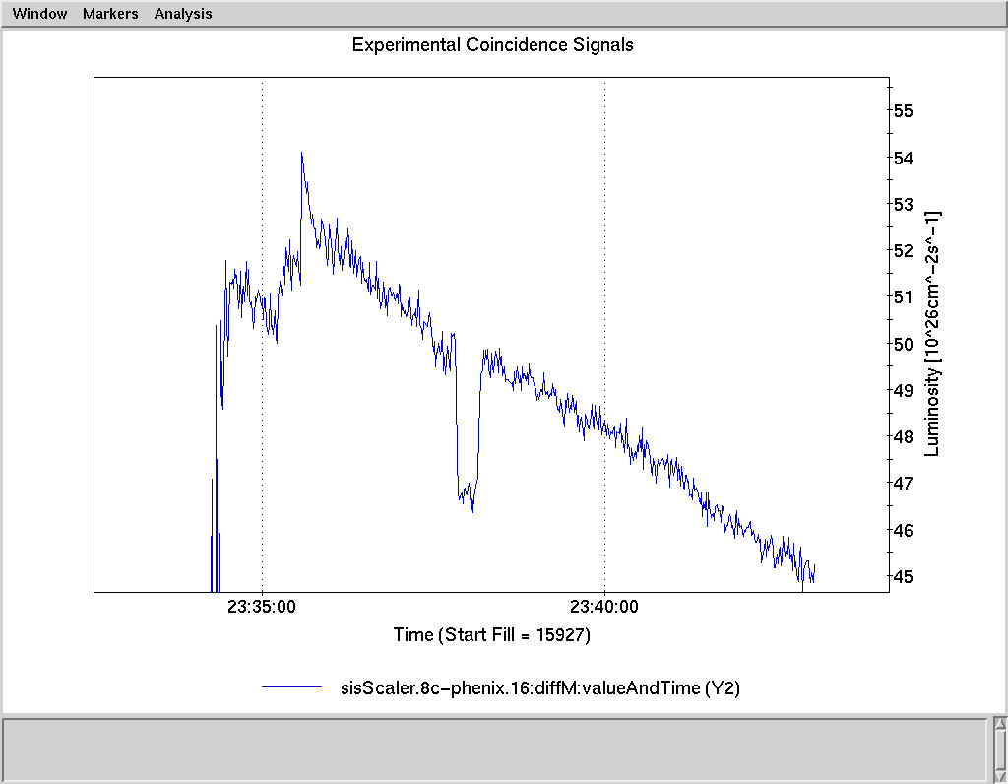
Fill 15927: record peak luminosity

Slide 4
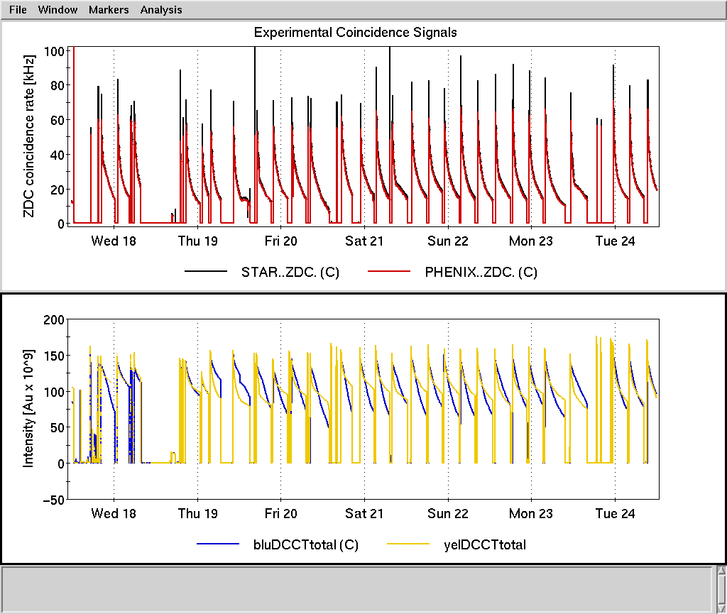

Slide 5
Preliminary, using Run-10 cross sections

Slide 6
Schedule and Run Plan
Stochastic cooling work continues, optimizing performance.
Tuning efforts focusing on Blue and Yellow store lifetime (Thursday Machine Development).
Begin planning for possible low energy run(s).

