Slide 1
Take 5 for Safety
Los Alamos Lessons Learned: Dewar Injury
Video of the Week – Locking Up When You Leave
E. Lessard
Collider-Accelerator Department
5-24-11

Slide 2
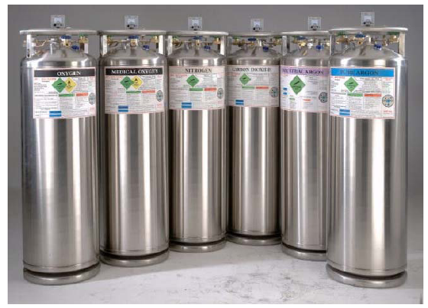
Cryogenic Dewar Movement Incident - Worker Sustains Injury to Two Fingers
Worker attempted to stabilize a 160 Liter (L) Argon Dewar (pictured below) that began to dislodge from a commercial transport cart
His right hand got caught between the Dewar and the cart, severing the ends of his right ring and little fingers
The Dewar fell onto the dock and the transport cart fell to the parking lot below the dock
The worker intended to move the recently filled Dewar a few feet in order to connect it to the building’s gas manifold for laboratory use
Preliminary indications are that as the worker pulled back on the cart either the pin in the adjustable assembly gave way or the lifting stem became dislodged from the Dewar
The worker lost two centimeters (2 cm) from the end of his right ring finger and one centimeter (1 cm) from the end of his right little finger

Slide 3
LANL Dewar Injury

Slide 4
LANL Actions In Progress
Identify users of inferior carts (determine extent of condition, number of replacements to procure)
No use of these inferior carts
Procure Anthony 86U-4 carts to replace inferior units
Review and revise work control documents, as appropriate
Address more specific hazards of Dewar movement
Specify use of cart, instruct on use of safety features
Adopt 2-person rule for cart movement to verify safety features, observe movement from safe location
Review cryogenic safety training course content, make appropriate revisions

Slide 5
Preventing Human Error - Locking Up When You Leave

