Slide 1
PHENIX Status
John Haggerty
Brookhaven National Laboratory

Slide 2
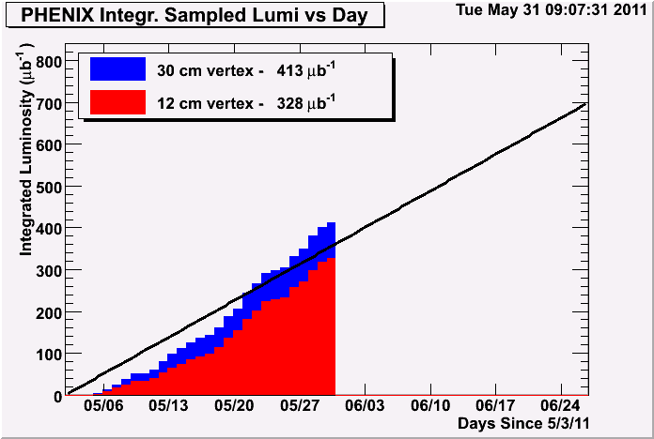
Recorded Luminosity

Slide 3
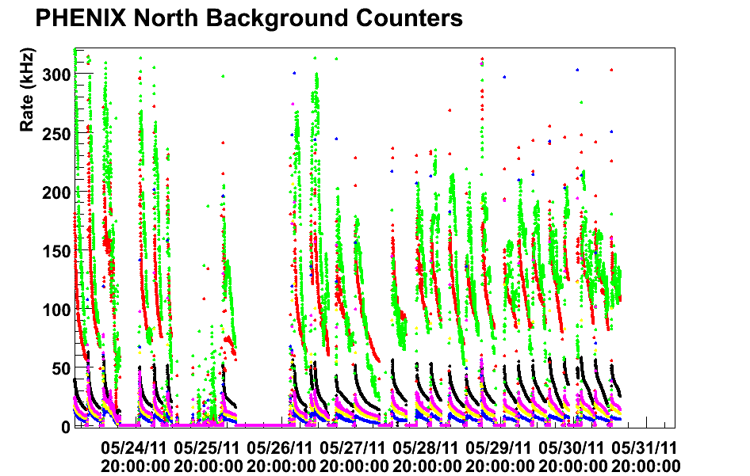
Background
Pretty good this week, but higher than the initial phenomenal backgrounds
Looked for correlations with VTX leakage current; looks ok to start with counters outside triplets above 200 kHz

Slide 4
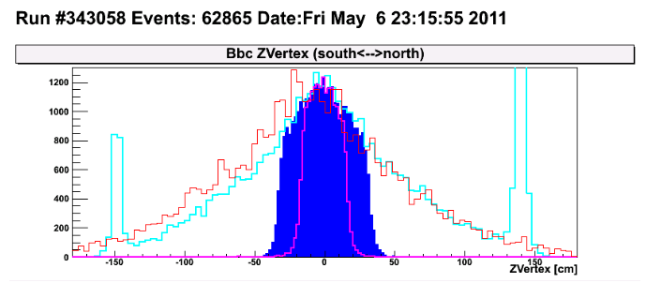
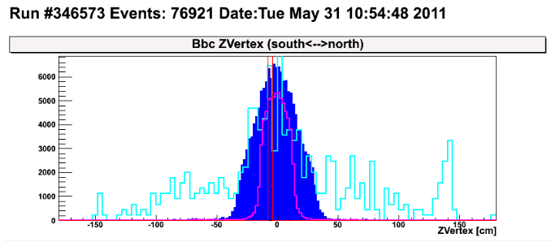
Vertex distribution
Nice improvement in the vertex distribution seen by our BB counters

Slide 5
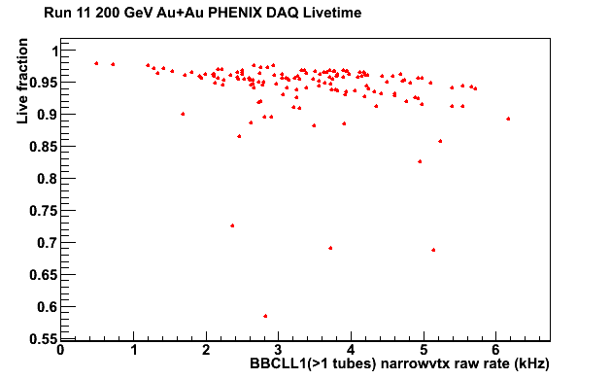
VTX Status
Physics running since May 6 with VTX always in (cautious startup)
Negligible effect on livetime
Problems along the way have been addressed with maintenance and workarounds
Strip “dropout” related to 4 event buffering, dropped back to 3
Pixel grounding loss repaired during maintenance days

Slide 6
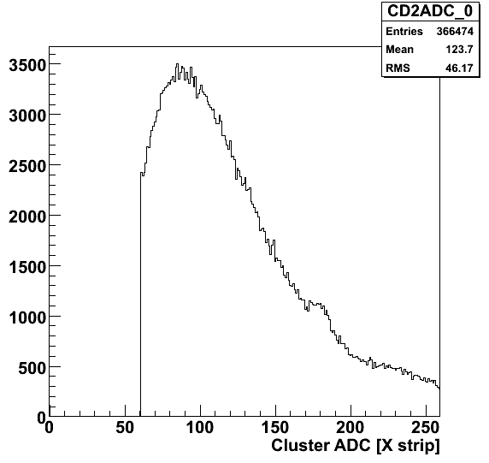
VTX Strip
Stripixel layers showing good MIP peak
Peak in ADC from stripixel SVX4 ADC ~90 for clusters

Slide 7
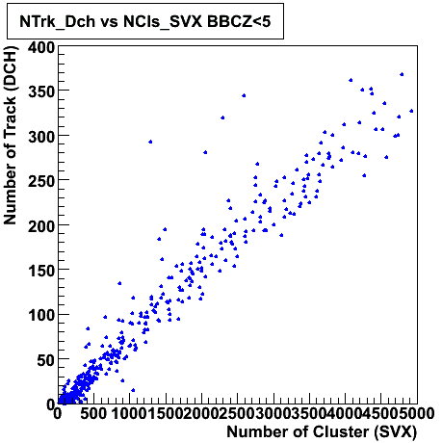
VTX Pixel
Pixel layers have been behaving well except for a weak ground connection that we have been repairing as we go along
Estimated ~80% live pixels right now
DST production ongoing during the run

Slide 8
Summary
A good week of running
Just about at the halfway point
The VTX is working well
There’s a lot more to do with the VTX, but the data we are taking is looking very good

