Slide 1
RHIC Heavy Ion Run-11
Gregory Marr
Run website: http://www.cadops.bnl.gov/AP/RHIC2011/
http://www.rhichome.bnl.gov/AP/RHIC2011/

Slide 2
Present Status
200 GeV Physics continues
  22 stores this week
  Blue & Yellow stochastic cooling operational
    All 4 longitudinal and vertical systems running
  Testing methods to squeeze β* during store
  Peak luminosities typically near or above best Run-10 levels; average luminosities could stand improving

Slide 3
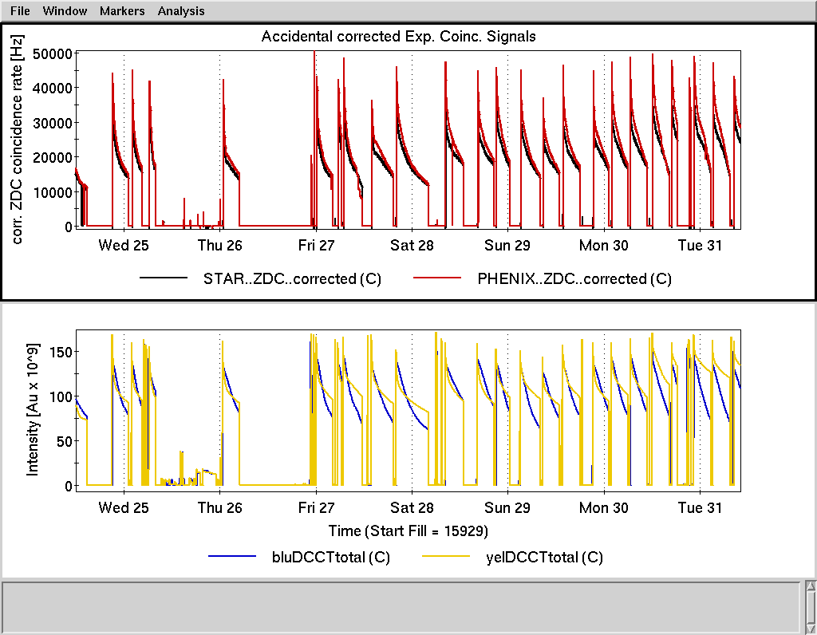

Slide 4
Preliminary, using Run-10 cross sections

Slide 5
Preliminary, using Run-10 cross sections

Slide 6
Schedule and Run Plan
Stochastic cooling effort continues, fine tuning from store to store.
Efforts focusing on Blue and Yellow luminosity lifetime
  Working point scan (Machine Development)
  Blue vertical cooling pickup (Maintenance)

