Slide 1
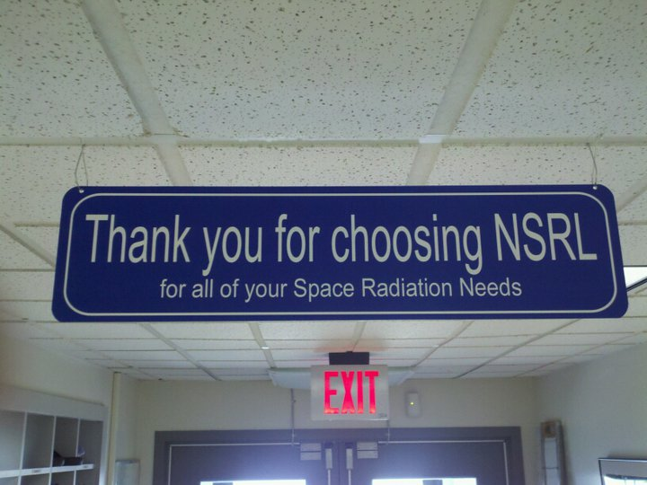
Seen at NSRL

Slide 4
Top 10 Failures April - May

