Slide 1
RHIC Heavy Ion Run-11
Gregory Marr
Run website: http://www.cadops.bnl.gov/AP/RHIC2011/
http://www.rhichome.bnl.gov/AP/RHIC2011/

Slide 2
Present Status
200 GeV Physics continues
25 stores this week
Blue vertical stochastic cooling pickup repaired
All 4 longitudinal and vertical systems running
Continuing tests to squeeze β* during store
Benefitting from quick turnarounds, high availability, good beam intensities, better lifetime.

Slide 3
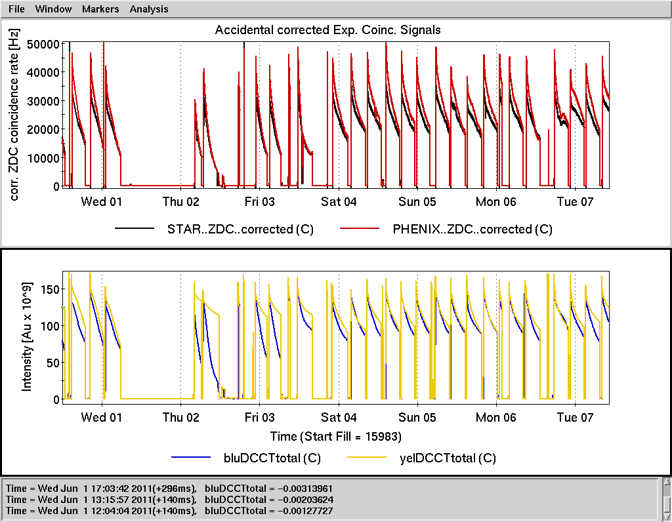

Slide 4
Preliminary, using Run-10 cross sections

Slide 5
Schedule and Run Plan
Stochastic cooling effort continues, fine tuning from store to store.
Machine tuning focusing on intermittent Blue instability after transition, store lifetime, intensity limitations.
Working to make β* squeeze at store operational.

