Slide 1
PHENIX Status
John Haggerty
Brookhaven National Laboratory

Slide 2
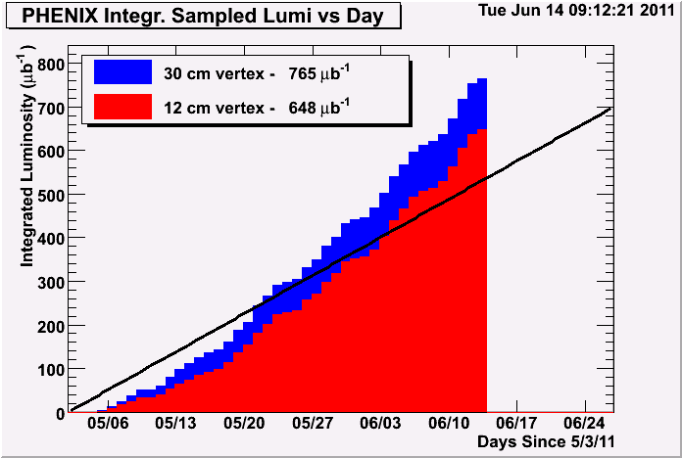
Recorded Luminosity

Slide 3
Goal is achievable
With the very efficient running of the last week, we are on course to achieve our luminosity goal this weekend
We’re taking very good quality data now, nice to save the best for last

Slide 4
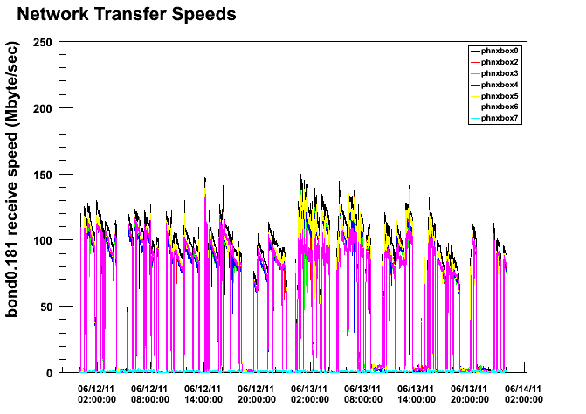
Data Acquisition Rates

Slide 5
Maintenance Activities
We chose to take the maintenance day to fix a few things before the 27 GeV run:
7% acceptance loss in DC.E tracking
12.5% acceptance loss in TOF.E
A few repairs and tests on MUTR and RPC that will be hard to investigate after the experiment goes off, like a test with some additional shielding around the north DX magnet

Slide 6
Summary
Running smoothly (beautiful fill after fill)
Clarified background monitoring
Probably a full 8 hours of maintenance activities
Expect only minor changes for 27 GeV running

