Slide 1
RHIC Heavy Ion Run-11
Gregory Marr
Run website: http://www.cadops.bnl.gov/AP/RHIC2011/
http://www.rhichome.bnl.gov/AP/RHIC2011/

Slide 2
Present Status
200 GeV Physics continues
  25 stores this week
    Including 12 back-to-back
  Blue vertical stochastic cooling pickup repaired
    All 4 longitudinal and vertical systems running
  Continuing tests to squeeze β* during store
  Benefitting from quick turnarounds, high availability, good beam intensities, better lifetime.

Slide 3
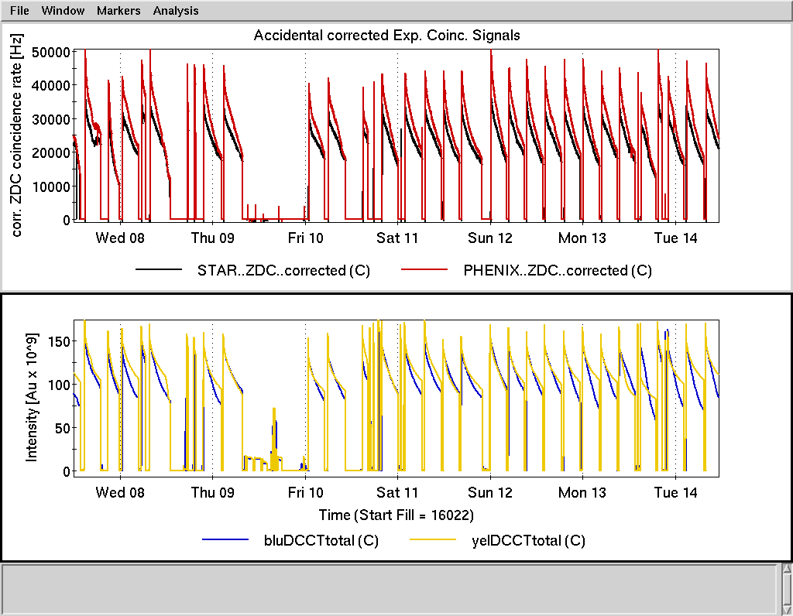

Slide 4
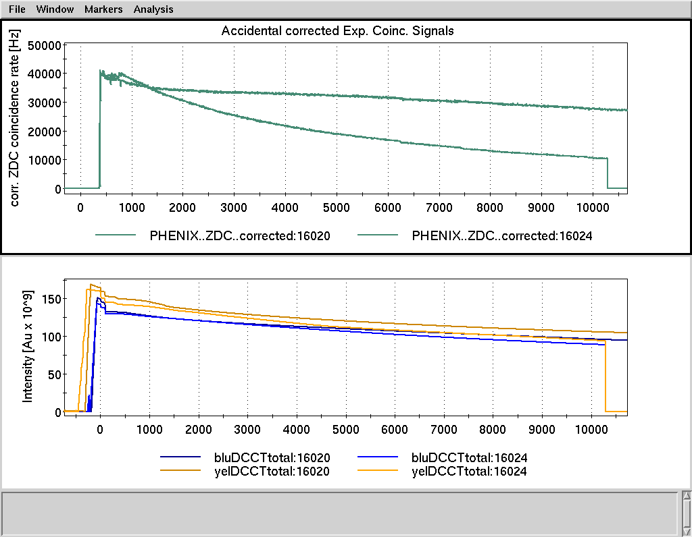
Benefits of stochastic cooling
Cooling all planes
No cooling
Two stores with similar conditions

Slide 5
Preliminary, using Run-10 cross sections

Slide 6
Schedule and Run Plan
Test of AnDY ZDCs upcoming this week.
Final set of 200 GeV vernier scans this week.
β* squeeze tests at store continuing.
200 GeV physics ends 0800 Monday.
27 GeV setup begins 1600 Monday.

