Slide 1
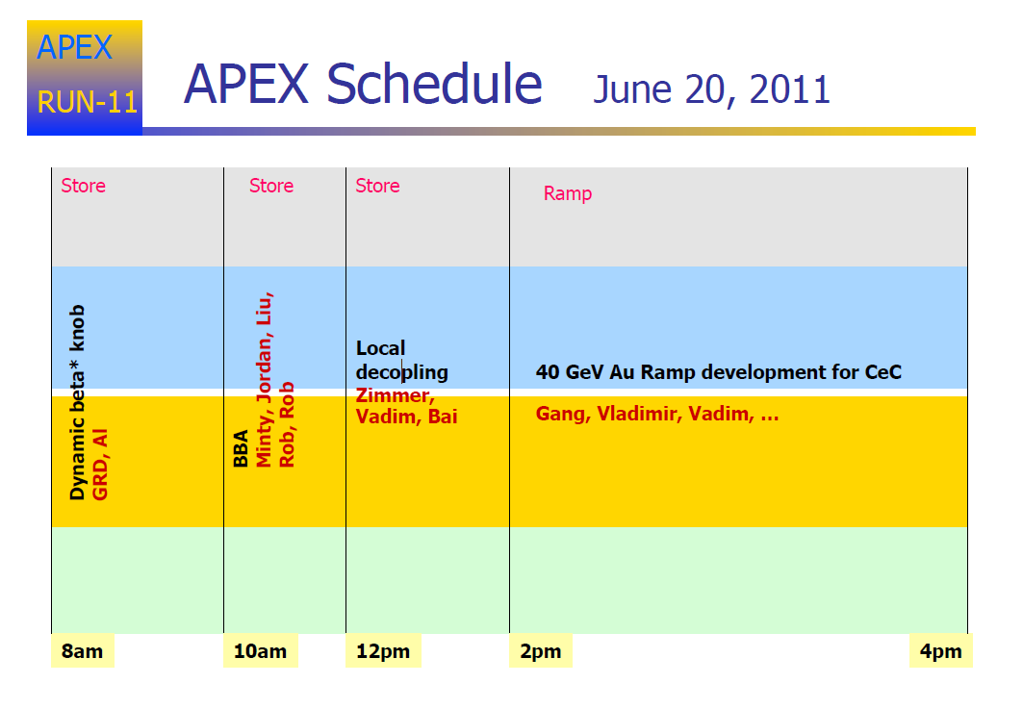
Local
Decoupling

Slide 2
Progress
Dynamic beta* squeeze
Squeeze at STAR to 0.62 m succesful ‘nearly routinely’
Subsequent squeeze at PHENIX caused significant beam decay.
Chromaticity control is critical
BBA
Able to measure offset at a few quads at injection energy
Is there a way to involve feedback to get a higher signal to noise.
Local decoupling
Some data taken, some not useful due to magnet control problems
Some time lost to RF failure
40 GeV CeC test
Succesful ramp to store in one attempt
Measured blue beta* at IP2, yellow unmeasured (beam dump due to PASS failure)
Request for more time (3 hours) to finish characterizing the optics

