Slide 1
RHIC Heavy Ion Run-11
Gregory Marr
Run website: http://www.cadops.bnl.gov/AP/RHIC2011/
http://www.rhichome.bnl.gov/AP/RHIC2011/

Slide 2
Present Status
200 GeV Physics complete
  21 stores this week
27 GeV setup in progress
  Injection, ramp work mostly complete
  Collisions established at store
  Working on collimation, backgrounds, store lifetime
  Increasing bunch intensity

Slide 3
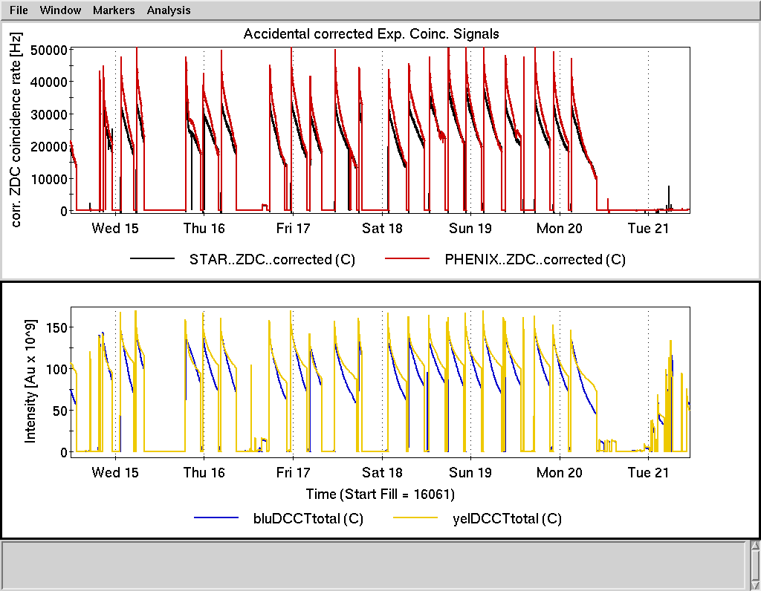

Slide 4
Preliminary, using Run-10 cross sections

Slide 5
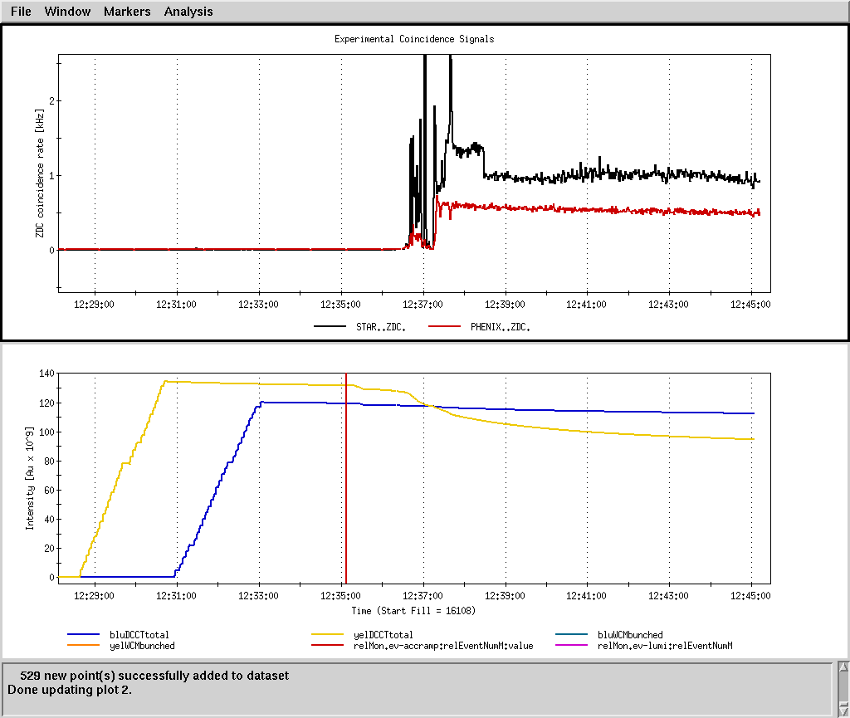

Slide 6
Schedule and Run Plan
Anticipating 27 GeV Physics later today.
  Beam lifetime, store length yet to be determined.
27 GeV continues through 0600 next Wednesday.

Slide 7
A Final Note
My sincere thanks for the hard work and long hours contributed by so many that made this Heavy Ion run a success.

