Slide 1
RHIC Heavy Ion Run-11
Gregory Marr
Run website: http://www.cadops.bnl.gov/AP/RHIC2011/
http://www.rhichome.bnl.gov/AP/RHIC2011/

Slide 2
Present Status
27 GeV physics running
Over 80 stores this week
Store length reduced to 1 hour after injection/ramp collimation allowed detectors to stay on.
Above goals for run

Slide 3
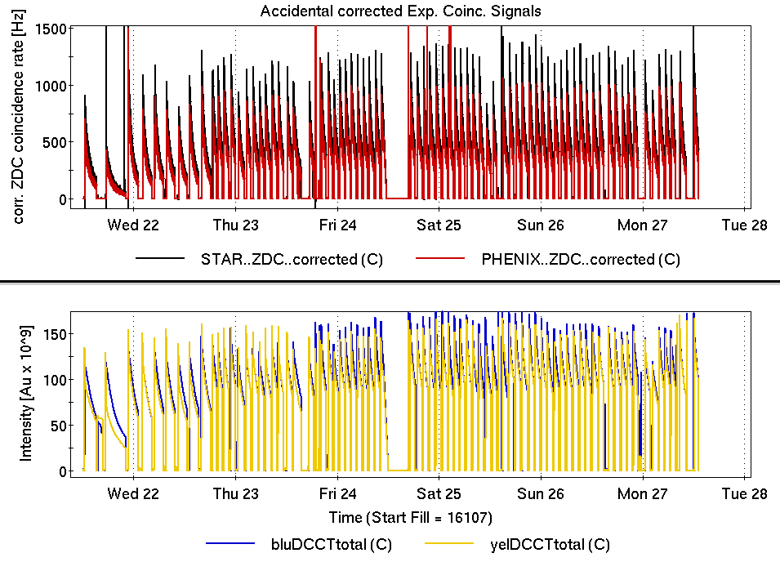

Slide 5
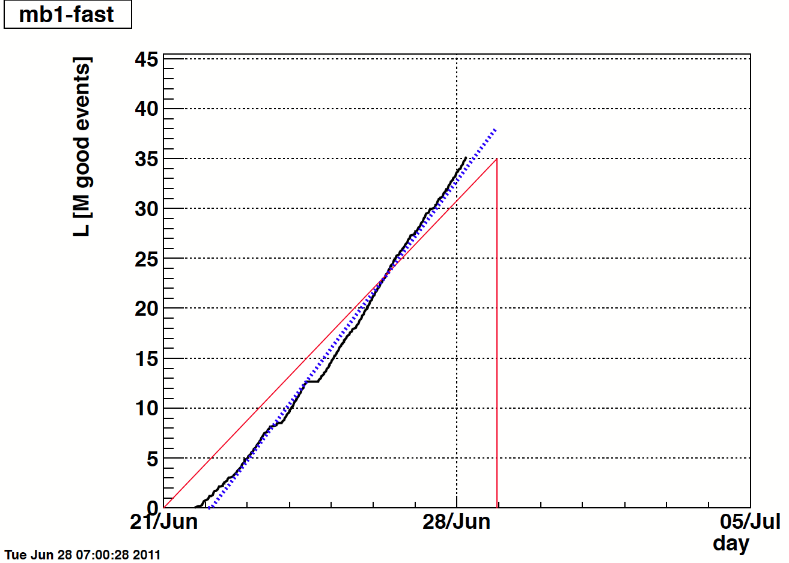

Slide 6
Schedule and Run Plan
27 GeV Physics ends 2200 tonight.
APEX, power supply/magnet tests follow

