Slide 1
AGS PP Progress
Haixin Huang
January, 10, 2012

Slide 2
Progress
The archives of last April before the end of run were loaded in AGS and Booster.
Polarization reached 65% with 1.6-1.7*10^11 with source polarization of 78%.
Jump quads were turned on and showed gain of polarization.
Emittance is similar to last run.

Slide 3
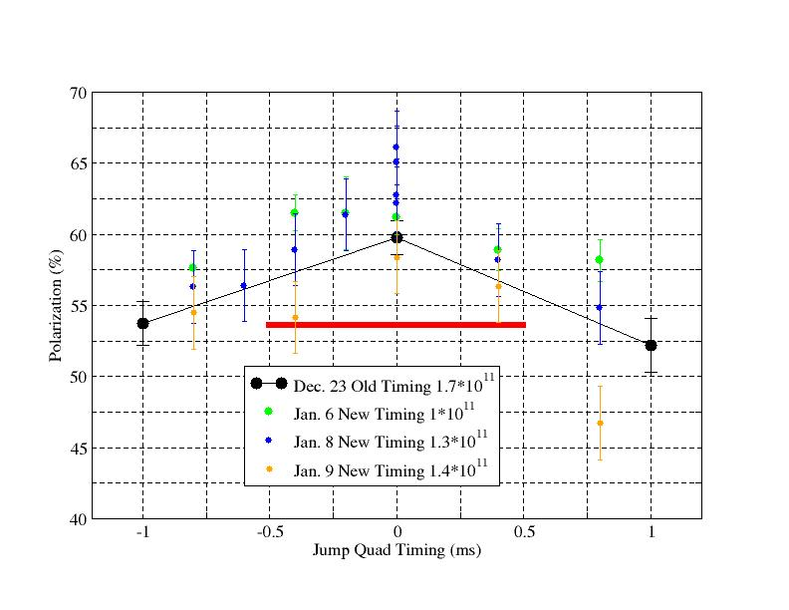
JQ Timing Scan

Slide 4
Problems
Source polarization is lower by ~2.4% after switching to solenoid from Einzel lens to allow BLIP running. But AGS polarization is lower by about 6% since last Wednesday. Need to search for reason after linac (Booster scraping, injection polarization measurement…)
AGS RF station problem.
9th harmonics keeps drifting, which is different from last run. The feed forward system is needed again.

Slide 5
Plan
Reduce emittance by scraping, further injection tuning.
Find out source of polarization drifting away.
Ramp polarization measurement.
Injection polarization measurements.
Take polarization profile measurements with JQ on and off. Needs more data set.
Working on improving the pulse shape of jump quads.

