Slide 1
PHENIX Status

Slide 2
Rack safety system testing completed last week
Magnet testing completed on Saturday (thanks to Frank Dusek)
Safety system (smoke, flammable gas, and crash button) testing hopefully completed today or tomorrow
Shield wall built, should be able to roll in soon
Shifts to begin Wednesday day shift
We want to start running detector gas as soon as possible to get started with cosmic ray running both for detector tests and as part of the W program

Slide 3
New for Run 12
RPC1 north and south (integrated into muon trigger)
Forward silicon detector (FVTX)
Barrel silicon reassembled to integrate FVTX
MPC electronics replaced on one arm
New shielding in the tunnel, thanks to Dave Phillips

Slide 4
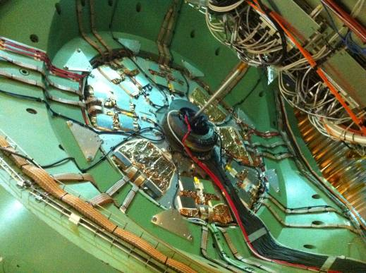
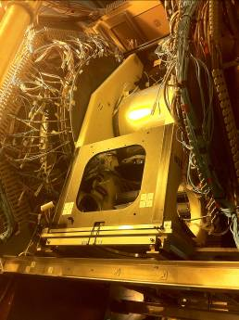
RPC1
VTX/FVTX

