Slide 1
AGS PP Progress
Haixin Huang
Time Meeting
January, 17, 2012

Slide 2
Status
The AGS polarization has been recovered over the weekend. The key is the vertical tune and chromaticity near 0+. AGS setup is reasonable stable: the polarization change can be reproduced by reloading different optics. The polarization is about 67% for 1.5-1.6*10^11.
Source polarization is around 76% last week when it was in good state, sometimes it is as low as 71%. As a reference point, the average source polarization from last run was 79%.
Injection polarization measurement done with CNI polarimeter for the first time. We take advantage of this capability to retune the Booster harmonics 3 and improved the polarization at AGS injection by 4% (relatively).
9th harmonics are important for AGS jump quads operation. A new version of orbit control can smooth out the harmonics on the ramp very nicely.

Slide 3
Intensity Scan with Booster Scraping
Source polarization:
76.17+-0.17%

Slide 4
Booster sin3v Scan
The data from last night is not so good.
Relatively ~4% difference

Slide 5
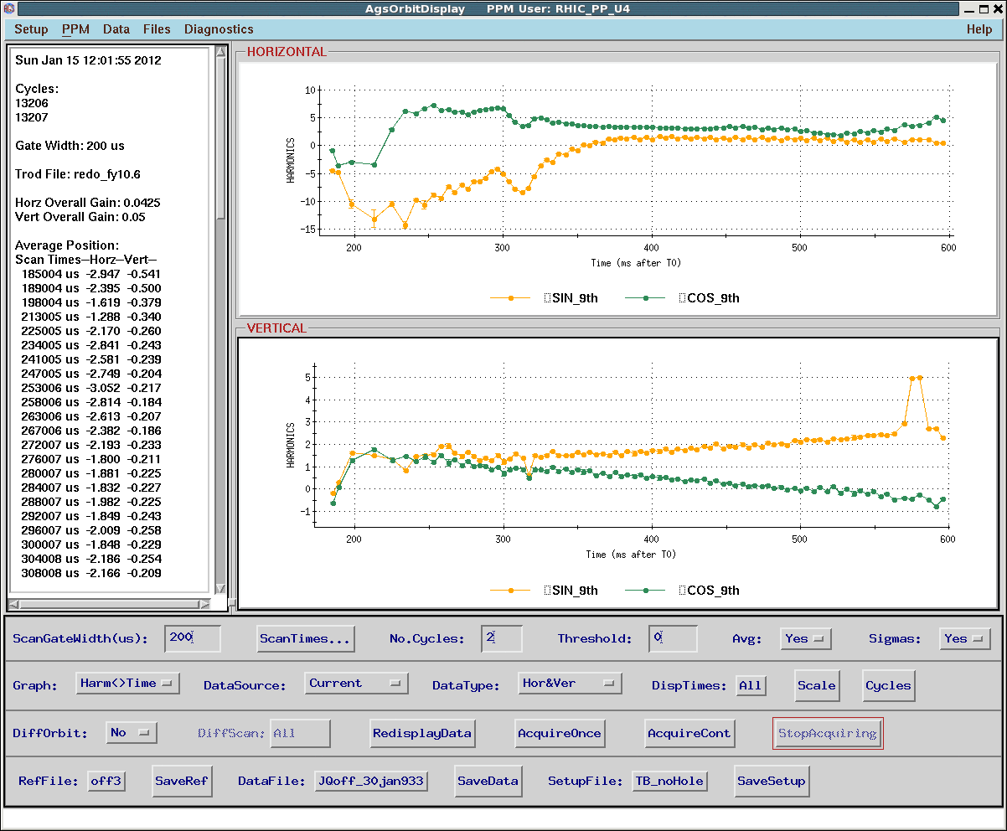
AGS 9th Harmonics Before and After

Slide 6
Remaining Job List
Extraction setup.
Load the jump quad timing for early part of ramp (before transition) to see if it give us additional gain of polarization. First test is to make sure P/S can take it.
Fine tuning the pulse shape for each pulse. The files for the two states are under testing today.
Modeling work with bare AGS and cold snake on.

