Slide 1
RHIC Status Update
Time Meeting, V. Schoefer
2/14/12
Declared physics Friday, Feb 10
Smooth running over the weekend (incremental ramp-by-ramp improvements to ramp/store conditions
Tight constraints on the longitudinal emittance
  Successful ramps with 109 bunches depend on small longitudinal emittance
  Loss monitor permit pulls on ramp and rebucketing traced back to large momentum spread.
  Longitudinal matching at RHIC injection is critical
  Can we do better in the injectors?
Rebucketing loss was limiting intensity to 96 bunches at 1.3e11
Can now do 109 at 1.3e11 with better longitudinal matching, will begin pushing per bunch intensity again

Slide 2
RHIC Status Update
Time Meeting, V. Schoefer
2/14/12
Speed bumps
  Still trying to understand carbon polarimeter noise problem
  Phase shifter cost about a shift (now disconnected from lattice)
  BBQ tune measurement ring to ring crosstalk
    Definitely beam-based, but not completely understood
    Tune feedback in this state causes the tune quads to walk away
    Requires a small tune separation between the two rings
  No automatic longitudinal matching available (yet)
  Human error
    Failed attempt to optimize orbit angles
    Two ring QLI from FEC reboot: ambiguous dialog box warning

Slide 3
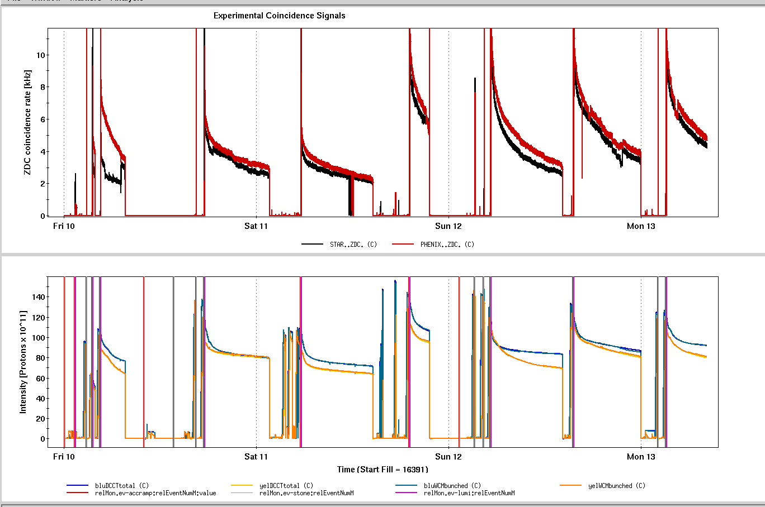
Misguided steering (hum err)
Phase shifter QLIs
Fixing yel lifetime
Incorrect FEC reboot (hum err)
Blue H<->V locking at dQ= 1e-3
Yellow loss permit at rebucketing

Slide 4
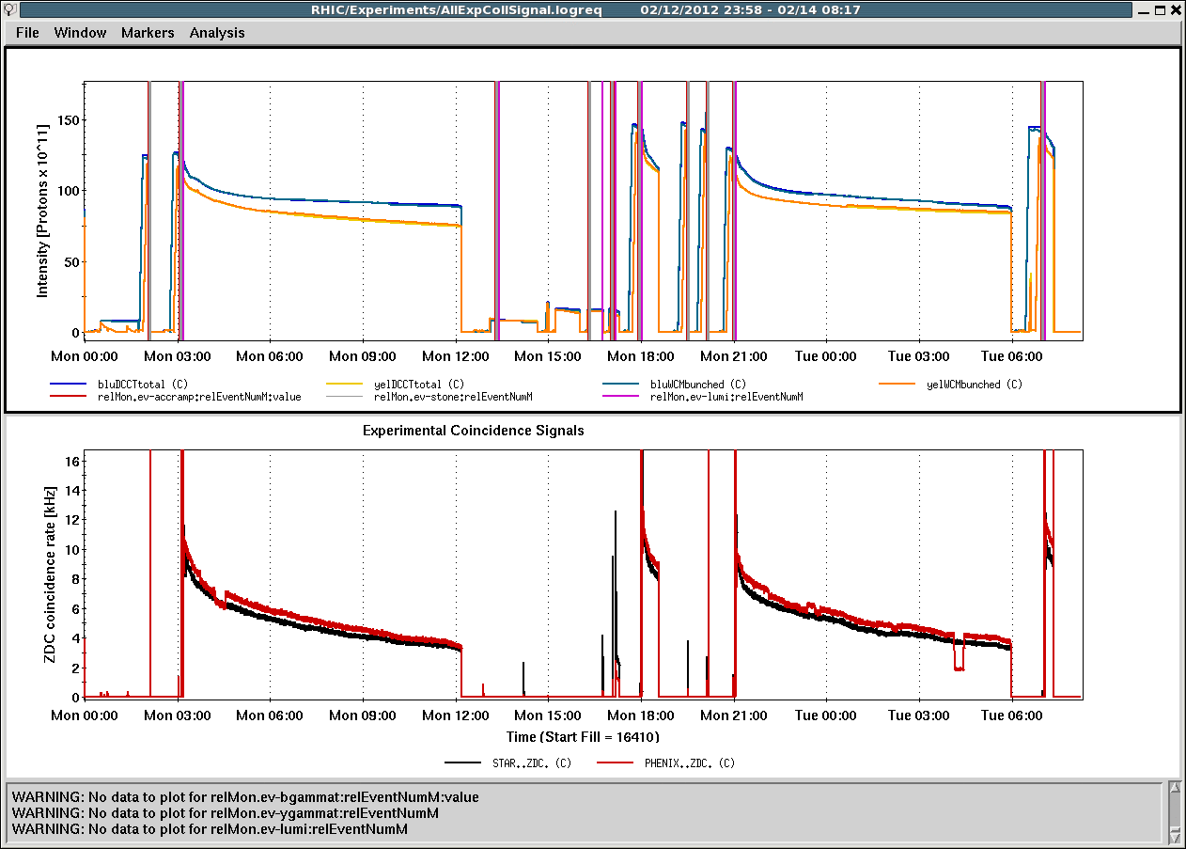
Optics and rebucket
YA1 Trip
BLM Threshold Problem
Ramp and Reb. Loss

