Slide 1
Status of the STAR Experiment RHIC Time Meeting
Pibero Djawotho
Texas A&M
14 February 2012

Slide 2
STAR goals & status for Run 12
Goals:
Reference data for heavy ion physics program
Transverse spin physics measurements at midrapidity and forward rapidity
All midrapidity detectors calibrated (BEMC, EEMC, TOF, etc) and triggers in production
Forward rapidity detectors (FMS) expected to load final calibrations and include triggers in production today
Forward GEM Tracker (FGT) being commissioned for W physics program at 500 GeV

Slide 3
STAR luminosity tracker
Goal: 16 pb^-1
Goal: 300M events

Slide 4
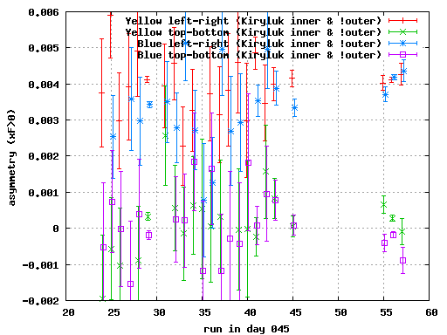
STAR BBC local polarimetry
STAR BBC local polarimetry just coming online
Web link will be sent out to C-AD and Polarimeter groups when ready

