Slide 1
RHIC Status Update
Time Meeting, V. Schoefer
2/28/12
109 x109 bunch stores 1.6-1.7e11 per bunch intensity stores
Attempted a ‘split tune’ working point for coherent mode suppression and store lifetime improvement
Blue (0.695, 0.685)
Yellow (0.735, 0.725)
Yellow polarization lifetime suffered, so we backed out
Still struggling with occasional yellow permit pulls at rebucketing, but otherwise running well

Slide 2
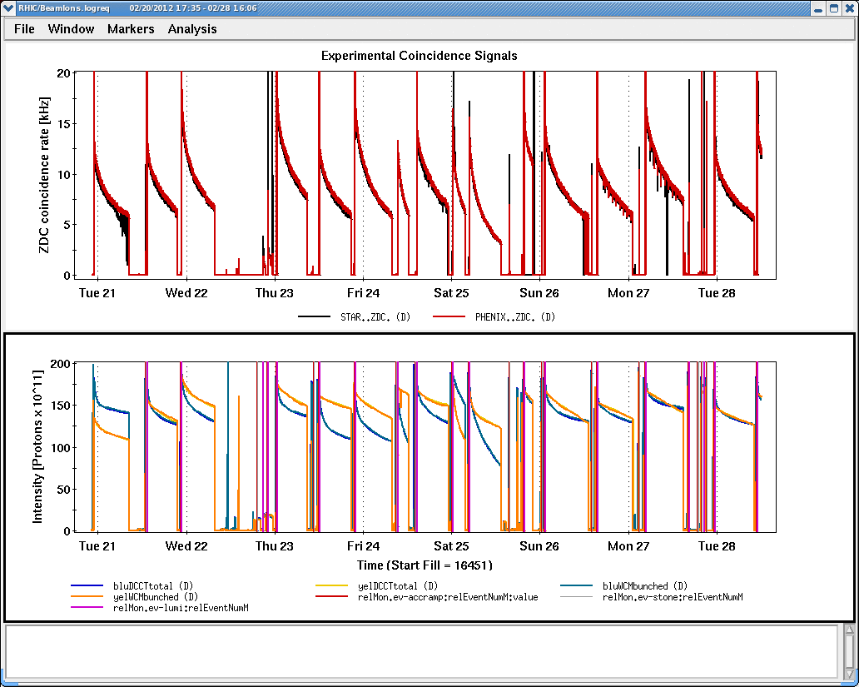
Split tunes

Slide 3
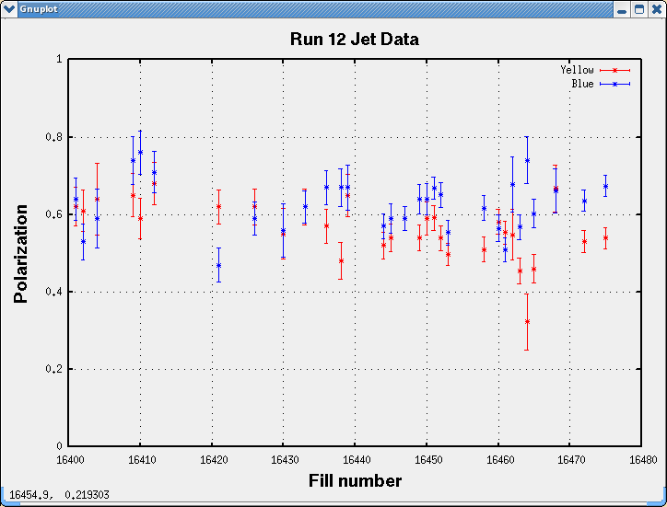

Slide 4
