Slide 1
From the Jet Folks

Slide 2
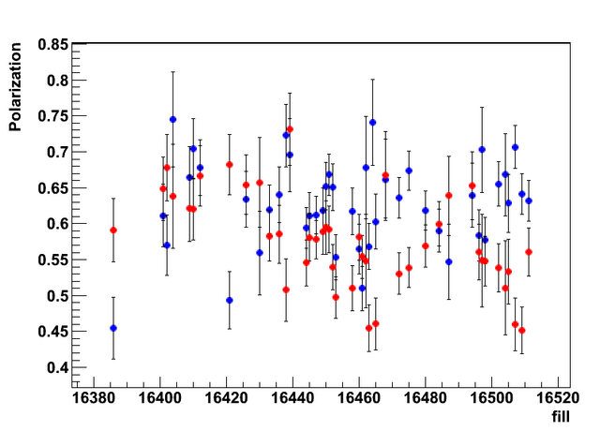
Polarization Vs Fills

Slide 3
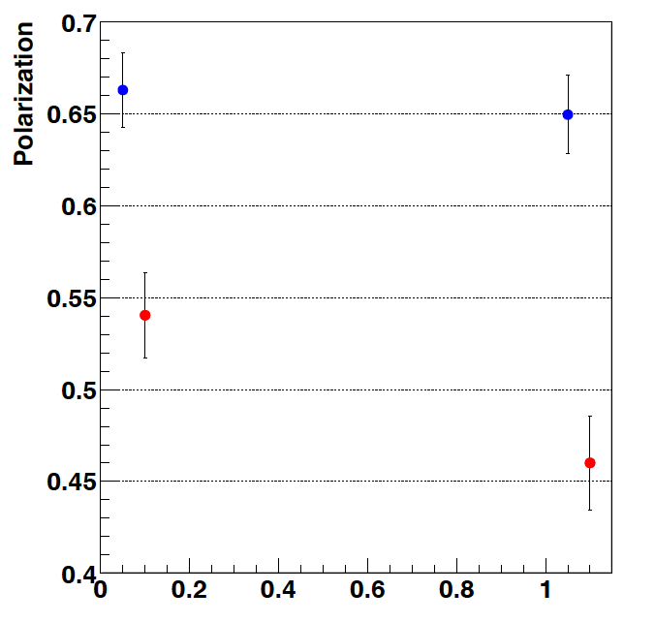
Polarization Decay in Store
Fills 16502-16511
Blue Beam
1st half / 2nd half
Yellow Beam
1st half/ 2nd half

