Slide 1
RHIC Operation Status
Yun Luo, yluo@bnl.gov
( 2012 May 01, Timing Meeting )

Slide 2
Operation Updates
RHIC operation is running smoothly and continuously.
Thanks to hard work from many groups.
Tuesday Declared Physics run in EVE shift
Wed Vernier scan / background reducing
Thursday Panic: huge measured Yellow emittance at injection
Friday QLI due to Blue mains in OWL shift
Both L cooling on from fill 16795 in EVE shift
Saturday Long store in DAY shift (LIPA work at Booster behind)
Sunday QLI due to in DAY shift due to bi5-qd2 unstable
Shorter store in EVE shift due to yi6-th17 tripped off
Monday Long store in DAY shift ( RF work in Booster )

Slide 3
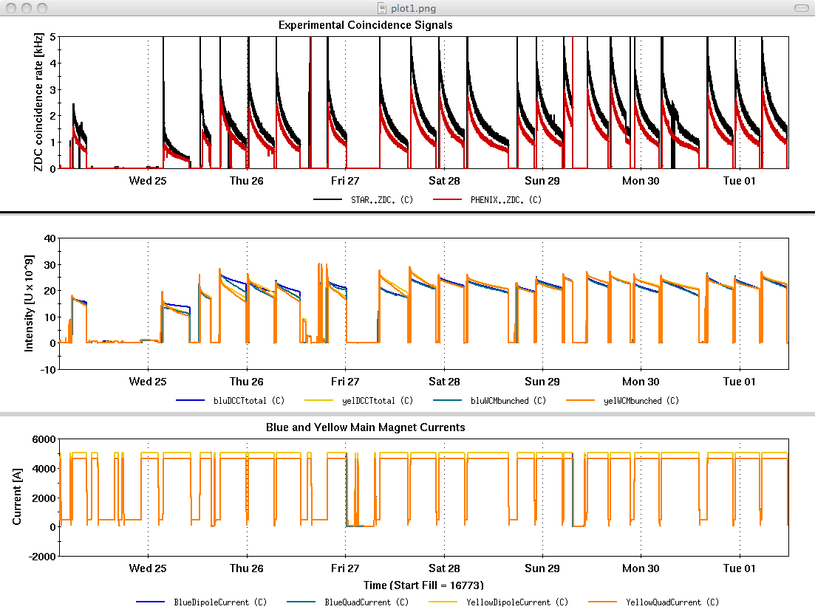
Bunch Intensities & Rates

Slide 4
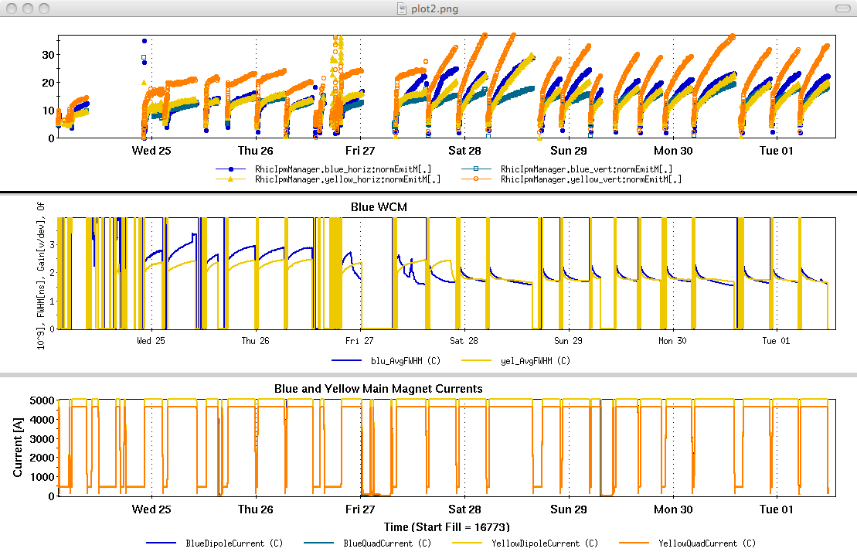
Transverse Emittance & Bunch Length

Slide 5
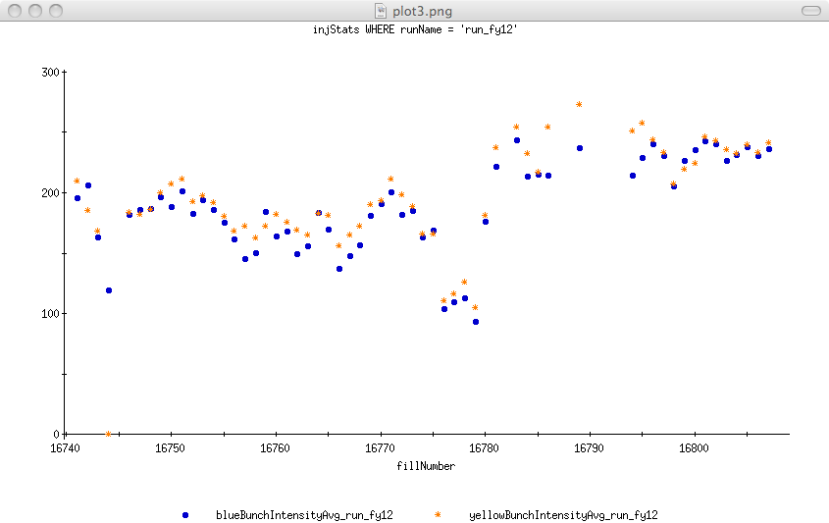
Injection bunch Intensities

Slide 6
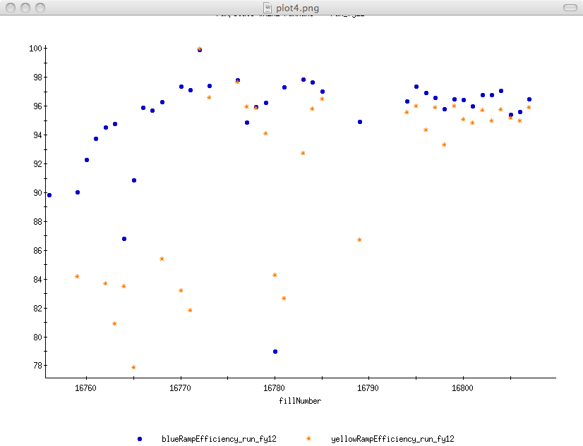
Intensity Ramp efficiency

Slide 7
Plan of this week
Continue Stable Physics run
Transverse Stochastic cooling
Double-merging in Booster
APEX Wednesday May 02

