Slide 1
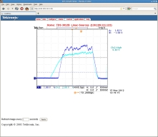
Linac Status 05/15/2012
High Intensity Source
The insulating tube (conduit) from the source-rack to the high intensity source
was breaking down (05/14/2012 , 9 AM)
We have rebuilt the conduit (partial)
The High Intensity source was running for 6 month
Source was rebuild ( full maintenance)
Will be delivering beam to BLIP by tomorrow morning
New Polarized Source
From the Anatoli’s new polarized source we have 4.5 mA (> 10 times)
at Tank 9
Tank 9
Before RFQ 7 mA

Slide 2
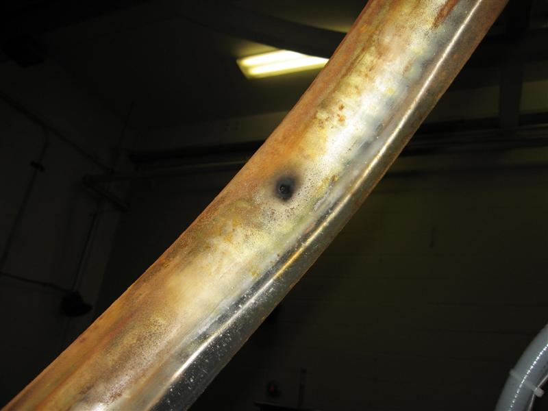
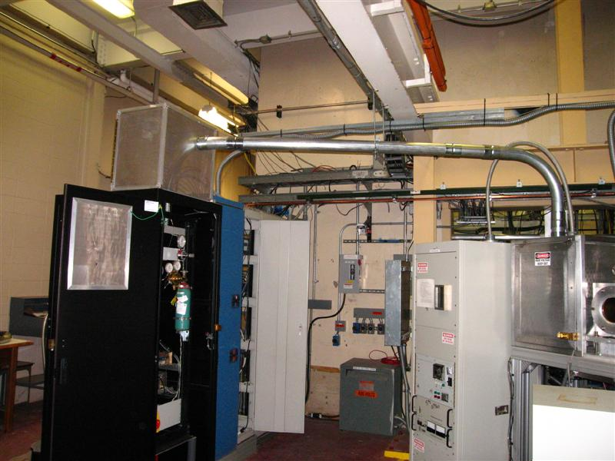
New HV Cage
Insulation break down

Slide 3
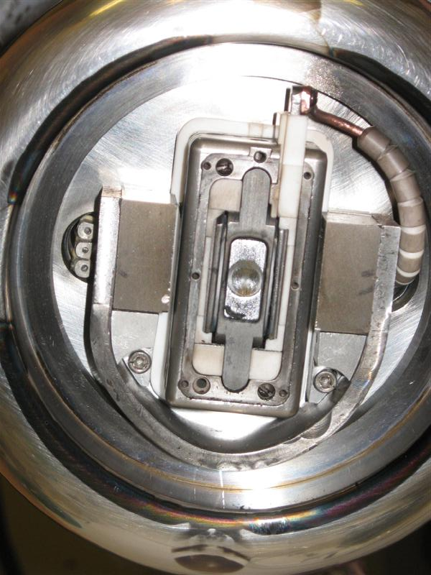
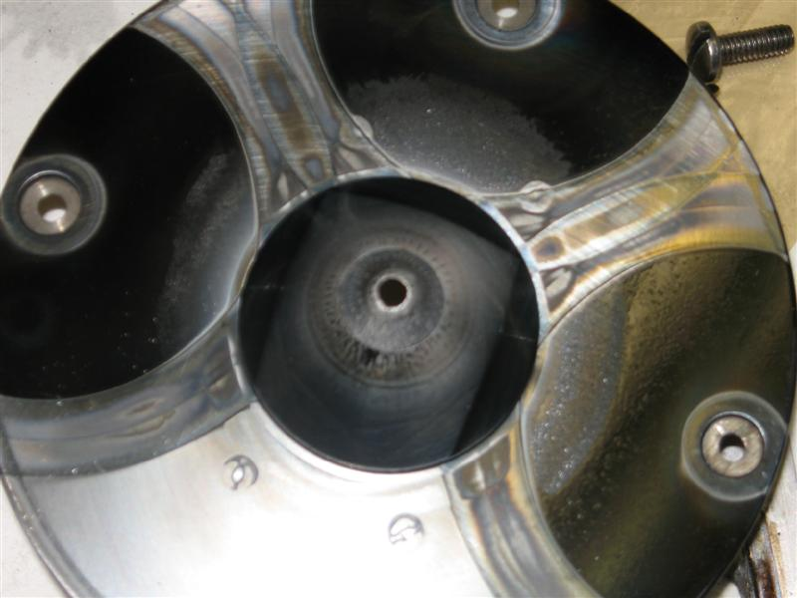
Extractor
High intensity Ion Source

