Slide 1
RHIC Operation Status
Yun Luo, yluo@bnl.gov
( 2012 May 22, Timing Meeting )

Slide 2
Operation Updates
Switching from U-U to Cu-Au run went smoothly and just on schedule to deliver the first detector setup store on Thursday night. Stochastic cooling setup went fast and so far 2-D cooling are on in both rings. Thanks to EBIS, Injectors, Cooling, PS groups.
Major Machine Failures:
Abort kicker per-fire: Friday EVE, severe damage to Phenix detector
Sunday EVE, ~ 2 hours loss
Yellow phase shifter PS: Sunday OWL, ~ 3 hour loss
Tuesday OWL, ~9 hours loss
EBIS e-collector PS : Sunday DAY, ~ 5 hours loss
Blue Q89 trim PS : Friday DAY, ~ 3 hours loss

Slide 3
Switching to Cu-Au Run
 | TUE | WED | THU | FRI
OWL | Last fill of U Replace U source Last store of U | Au from EBIS Setup Booster/AGS/ ATR for Au beam | Fast Ramp Development | First overnight store for detector setup
DAY | Switch to Cu-Au Control setup PS/ RF work May no access | Au RF work Au beam injection Au beam circulating | Re-bucketing Store tuning Beam lifetime | Cooling setup
EVE | Cu beam injection Cu beam circulating Cu RF Capture | Au RF capture Instru. Setup RF loops for ramp feedbacks for ramp | Store tuning Collimation Background Orbit capture | Physics stores begin
About 2 shifts delayed by Au beam.
Au beam was ready on WED EVE, then missing in THU OWL.

Slide 4
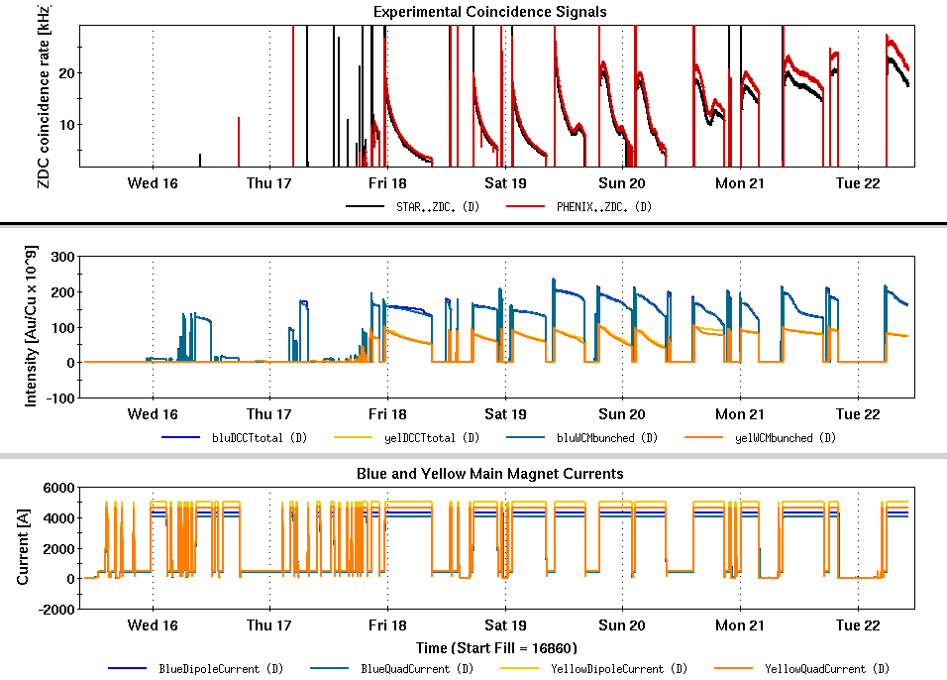
Beam Intensities & Experiment Rates

Slide 5
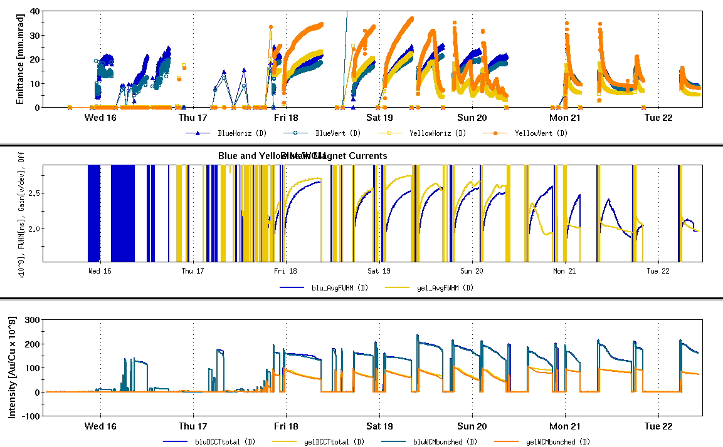
RHIC Injection Bunch Intensities

Slide 6
Plan of the Week
Continue Physics running
We need a stable machine and a steady running
3-D Stochastic cooling
Pushing RHIC bunch intensity
Bunch intensity goal at store: Cu→ 4.0e9, Au→ 1.3e9
Currently averaged at injection: 2.1e9 Cu, 0.987e9 Au

