Slide 1
Take 5 for Safety
Results of Feedback from Lab Stand-down
Picture of the Week
Collider-Accelerator Department
5-22-12

Slide 2
Feedback Summarized by Maggie Sullivan, Human Resources Division
Maggie summarized results in “themes”
There were some positive messages
There was agreement that enhancing leadership will help to drive improvement
Management / leadership was viewed as critical to the solution
Actions that come out of the stand-down cannot be viewed as another initiative or as a way to add more processes

Slide 3
Trust “Here we go again…”
Employees’ trust in management is eroding
Too many initiatives – these are viewed as the flavor of the month
There are barriers to a “questioning attitude”:
Management does not listen and respond to input. Consequently, staff does not believe it is worth their time to report issues or concerns
Management and peers are easily offended when someone questions or raises concerns about their approach to work
There is a fear of repercussion when concerns are reported – new rules will be implemented, fear of my job
When concerns are regularly raised, it creates the perception that the individual is not a “team player”
We are not “One Lab, One Team”
Need to improve communications within and across functional lines
Despite feelings of mistrust, employees want more relevant and targeted communication (to be informed and understand the “why” behind a change) and are seeking higher levels of engagement

Slide 4
Top Down Approach “Communicating to, versus with employees”
Priorities are unclear – there are too many initiatives and they are not perceived as valuable
Management communicates directives with little input from the workers who need to implement them
Safety rules, which are seen as a “push down”without clear reasons for their value, are most often ignored
Top down approach fosters an attitude among workers that they do not need to take individual responsibility for safety
Managers don’t walk the talk, hence they are not viewed as role models for BNL’s values or safety culture
If Management did not think of the idea, it is not viewed as a good idea
Employees and supervisors WANT to be part of the process
There are supervisors who are highly engaged with their workers and involve them in planning and dialogue

Slide 5
Accountability “It’s not my job and not my fault”
There is a resistance to change
BNL has evolved into a culture where workers believe that management will leave before they need to change
The BLAME GAME is prevalent
The problem lies in SBMS, the IFM model…..
It is not my job or responsibility
Unclear ownership and hand-off of systems
Matrix organizations contribute to this concern
C-AD is working with F&O and RCD to improve interfaces
Managers lack the moral courage to have the tough discussions
Safety will not improve until people are held accountable for their actions and inactions.
Employees need to also hold themselves accountable
Managers and supervisors disregard compliance
Some employees want to be held accountable for work planning and therefore are not looking for increased supervisory involvement

Slide 6
Procedures and Processes “We’re buried in our paperwork”
Employees feel overworked and overburdened
There is too much paperwork and therefore too little time is spent on the things that make a difference
There is an over reliance on SBMS and documentation as a way to drive change or improvement
Procedures are overly complex
The Lab’s response to incidents, errors, or concerns is to put more processes in place. This is not viewed as a solution and some feel that it increases the likelihood of repeat problems
There are pockets of the organization where workers are always questioning what can go wrong and will delay work until safety concerns are adequately addressed
C-AD has maintained /evolved about 40 operations assurance processes since mid-1990s

Slide 8
The Safety Program
There is a dilution of safety messages
Too much information is communicated and it is not always targeted to the right audiences
Insufficient statistical analysis of safety metrics and understanding of what drives fluctuations
Corrective actions, punitive actions and other improvement tactics are too scattershot and not aimed at the root cause
Investigations are frequently either too broad (extent of condition) or too narrowly defined
Management should endorse safety, but we do not need more safety police
Safety program is too fragmented and not clearly branded

Slide 9
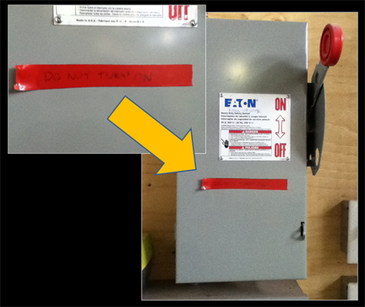
Picture of the Week - Why Didn’t It Work?

