Slide 1
PHENIX Cu+Au Run Status (5/22)
Xiaochun He
We did have an early start of taking physics data from Cu+Au collisions. This is probably one of the first time that we seriously taking physics data before C-AD declared “Physics”. ☺
We have started our luminosity counters and data fast production in the counting house.
There was a pre-fired event in Yellow abort kicker late night on last Friday (5/18), which caused a significant readout damage to the PHENIX Muon Piston Calorimeter. Details will be discussed at the Phil Pile meeting.

Slide 2
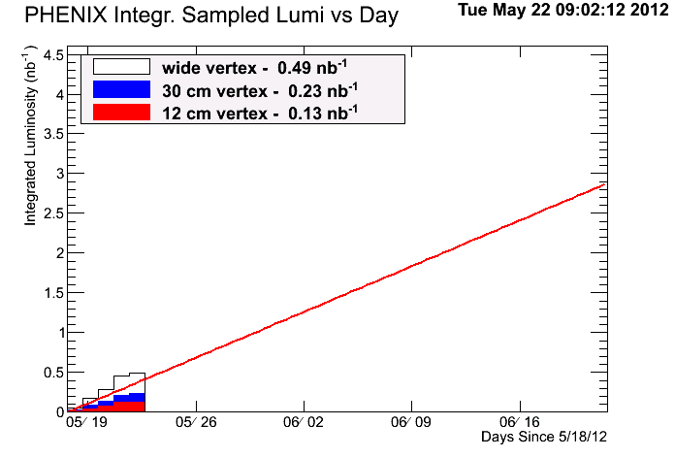
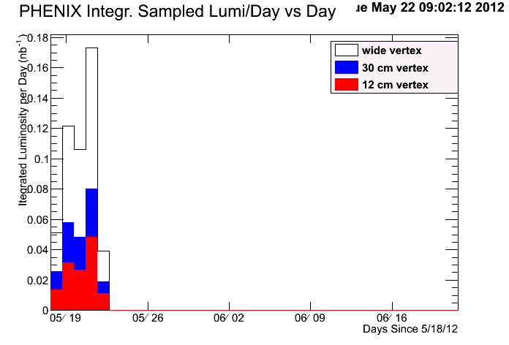
Sampled Integrated Luminosity
Daily Sample
Goal: 2.4 nb⁻¹ for |z|<10 cm
Notes:
We collected 50% more data than we initially wanted.

Slide 3
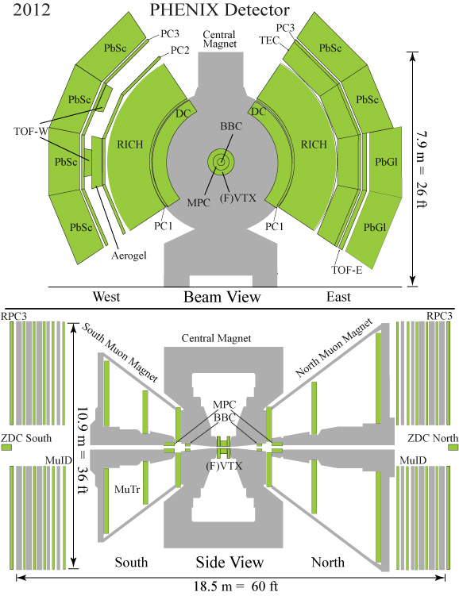
Run-12 Configuration
Au
Cu

Slide 4
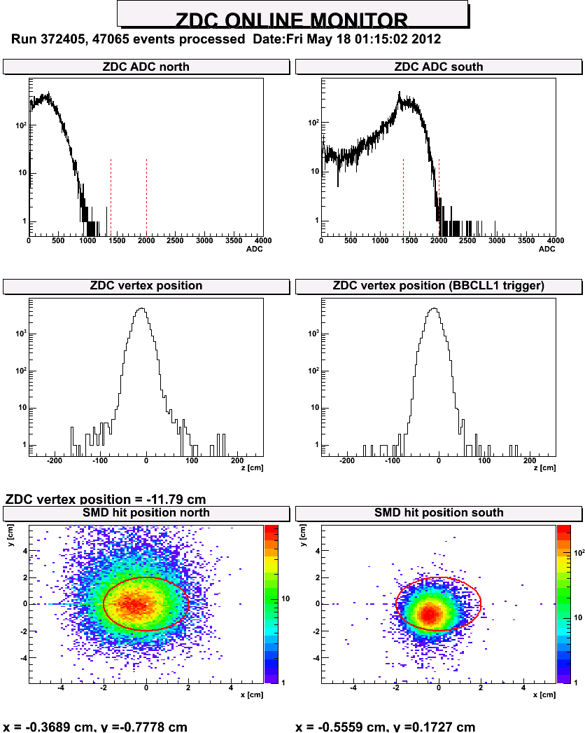
ZDC

Slide 5
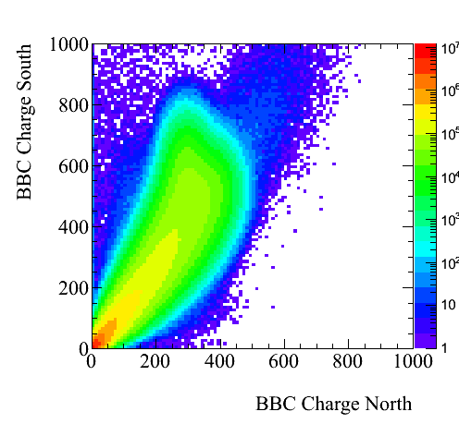
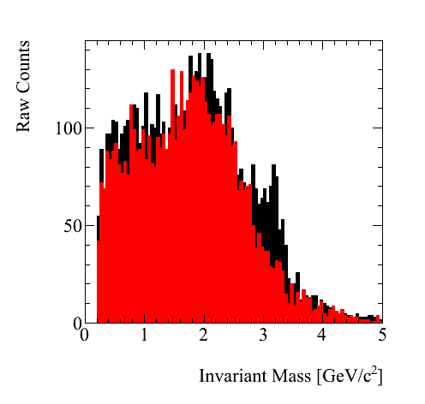
Quick Results from Our Fast Production
J/ψ peak
Au going side
Cu going side

