Slide 1
RHIC Operation Status
Yun Luo, yluo@bnl.gov
( 2012 June 19, Time Meeting )

Slide 2
Operation Updates
RHIC Continues Physics stores. APEX took placed between 08:00AM to mid-night on Wednesday. Continued working bunch intensity increase, improving ramp efficiency, and maximizing integrated luminosity during store.
Currently highest bunch intensities at injection are 4.80e9/ 1.51e9 ( Fill 16993 ). Highest bunch intensities at store are 4.06e9/1.40e9 ( Fill 16993 ). The highest Phenix rate is 63.5 kHz ( Fill 16993 ).
Major Machine Failures:
Thu: Yellow Landau cavity tripped off on ramp several times
Sun: Cyro problem, about 9 hour loss
Mon: BS1 broken, needs 3-4 hour access, repairing delayed
Tue: YI10-TQ4 tripped off again, swapped out

Slide 3
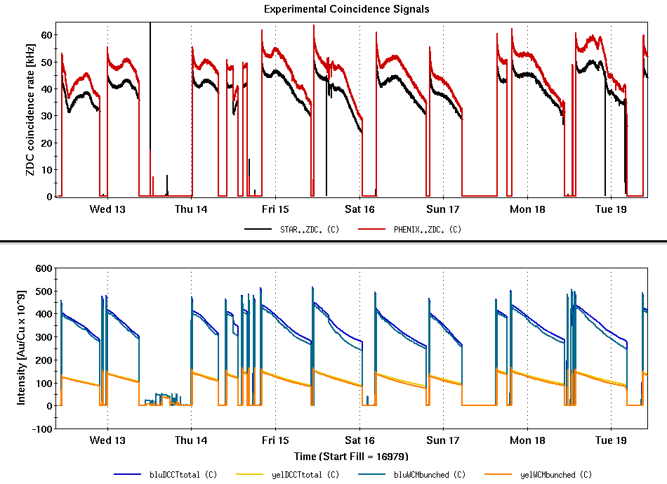
Beam Intensities & Experiment Rates
APEX
Cryo Failure

Slide 4
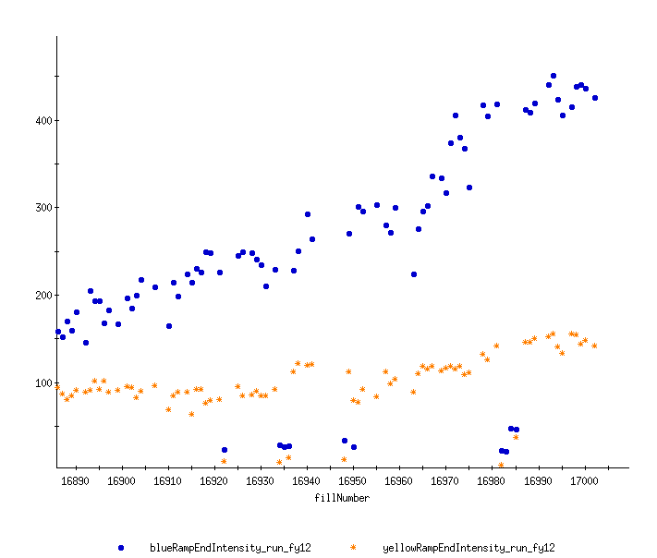
Pushing RHIC Bunch Intensities
Last week is a record breaking week.
Keith Zeno is doing a great job in fine tuning injectors.

Slide 5
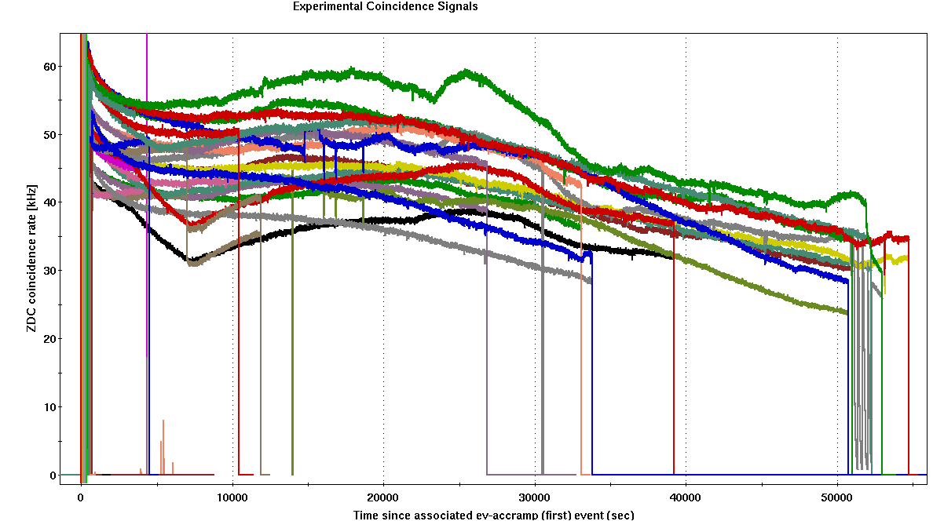
Recent Physics Stores
New record of integrated luminosity per store

Slide 6
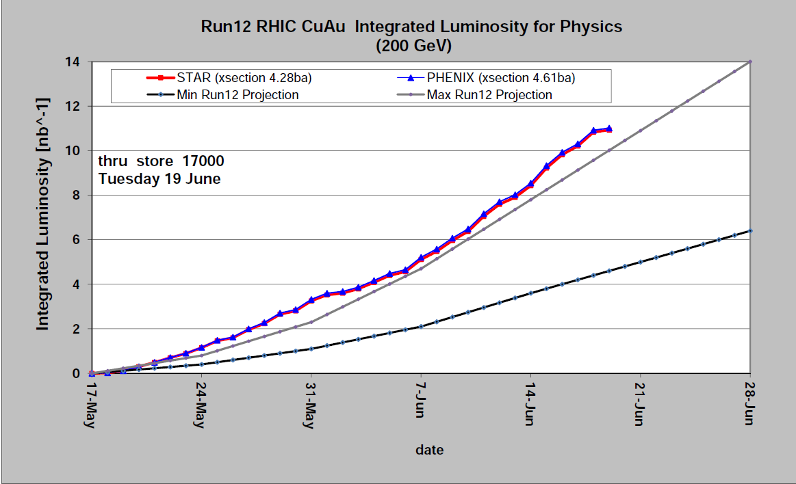
Integrated Luminosity ( C-AD )
Phenix
Star

Slide 7
Plan of the Last Week
Steady BACK-TO-BACK Physics stores
reduce downtime
colliding at IR2 for Star some time, 2 fills needed
Push RHIC bunch intensities at injection
There is still some room to push bunch intensities
Improve RHIC ramp efficiency

