Slide 1
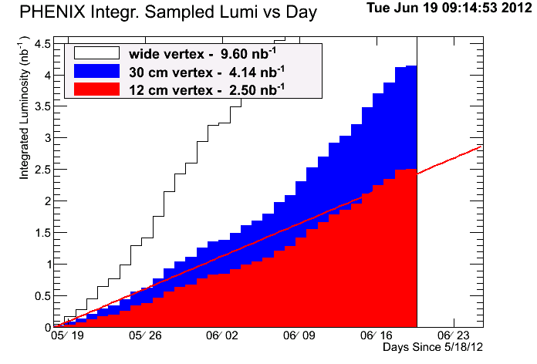
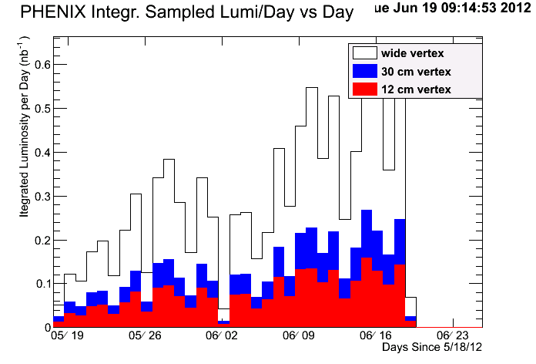
Sampled Integrated Luminosity
PHENIX Cu+Au Run Status (6/12) Xiaochun He
2.88 nb⁻¹
~87%
Collected 28% data during the past week. It is likely that we are able to reach the goal before the weekend comes!!!
Goal: 2.4 nb⁻¹ for |z|<10 cm
Notes:
It is good to see that PHENIX has crossed the line starting from the past Saturday in a good way!!!

Slide 2
Another Super Week of Data Taking!!!
ZDCNS Rates (kHz)
Narrow ZDCNS Rates (kHz)
Day

Slide 3
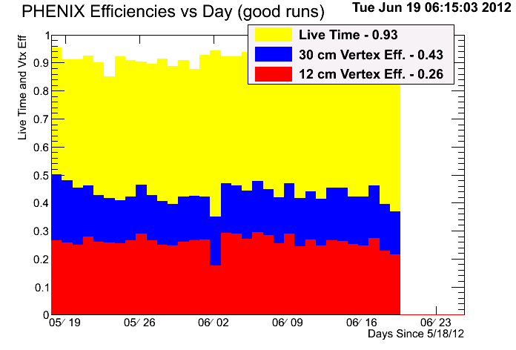
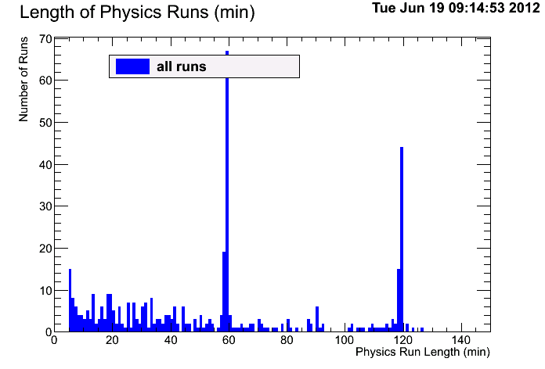
PHENIX Continues on Improving Data Taking Efficiency
PHENIX Efficiency
Day
Number of Runs
Livetime and VTX Efficiency

Slide 4
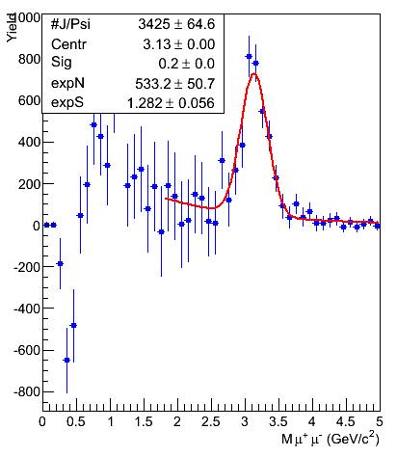
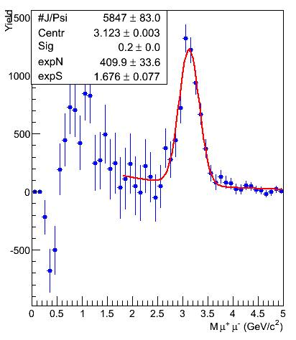
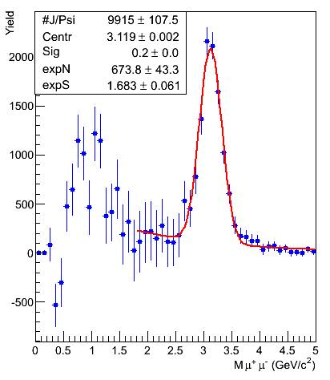
Collision Geometry Dependent Study of J/ψ
0 – 5% Most Central
0 – 10% Most Central
0 – 20% Most Central

Slide 5
Preparing for 5 GeV Test Run
PHENIX will need three hours of IR access in order to move out VTX/FVTX detectors to their retracted position in order to void potential radiation damage to the silicon pixel sensors which are very close to the beam pipe. In the meantime, we will install a few film badges for measuring radiation levels near the beam pipe.
It is most likely that we will turn off muon arms entirely including RPC’s. However, we will keep the PHENIX central arms on and collect data if there is any. Just started setting up the triggers.

Slide 6
Backup

Slide 7
Super Week of Data Taking!!!

