Slide 1
Take 5 for Safety
Safety in Your Surroundings
P. Cirnigliaro
Collider-Accelerator Department
6-19-11

Slide 2
C-AD is an Industrial Complex
Conventional Hazards
Heavy Machinery, Road Hazards, Slips, Trips, Falls, Noise, Electrical, Pressure
Accelerator specific
Electrical, radiation, cryogenics

Slide 3
LONG PANTS
FULLY ENCLOSED
SHOE
Accelerator Facility

Slide 4
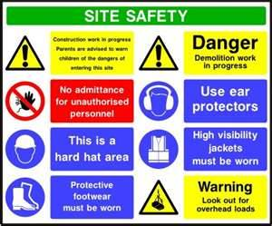
Safety Signs and Training
Responsible for our own safety as well as our co-worker

Slide 5
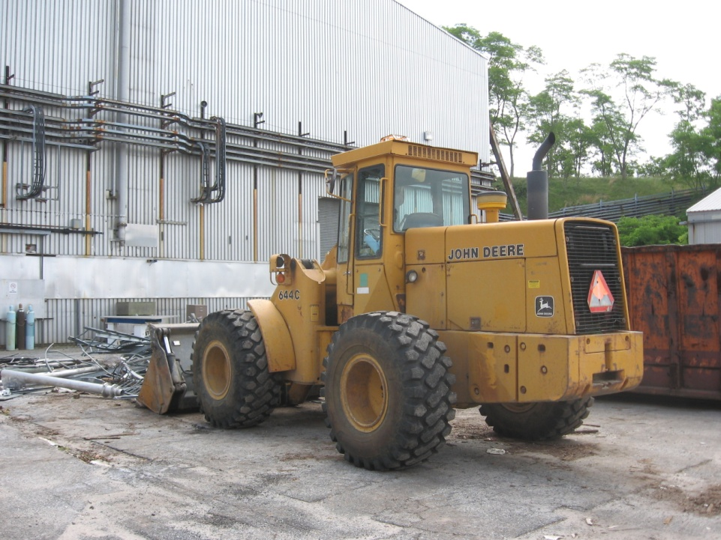
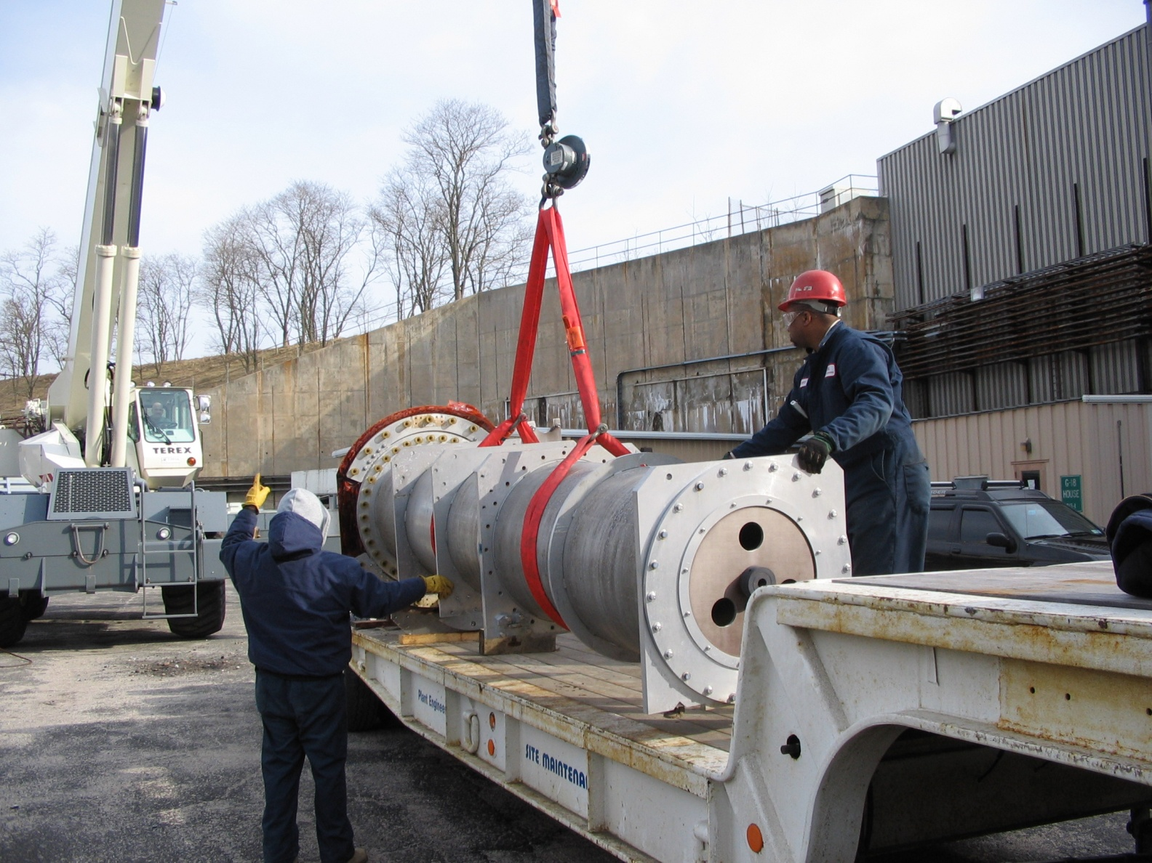
Be Aware of your surroundings

