Slide 1
RHIC Operation Status
Yun Luo, yluo@bnl.gov
( 2012 June 26, Time Meeting )

Slide 2
Operation Updates
In the last week of 2012 Cu-Au run, we suffered 3 days of high temperature and a thunder storm on Friday which caused power line disconnection. We continued improving blue bunch intensity: Highest Blue bunch intensity: 5.3e9 at injection ( Fill 17014 ), 4.4e9 at store ( Fill 17014 ). Highest Yellow bunch intensity: 1.5e9 at injection, 1.4e9 at store ( Fill 16993 ). Highest initial Phenix rate 64kHz ( Fill 17014). Star calorimeter test at IP2 more than 30 hours. All detectors reached their goals by Sunday morning.
Major Machine Failures:
Wed: 1002A A/C problem, ~7 hours loss, followed by several
failed ramps: Blue QLI, Yellow BBQ locking, BA1 tripped
Fri: Power dip caused by thunder storm in the afternoon
Sat: H10 diagnosis and repairing delayed recovering
Sun: 96 faraday cup stuck in Linac beam pipe

Slide 3
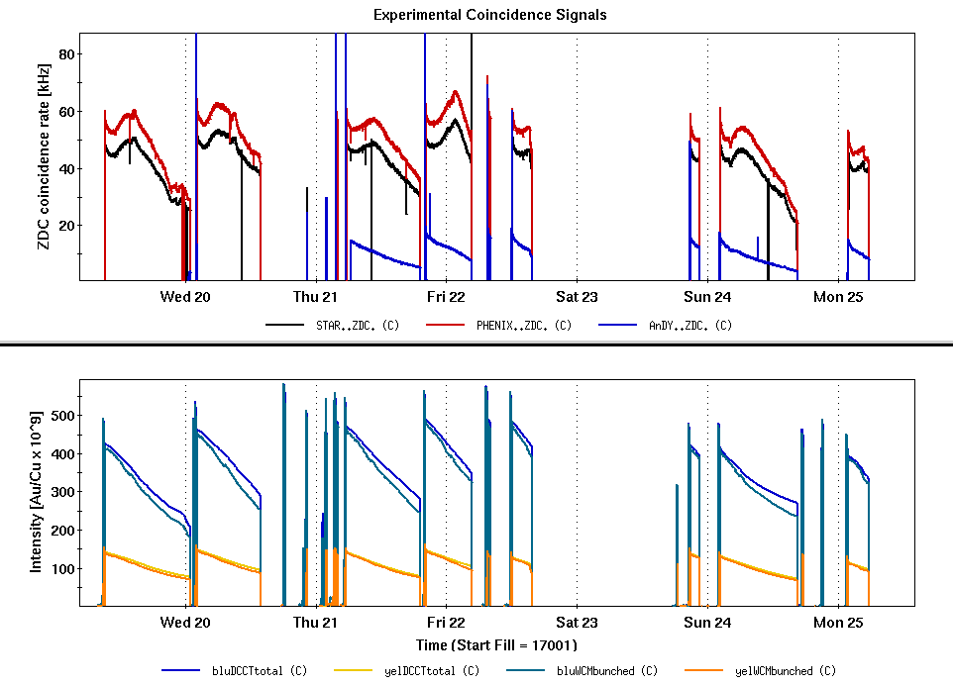
Beam Intensities & Experiment Rates
2 QLI
QLI bo6tq5
Pre-fire
Power-dip
/ Power line splice~8hrs
/H10 failure
96f
cup stuck
A/C
Failure
others

Slide 4
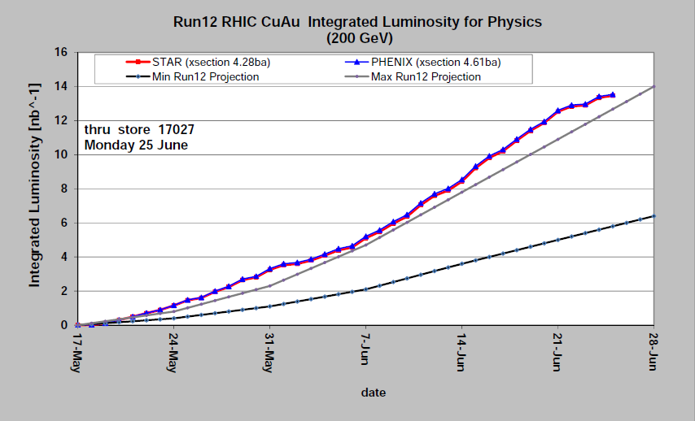
Integrated Luminosity ( C-AD )
Phenix
Star

Slide 5
Thank you to everyone!

