Slide 1
Take 5 for Safety
Configuration Management During Shutdown
Picture of the Week
Collider-Accelerator Department
6-26-12

Slide 2
Configuration Management (CM)
The Accelerator Safety Order requires a CM program for accelerator safety
C-AD focuses on non-standard industrial hazards (radiation, ODH, large volume flammable gases) and maintains their corresponding Credited Controls identified in the ASE
Appropriate configuration management is considered necessary for mission and safety success, as is evidenced by documented cases attributed to CM inadequacies in several formal investigations, occurrences and mission delays at DOE accelerator laboratories
Notes:
Some CM related events: Sealed source contamination event, relay fires in the AGS ACS, malware on ACS computers…c-line diffuser (1990), aerial lifts (BGRR)

Slide 3
Configuration Management During Shutdown
C-AD follows an established procedure for changes to approved safety documents (the ASE and SAD)
See OPM 1.10.1
C-AD maintains a list of Credited Controls to control changes to key safety systems
Examples of Credited Controls are shielding, air handling systems, exhaust stacks, Access Control System…
See C-AD OPMs 2.5. 2.5.1, 2.5.2, and 2.5.3
Boundaries related to specific Credited Controls at C-AD are defined in a checklist at:
http://www.c-ad.bnl.gov/ESSHQ/SND/Credited%20Controls/screen.html

Slide 4
Configuration Management During Shutdown
Ensure changes to accelerators and experiments are reviewed against the assumptions in the safety analyses
Changes are reviewed by C-AD RSC, ESRC and ASSRC since members are aware of assumptions in the safety analyses
Ensure changes to design limits (e.g., beam energy, beam current, etc.) are reviewed prior to making the changes
Ensure only the most recently approved versions of documents are used to maintain or calibrate Credited Controls
Document changes to the physical configuration of Credited Controls by updating the appropriate drawings
Ensure labeling for Credited Controls is maintained where applicable
Perform testing of Credited Controls after preventive or corrective maintenance

Slide 5
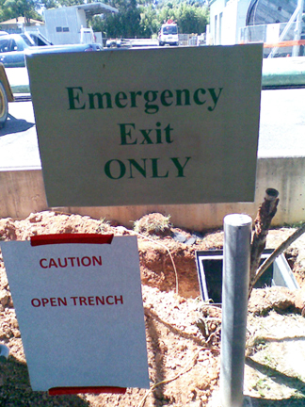
Picture of the Week - Self-Fulfilling Prophecy
Notes:
If you aren’t having an actual emergency when you try to use this exit, there’s a good chance you will have one in short order.

