Slide 1
Last PHENIX Run-12 Status Report (6/26)
Xiaochun He
PHENIX reached the goal of the total sampled luminosity of Cu+Au run in the early morning on Sunday after ~36 hours of beam downtime due a power dip caused by lightening.
PHENIX is ready for the 5 GeV Au+Au engineering run. Both VTX and FVTX have been moved to their retracted position during a ~3.5-hour access yesterday. Six film badges were installed near beam pipe in order to monitoring the radiation level.
Our current shift schedule is extended to the end of June 28. The last two days will be watching shifts.

Slide 2
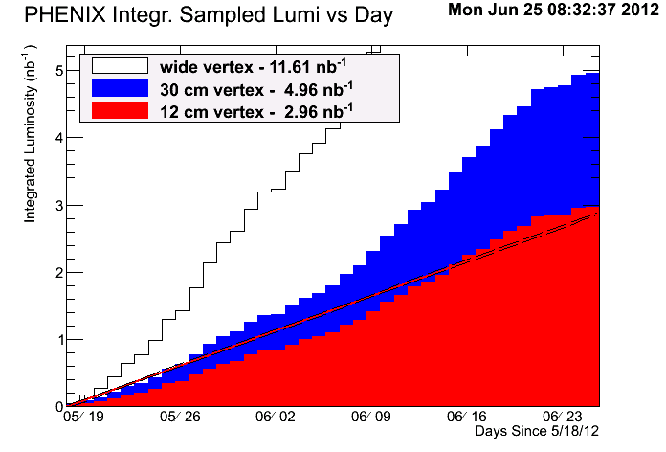
Total Sampled Integrated Luminosity from Cu+Au
2.3% above the goal of 2.4 nb⁻¹ within |z| < 10 cm.
Reached the goal around 6am on Sunday (6/24)
Notes:
It is good to see that PHENIX has crossed the line starting from the past Saturday in a good way!!!

Slide 3
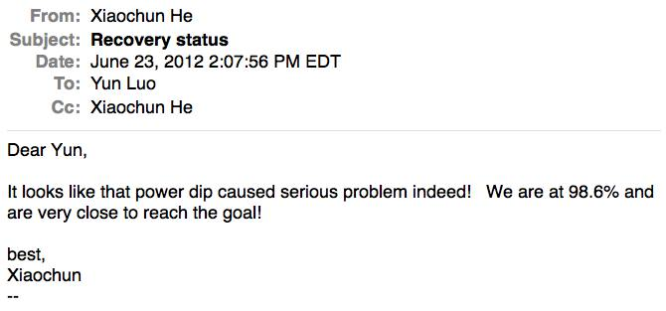
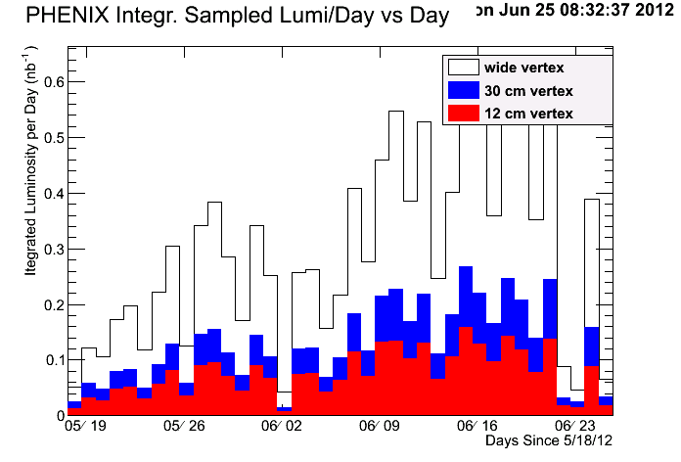
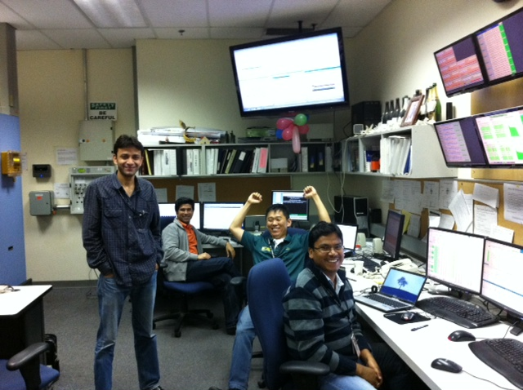
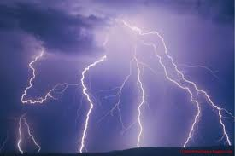
36-hour Beam Downtime Made the Moment Sweeter
Daily Sample
36-hour downtime

Slide 4
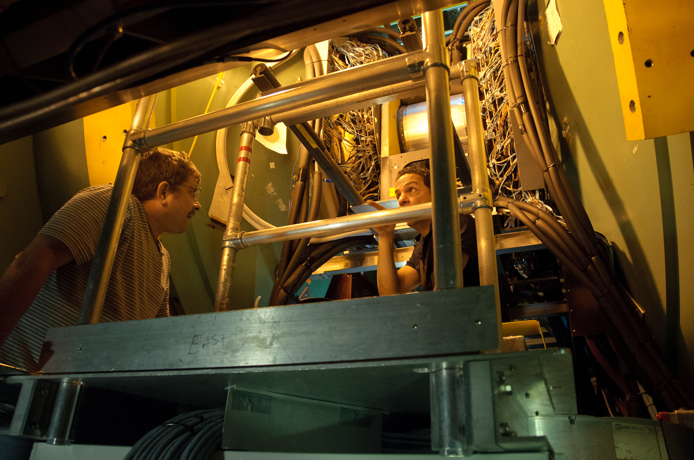
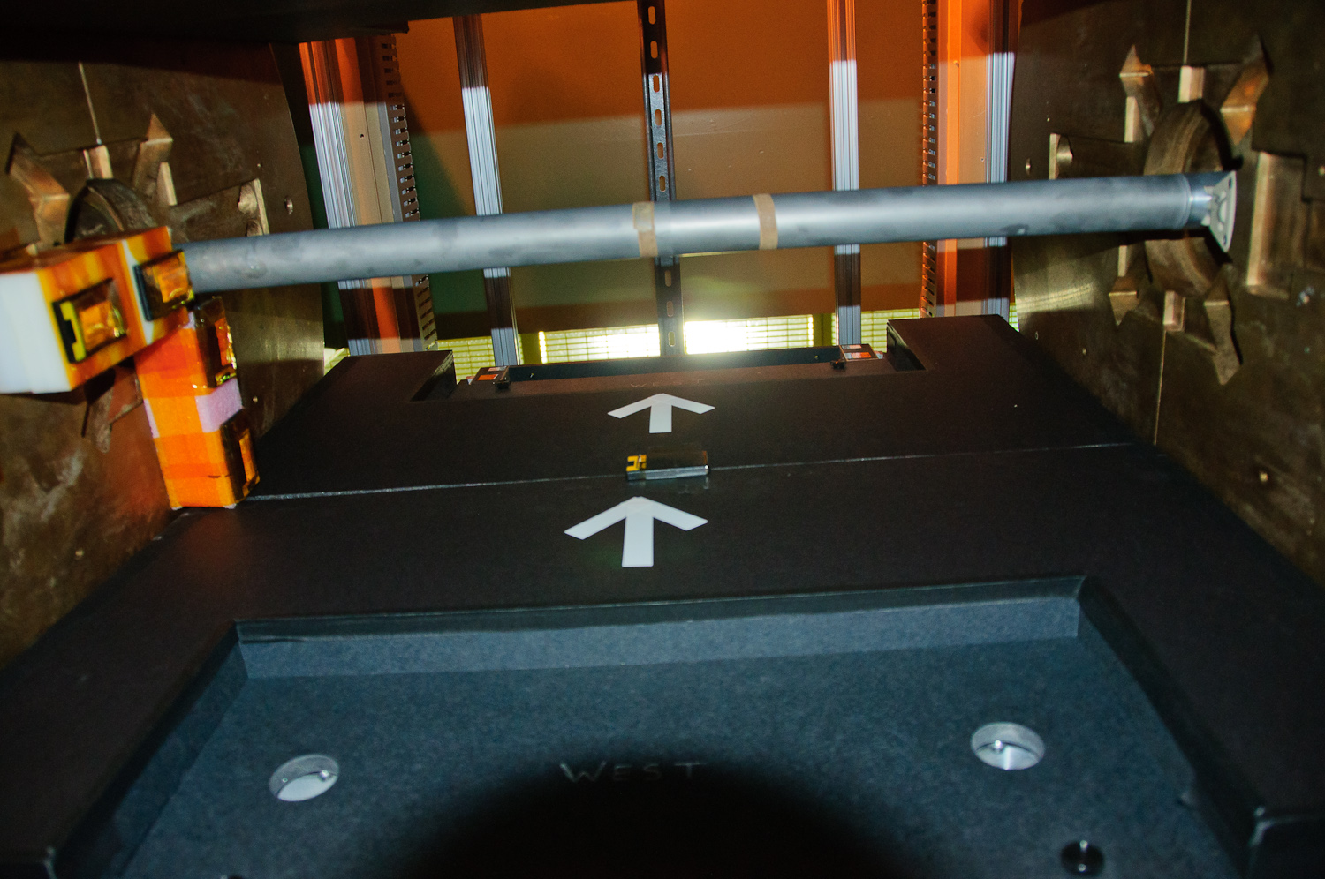
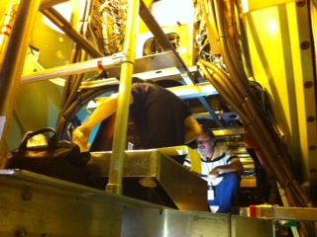
Short IR Access on 6/25
Moved the PHENIX VTX/FVTX detector to their retracted position in order to avoid potential radiation damage to the silicon pixel layer.
Installed six film badges for monitoring the radiation level during the 5 GeV Au+Au test run.
Beam pipe
On the south side of copper nose cone

Slide 5
Final Note
RHIC Run-12 is extremely successful. Our sincere thanks go to everyone involved in CA-D.
PHENIX has had a record-breaking run. It seems that PHENIX can measure anything that RHIC could provide.
I had a good time of sharing the stories from PHENIX weekly basis. In the meantime, I am very glad that it is about to be over. ☺

