Slide 1
AGS/Booster PP Setup Status
Haixin/Vincent
Feb. 5, 2013
Time Meeting

Slide 2
Timeline
Jan. 23: PASS system issue delayed start, but got beam spiraling in the AGS.
Jan. 24: LLRF commissioning. Beam accelerated to flattop.
Jan. 25: AGS cold snake PS test.
Jan. 26: AGS LLRF setup continued. Beam survival from shot to shot.
Jan. 27: Polarimeter setup for flattop energy setup was done.
Jan. 28: AGS LLRF setup continued.
Jan. 29: AGS LLRF setup almost done. Field fluctuation near flattop was fixed. Booster F3 and F6 fixed.
Jan. 30: JQ was tested with beam. AGS access to fix E17 snake compensation quads.
Jan. 31: Tunemeter setup was done. AGS setup with snake on was done.
Feb. 1: Tune jump functions were set. Polarimeter setup for injection was done. Polarization was measured above 50% at flattop.
Feb. 2: JQ on shown polarization gain (65% vs. 59%). Zigzags in 9th harmonics have been tuned out. Seen some vertical emittance growth with JQ on.
Feb. 3: Continue to optimize optics, to get higher polarization with higher intensity (seen polarization near 70% with 0.9*10^11).
Feb. 4: Increase intensity and efficiency.
Feb. 5: Readjusted the JQ pulse shape for better matching. Taking polarization profile measurements with JQ on and off.

Slide 3
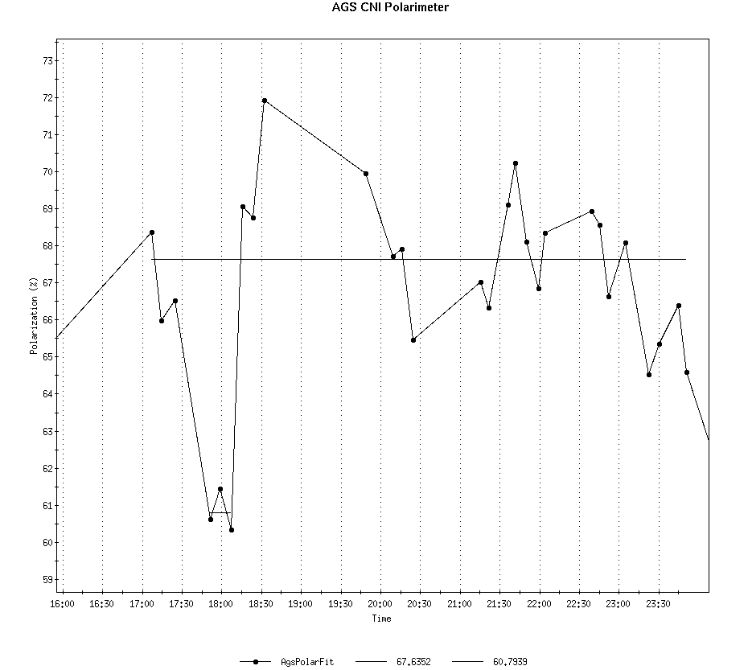
JQ on and off Comparison
67.6% with JQ on
60.8% with JQ off

Slide 4
Plan Over Next A Few Days
Ramp measurement with JQ on.
Timing scan with JQ timing (+-1ms, +-2ms).
Polarization profile measurement with JQ on and off.
Test extraction bump (the DC one, used in last year).
Set up H=2 in the booster while doing Siemens test on coming days.
After switching to Siemens, we will setup the snake on machine right away.

