Slide 1
PHENIX Run-13 status
Hubert van Hecke

Slide 2
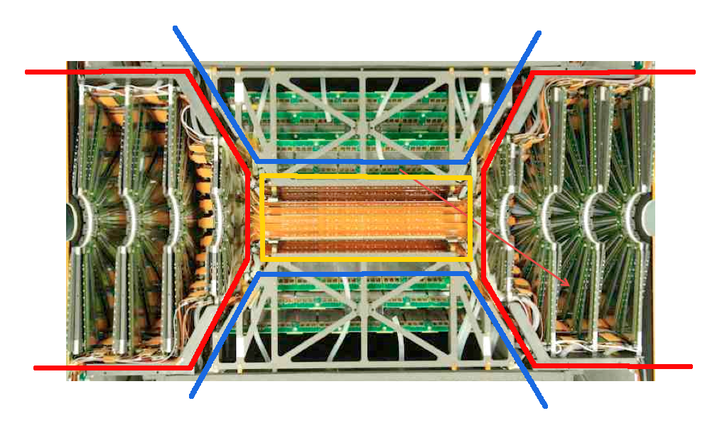
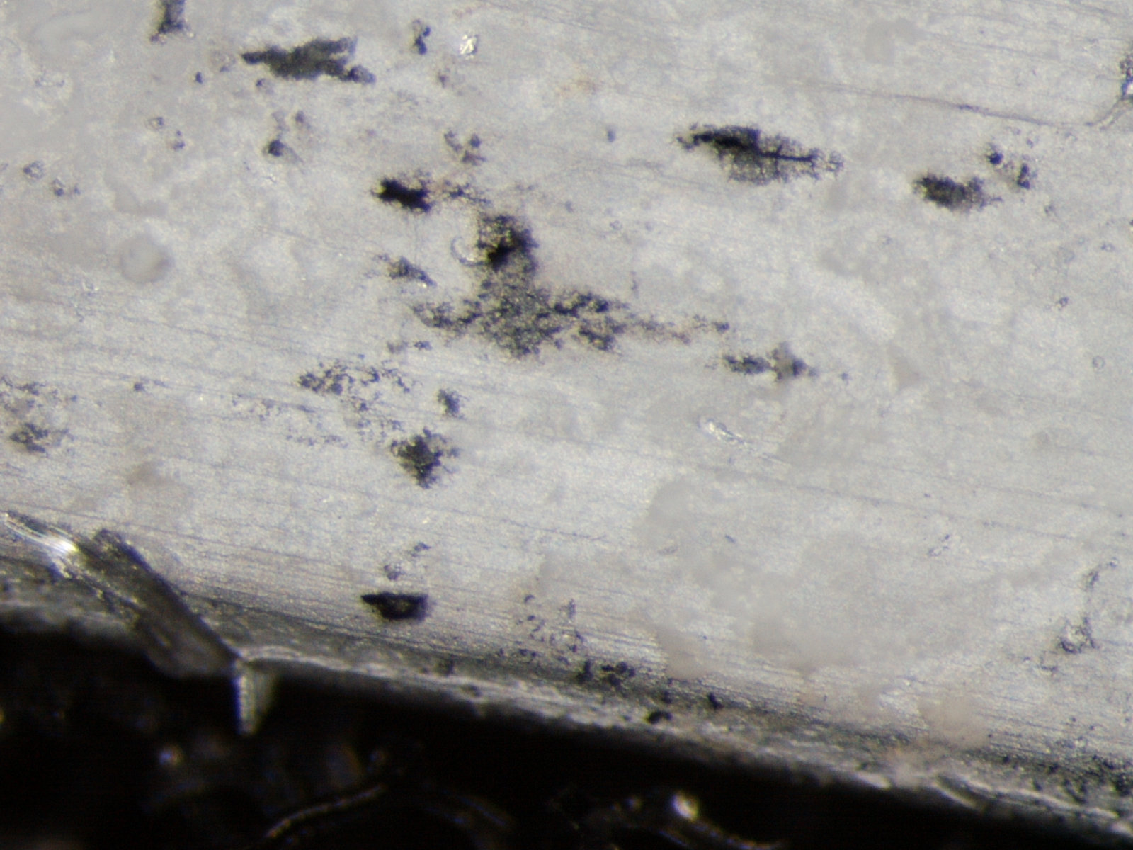
Commissioning continues
Commissioning was going well in December, but
Massive leaks were seen in the outer barrel layer of the VTX (stripixels)
Removed the East half of the detector, disassembled it, reassembled with only the FVTX, and reinstalled in the IR
Investigation identified galvanic corrosion between carbon and Aluminum as the cause
VTX pixels (inner 2 barrels) and FVTX don’t use Aluminum
VTX stripixels
FVTX
VTX pixels
FVTX
VTX stripixels

Slide 3
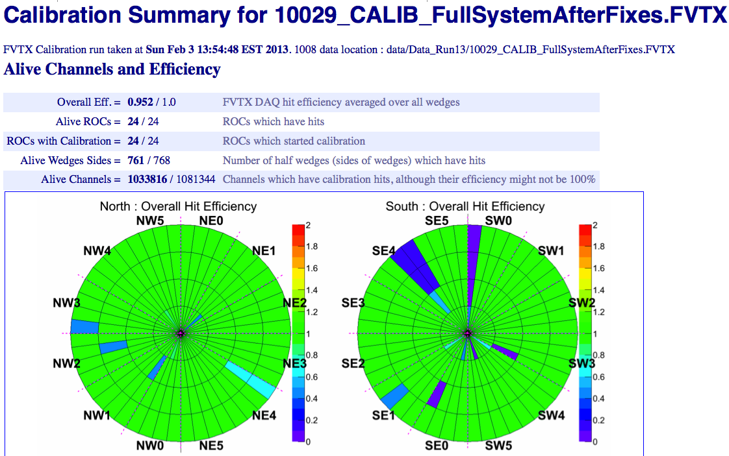
Commissioning continues
FVTX back and operating (>96% live channels)
Flammable gas is on since Feb 1, 2-person watch shifts started Jan 22
First Cosmic data taken last night
Magnets on today
Shielding wall is up, plan to roll in on Friday 8
Full shifts starting Feb 11

Slide 4
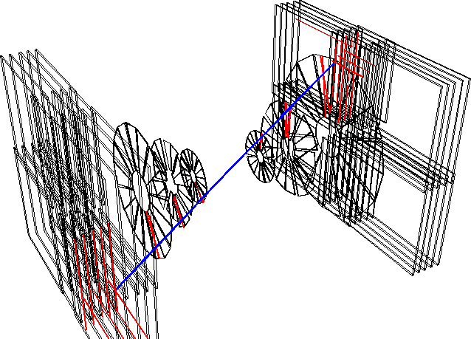
Near-term objectives
Commission all systems
Overnight, run cosmics
Cosmics are needed to study momentum smearing, charge-sign efficiencies, trigger issues, backgrounds etc.
Cosmics will be collected in beam down-time periods throughout the run
Commission with beam as it arrives

