Slide 1
Time Meeting February 19, 2013
Agenda
Safety
Schedule
Machine and system reports

Slide 2
Safety and training
Ray Karol

Slide 3
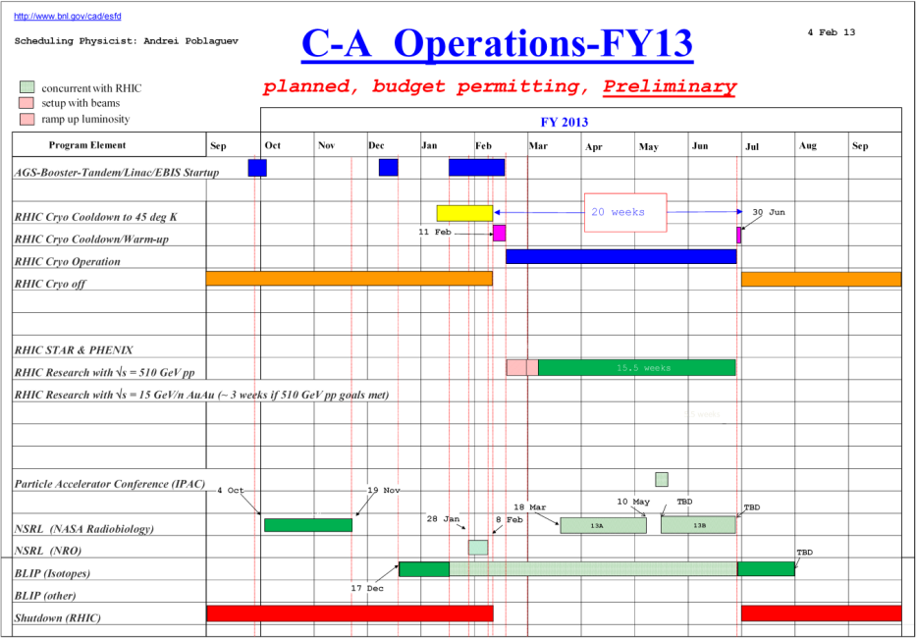
Schedule
NSRL Run ended (02/08/2013)
BLIP Run continues
RHIC Run was started
- RHIC power supply work,
beam setup
- STAR off shifts
- PHENIX cosmic/beam tests
- AGS beam setup
February 8: Turnover to the Siemens MG
February 8: NSRL Run for NRO eneded
February 11: RHIC cooldown to 4K started
February 15: First Beam in RHIC
February 20: Maintenance (behind power supply work)

Slide 4
Machine and system reports
RHIC pp Run13 Vahid Ranjbar
STAR Bill Christie
PHENIX Hubert Van Hecke
BLIP Leonard Mausner
AGS Haixin Huang
Maintenance Paul Sampson

Slide 5
Next Time Meeting
Next Time Meeting: Tuesday, February 26
1:30PM, Snyder

