Slide 1
PHENIX Run-13 status
Hubert van Hecke

Slide 2
Commissioning continues
Flammable gas is on since Feb 1, 2-person watch shifts started Jan 22
Cosmics taken since 4 Feb, ongoing when there is no beam
IR closed up on 8th
Test runs with all (~20) subsystems
Full 5-person shifts as of today

Slide 3
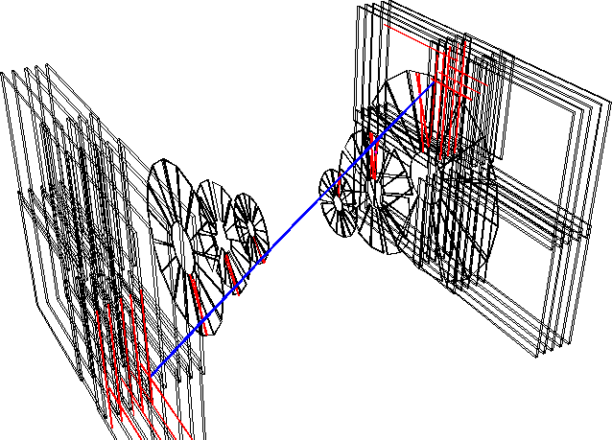
Near-term objectives
When no beam, collect cosmics
When there is beam, some system checks are done, and ‘junk runs’ to maintain system readiness
With collisions: time in subsystems (BBC, ZDC, TOF…)
IR access when available

Slide 4
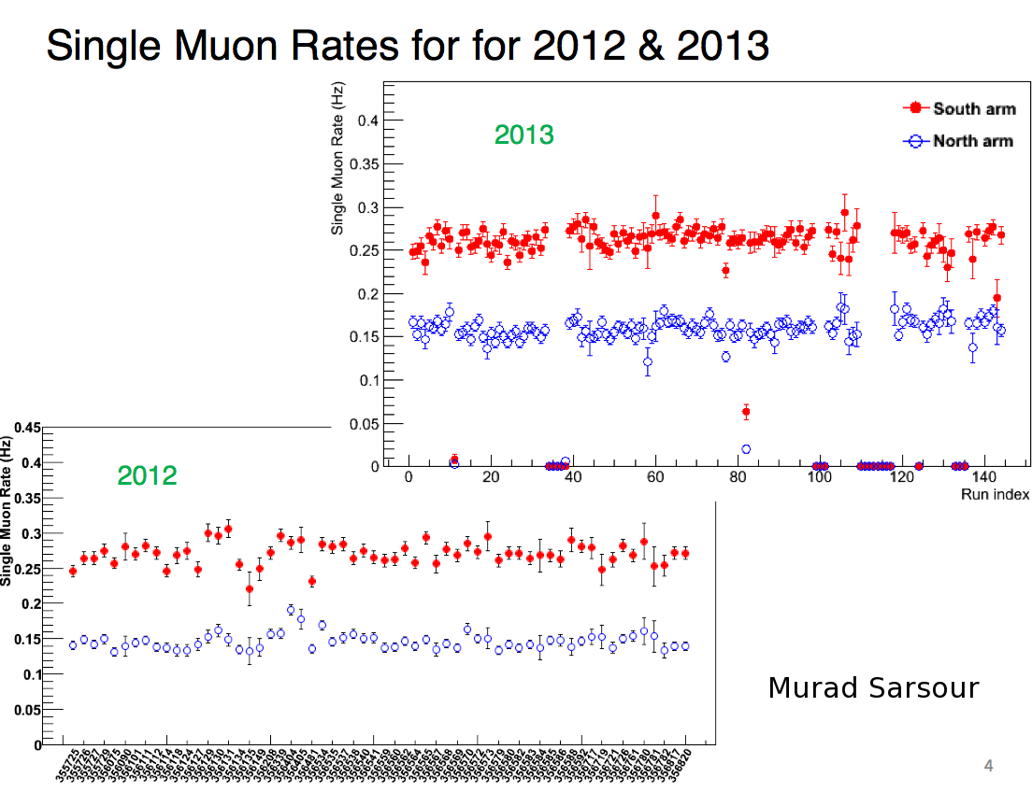

Slide 5
