Slide 1
AGS/Booster PP Setup Status
Haixin Huang
March 5, 2013
Time Meeting

Slide 2
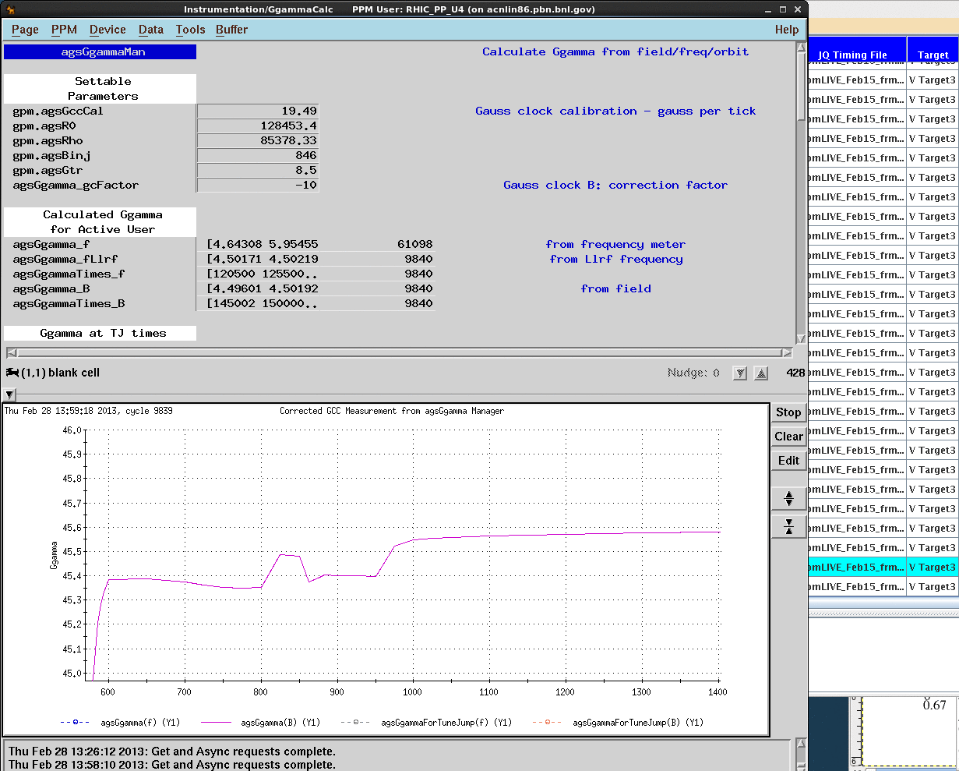
The Radial Swing Removed
after
before

Slide 3
Faster Ramp Near the End

Slide 4
Status
The radial swing during extraction which caused Ggamma value dipped below 45.3 from time to time has been mitigated to less level. Tom and Freddy increased the length of the extraction setup up to reduce the amplitude of the radial swing. Polarization measurements before and after showed polarization increased from 65% to 70% (1.8*10^11).
Keith has set up a faster ramp near the end. Rocco and Yann already developed new jump quads timing for this lattice. Sev has modified the orbit control software to accommodate the shift of 36+Qy. The polarization is around 70%. We will continue to tune this setup and hope for higher polarization.
Intensity at AGS flattop has been pushed to 2.4*10^11 with 4.2*10^11 as Booster input.
Keith has switched Booster stripping foil to the stamp foil. It give slightly better emittance at Booster extraction.

